Slide 1
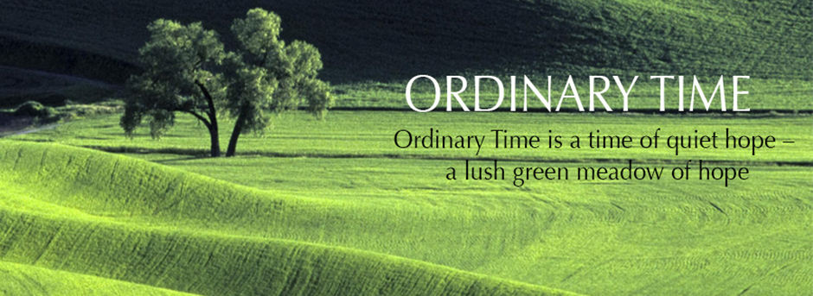
Ordinary Time and the Lord’s Day
R-1
S-01
Notes:
Slide 1 Ordinary Time and Lords Day
Use this slide as a focussing strategy to introduce the resource topic. Read the title together and invite students to share something they know about Ordinary Time and how Catholics celebrate Sunday in their parish community.

Slide 2
Learning Intentions
The students will:
1)
explain the meaning of Ordinary Time
2)
identify the gifts of the Holy Spirit Te Wairua Tapu
R-1
S-02
Click the borders to reveal text
Notes:
Slide 2 Learning Intentions
Read through the Learning Intentions with the class and identify some ideas/questions that might be explored in the resource.

Slide 3
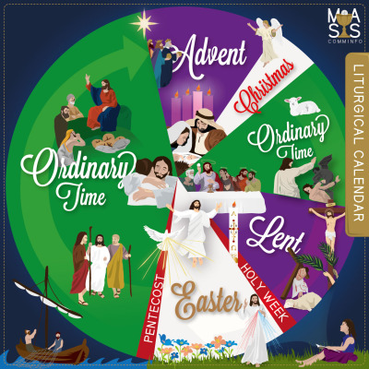
Ordinary Time in the Liturgical Year
Look at the Liturgical Calendar and describe where Ordinary Times occurs.
From the Ordinary Time images on the calendar, explain what the focus of this time is.
What could people do to help themselves to grow closer to Jesus in Ordinary Time?
The history of the Christian Liturgical Calendar goes back a long way. What do you know about it? Watch the clip and make notes of 3 interesting facts you learned. Share your facts with the class and compile a class list to keep for reference in your RE Learning Journal.
R-1
S-03
Click the video button to play ‘The story of the Christian Calendar’
Notes:
Slide 3 Ordinary Time in the Liturgical Year
Follow the directions on the slide and use them to generate discussion on the place of Ordinary Time in the Liturgical Year.
Watch the clip
https://www.youtube.com/watch?v=viDTdesWGfo
The story of the Christian Calendar 3:42 minutes
Take time to share the interesting facts the young people learned, make them into a list and share them.

Slide 4
Basic facts about Ordinary Time
Focus on the facts for five minutes
Remember, record and recall them.
Share your learning with a partner.
R-1
S-04
Notes:
Slide 4 Basic facts about Ordinary Time
Follow the directions on the slide.
Share them with someone at home.

Slide 5
What Ordinary Time is NOT?
Ordinary Time does not mean it is unimportant or time for a break from the Liturgical Year celebrations.
Ordinary Time does not occur within the other seasons in the Church calendar in which specific particular events in Christ’s life are celebrated.
Ordinary Time is not to be wasted but used to get to know more about the life of Jesus through reading about it in the Scriptures and through getting to know him better and becoming a closer friend.
Ordinary Time is not a static time but a time of energy, hope and growth – that is why its Liturgical colour is green.
Ordinary Time is not a time to lose track of the Sundays during the year but to notice the number of each one and celebrate them as the Lord’s day by participating in Eucharist with your parish community.
R-1
S-05
Click the icons to reveal text
Notes:
Slide 5 What Ordinary Time is NOT?
The reveal shape is the Chi Rho (key row). It is a monogram and abbreviation for Christ and is the first 2 Greek letters of his name. It is used on this slide to remind students that Ordinary Time is time for Christ’s followers to draw closer to him. X means Christ so it explains the origin of the word ‘Xmas
Draw your own Chi Rho and write what it is and what it means.

Slide 6
Ordinary Time FAQs - Frequently asked questions
Are the seasons of the Liturgical Year the same for all Christian Churches?
How are the Readings chosen for the Sundays in Ordinary Time?
What is the connection between liturgy and the Liturgical Year?
What particular event does Ordinary Time celebrate?
When did Ordinary Time become officially part of the Liturgical Cycle of the Church?
The Christian community celebrates the events in the Liturgical Calendar through liturgy, which is public worship. Liturgy means ‘work’ and this refers to the prayer, Scripture, music, symbols and rituals that are part of the community celebrations of each feast and season that are repeated each year in the order of the Liturgical Cycle.
On the Sundays in Ordinary Time the gospels highlight one gospel writer over the 34 Sundays. The major events in the gospel are read. Over a 3 year cycle the gospels of Matthew (Year A), Mark (Year B), and Luke (Year C) are read. Each gospel shows different aspects of the life of Jesus. Readings from St John’s gospel are spread through the 3 years.
Ordinary Time doesn’t celebrate any particular events of the Christian story but rather the fullness of all of them. It is a time for Jesus’ followers to celebrate all aspects and events in his life and grow in deeper appreciation of them.
Ordinary Time was officially recognised by the Liturgical reforms of the Vatican 11 Council. It was then that Ordinary Time became recognised as one of the 5 seasons of the Liturgical Year. Can you name the other seasons?
All the Christian Churches celebrate the same Liturgical seasons during the Liturgical Year. There are small variations in the starting dates for some of the seasons. The Catholic Church celebrates more feast days during the year especially in Ordinary Time.
?
?
?
?
?
R-1
S-06
Click the icons to reveal a question and then the question mark to reveal the answer
Notes:
Slide 6 Ordinary Time FAQs - Frequently asked questions
Work through the FAQs and share your answers them check them out.
Ask a partner one the FQAs then check out the answer.

Slide 7
Sunday Eucharist – Celebration of the Lord’s Day
numbered, as Ordinary Time is ordered time.
The 34 Sundays in Ordinary Time are
Sunday the day of Christ’s resurrection
The Resurrection is the event upon
Sunday is the day Christians are called to
When the community gathers to celebrate the Eucharist…
Gathering to celebrate Eucharist strengthens people
is also called the Lord’s Day
which the whole Christian faith rests.
set aside time to worship and give honour to God.
…the Risen Jesus is at the heart of the celebration.
and affirms their identity as followers of Jesus.
A) is also called the Lord’s Day
B) set aside time to worship and give honour to God.
C) the Risen Jesus is at the heart of the celebration.
D) numbered, as Ordinary Time is ordered time.
E) and affirms their identity as followers of Jesus.
F) which the whole Christian faith rests.
Click the words in the box or the empty frames to reveal the solution
R-1
S-07
Click the audio button to stop reflective music
Click the audio button to play reflective music
Notes:
Slide 7 Sunday Eucharist – Celebration of the Lords Day
Adapt Teaching and Learning Experience 3
Share which statement completes each sentence correctly then check them out with the floaters.
ANSWERS 1) D, 2) A, 3) F, 4) B, 5) C, 6) E
Sing using the MP3 ‘Summoned by Love’

Slide 8
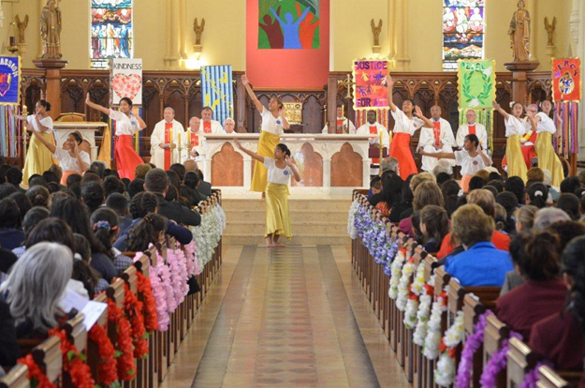
Why Jesus’ Resurrection Te Aranga is such a significant event for all Christians
Because of the importance of the resurrection it is not only celebrated as an annual feast but Christians treat every Sunday as an ‘Easter’ day, which they celebrate in their community celebration of the Eucharist. Because Sunday was the day Jesus rose from the dead it is known as the Lord’s Day – a day to give special thanks and honour to God.
As Christians, we know that God became a human person in Jesus, who died
for our sins, and was resurrected on the third day after his death.
Today he lives, and he sits at the right hand of God the Father in heaven (Hebrews 10:12).
Jesus is “the first fruits of those who have fallen asleep”
(1 Corinthians 15:20). In other words, Jesus led the way in having life after death. The resurrection of Jesus Christ is important as a testimony to the resurrection of human beings, which is a basic belief of the Christian faith.
Jesus’ resurrection guarantees that the bodies of those who believe in him will not remain dead but will be resurrected to eternal life.
It was on the basis of Jesus’ resurrection that Paul preached, “Through Jesus the forgiveness of sins is proclaimed to you. Through him everyone who believes is set free from every sin”
(Acts 13:38–39).
The resurrection of Jesus Christ
was attested to by hundreds of eyewitnesses (1 Corinthians 15:3–8), and this provides irrefutable proof that He is the Saviour of the world.
Jesus’ resurrection proves that physical death is not the end of human existence. God, who is the giver of life (1 Timothy 6:13), has the power to resurrect the human body. Christ’s triumph over death is God’s promise to us that we too shall be raised.
The resurrection is the triumphant and glorious victory for every believer. Jesus Christ died, was buried, and rose on the third day according to the Scriptures and He is coming again when those who died in Christ will be raised up, and those who are alive at His coming will be changed and receive new, glorified bodies.
This will be at the end of time.
Unlike other religions, Christianity has a founder who overcomes death and promises that his followers will do the same. Every other religion was founded by men or prophets whose lives ended in their graves.
Jesus gives his life to those who trust in Him, so that they can share in his triumph over death (1 John 5:11–12). We who believe in Jesus Christ will personally experience resurrection because, having the life Jesus gives, we have overcome death.
Jesus said, “I am the resurrection and the life” (John 11:25), and in that statement claimed to be the source of both. There is no resurrection apart from Christ, no eternal life. Jesus does more than give life; He is life, and that’s why death has no power over Him.
Another reason the resurrection of Jesus Christ is important is that it proves His sinless character and divine nature. The Scriptures said God’s “Holy One” would never see corruption (Psalm 16:10).
The resurrection of Jesus Christ is also important because it validates who Jesus claimed to be, namely, the Son of God and Messiah. According to Jesus, His resurrection was the “sign from heaven” that authenticated His ministry (Matthew 16:1–4).
Jesus’ resurrection is one of the major pieces of evidence that Jesus Christ is the Son of God. Paul affirmed that Christ is “declared to be the Son of God with power . . . by the resurrection from the dead” (Romans 1:4).
R-1
S-08
Click the top card to discard it. Click the worksheet button to go to the worksheet.
Notes:
Slide 8 Why Jesus’ Resurrection Te Aranga is such a significant event for all Christians
Print off the worksheets and cut up the statements that match the flip cards on the slide. Students work in pairs with one statement. They can write what it means in their own words and prepare a question to help them clarify the meaning if necessary. As their statement appears on the screen they share their work with the class. This slide and activity could be repeated as this is a very important truth for the students to understand.

Slide 9
Check up
1)
Make a one minute speech sharing all you know about Ordinary Time. Share it with your class and your family.
2)
Say the names and colours of the 5 seasons in the order of the Liturgical Cycle.
3)
Why is the Lord’s Day the best day to celebrate Eucharist in your community?
4)
What great Feast is remembered and celebrated every Sunday?
5)
Which activity do you think helped you to learn best in this resource?
6)
Questions I would like to ask about the topics in this resource are …
Click in each caption space to reveal text
Click on the worksheet button to go to the worksheet.
R-1
S-09
Notes:
Slide 9 Check Up
This formative assessment strategy will help teachers to identify how well students have achieved the Learning Intentions of the resource .
Teachers can choose how they use the slide in their range of assessment options.
A worksheet of this slide is available for students in Years 5-8 to complete.
The last two items are feed forward for the teacher.
Recording the students’ responses to these items is recommended as it will enable teachers to adjust their learning strategies for future resources and target the areas that need further attention. Changed to "resource" as the learning intentions refer to the resource.

Slide 10
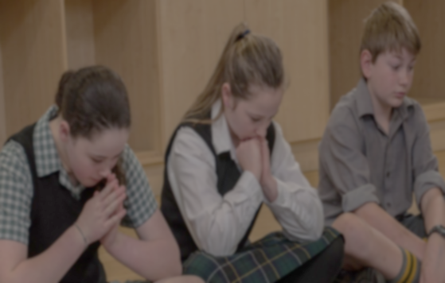
Time for Reflection
R-1
S-10
Click the audio button to stop reflective music
Click the audio button to play reflective music
Notes:
Slide 10 Time for Reflection
The MP3 is played to help create a reflective atmosphere and bring the young people to stillness and silence as the teacher invites them to reflect on how they can participate in the celebration of the Eucharist on Sunday and how this helps them to feel part of the community of disciples of Jesus in their community.

Slide 11
Why Jesus’ Resurrection Te Aranga is such a significant event for all Christians
Jesus’ resurrection is one of the major pieces of evidence that Jesus Christ is the Son of God. Paul affirmed that Christ is “declared to be the Son of God with power . . . by the resurrection from the dead” (Romans 1:4).
Jesus’ resurrection proves that physical death is not the end of human existence. God, who is the giver of life (1 Timothy 6:13), has the power to resurrect the human body. Christ’s triumph over death is God’s promise to us that we too shall be raised.
1
2
Another reason the resurrection of Jesus Christ is important is that it proves His sinless character and divine nature. The Scriptures said God’s “Holy One” would never see corruption (Psalm 16:10).
5
The resurrection of Jesus Christ is also important because it validates who Jesus claimed to be, namely, the Son of God and Messiah. According to Jesus, His resurrection was the “sign from heaven” that authenticated His ministry (Matthew 16:1–4).
The resurrection of Jesus Christ was attested to by hundreds of eyewitnesses (1 Corinthians 15:3–8), and this provides irrefutable proof that He is the Saviour of the world.
3
4
Name: _______________
Date: _________
R-1
S-08A
Worksheet
Click the forward arrow to go to the next worksheet

Slide 12
Why Jesus’ Resurrection Te Aranga is such a significant event for all Christians
It was on the basis of Jesus’ resurrection that Paul preached, “Through Jesus the forgiveness of sins is proclaimed to you. Through him everyone who believes is set free from every sin” (Acts 13:38–39).
Jesus said, “I am the resurrec-tion and the life” (John 11:25),
and in that statement claimed to be the source of both.There is no resurrection apart from Christ, no eternal life. Jesus does more than give life; He is life, and that’s why death has no power over Him.
6
7
Jesus is “the first fruits of
those who have fallen asleep”
(1 Corinthians 15:20). In other words, Jesus led the way in having life after death. The resurrection of Jesus Christ is important as
a testimony to the resurrection
of human beings, which is a basic belief of the Christian faith.
10
Jesus’ resurrection guarantees that the bodies of those who believe in him will not remain dead but will be resurrected to eternal life.
Jesus gives his life to those who trust in Him, so that they can share in his triumph over death (1 John 5:11–12). We who believe in Jesus Christ will personally experience resurrection because, having the life Jesus gives, we have overcome death.
8
9
Name: _______________
Date: _________
R-1
S-08B
Worksheet
Click the forward arrow to go to the next worksheet

Slide 13
Why Jesus’ Resurrection Te Aranga is such a significant event for all Christians
Unlike other religions,
Christianity has a founder who overcomes death and promises that his followers will do the same. Every other religion was founded by men or prophets whose lives ended in their graves.
As Christians, we know that God became a human person in Jesus, who died for our sins, and was resurrected on the third day after his death. Today he lives, and he sits at the right hand of God the Father in heaven. (Hebrews 10:12).
11
12
The resurrection is the triumphant and glorious victory for every believer. Jesus Christ died, was buried, and rose on the third day according to the Scriptures and He is coming again when those who died in Christ will be raised up, and those who
are alive at His coming will be changed
and receive new, glorified bodies. This will be at the end of time.
Because of the importance of the resurrection it is not only celebrated as an annual feast but Christians treat every Sunday as an ‘Easter’ day, which they celebrate in their community celebration of the Eucharist. Because Sunday was the day Jesus rose from the dead it is known as the Lord’s Day – a day to give special thanks and honour to God.
13
14
Name: _______________
Date: _________
R-1
S-08C
Worksheet
Click the up arrow to return to the lesson

Slide 14
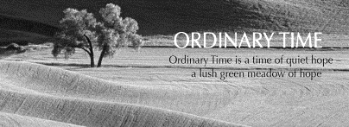
Check up
Name:_________________________
Date:___________
Make a one minute speech sharing all you know about Ordinary Time. Share it with your class and your family.
Say the names and colours of the 5 seasons in the order of the Liturgical Cycle.
Why is the Lord’s Day the best day to celebrate Eucharist in your community?
What great Feast is remembered and celebrated every Sunday?
Which activity do you think helped you to learn best in this resource?
Questions I would like to ask about the topics in this resource are …
R-1
S-09
Worksheet
Click the up arrow to return to the lesson

