Slide 1
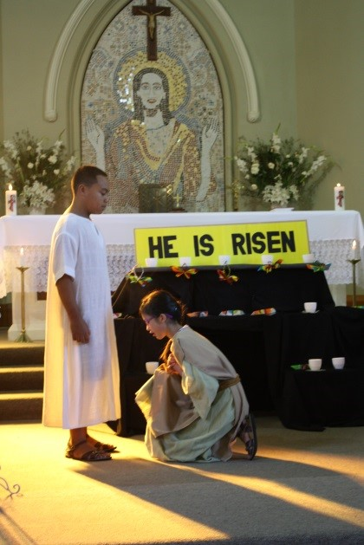
Renewed in the Risen Life of Christ
R-3
S-01
Notes:
Use this slide as a focussing strategy to introduce the resource topic. Read the title together and invite children to share something they know about renewing their commitment to living their baptismal promises in the risen Christ.

Slide 2
Learning Intentions
The children will:
recognise that during Lent people prepare to renew their Baptismal promises at Easter
1)
explain what it means to live in the life of the risen Christ
2)
R-3
S-02
Click the box to reveal the learning intention
Notes:
Read through the Learning Intentions with the class and identify some ideas/questions that might be explored in the resource.

Slide 3
In Lent People Renew their Commitment
to Follow Jesus faithfully
What can people do to renew their promise to follow Jesus faithfully?
People can make time to talk to Jesus about how they are living as his followers.
They can also talk to each other and learn new ways to live as Jesus lived.
Why is Lent a good time to reflect on your promise to follow Jesus faithfully?
What helps people to live as Jesus lived?
Lent is a time to think about your life as a follower of Jesus, a time to turn away from sin and prepare to renew your baptismal promises at Easter.
It is through God’s own life and love, God’s Tapu and Mana that people can follow Jesus and live with his values in their lives.
Click the images to reveal text
R-3
S-03
Notes:
Give children a chance to make their own responses to each question and then reveal the black text by clicking on the cross and discuss each statement. Invite children to make up a hint that children of their age could use to remind themselves to live as Jesus lived.

Slide 4
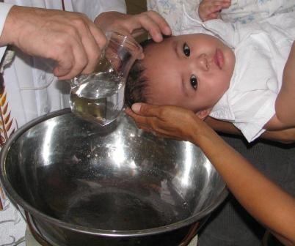
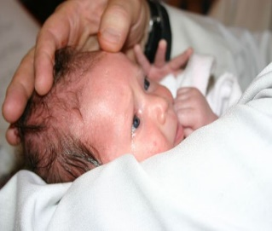
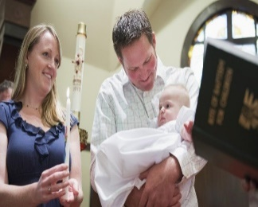
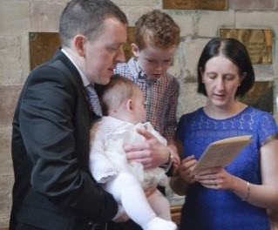
Recalling the Rituals of Baptism
in the Baptismal Ceremony
The pouring of the holy water while the words of baptism are prayed.
The anointing with the oil of chrism to imprint the spiritual seal and consecration to Christ so the person can live out their faith.
Putting on the white garment to signify the new life of the risen Christ.
Professing their faith through the baptismal promises
Receiving the light of Christ
Click the images to reveal text
R-3
S-04
Click the video button to play a video
Notes:
Adapt Teaching and Learning Experience 1 Use the images and reveal the text to help children revise what they know about the baptism rite. Children name each part of the ritual then read and discuss the reveal text. Watch the clip ‘What is Lent all about’ 2:55 minutes
https://www.youtube.com/watch?v=pb9OMeGzyRg

Slide 5
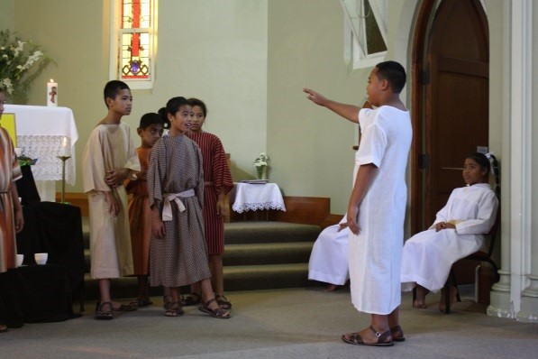
Being Renewed in the Life of the Risen Christ
What do you think this means?
What does each ritual in the baptismal ceremony tell us about sharing in the new life of Jesus after he rose from the dead?
What do you think it means to live in the life of the risen Christ?
Listen to what St Paul says about it in his Letter to the
Colossians 3:12-17.
X
R-3
S-05
Click the I-button to reveal information
Notes:
Adapt Teaching and Learning Experience 3 Work through bullet points on pop up and refer to previous slide to help relate the baptism rituals to sharing in the new life of Jesus after his resurrection.
Use a white T shirt to symbolise the new risen life of Christ.

Slide 6
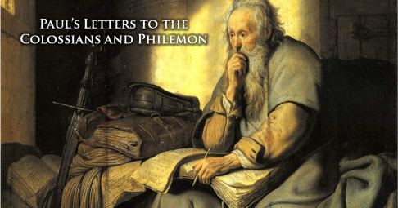
Imagine St Paul writing this to the Christians in Colossae while he was imprisoned
As God’s chosen ones, holy and beloved, clothe yourselves with compassion, kindness, humility, meekness and patience.
Bear with one another and if anyone has a complaint against another, forgive each other;
Just as the Lord has forgiven you, so you also must forgive.
Above all, clothe yourselves with love, which binds everything together in perfect harmony.
Let the peace of Christ rule in your hearts, to which indeed you were called in the one body, and be thankful.
Let the word of Christ dwell in you richly; teach one another in all wisdom;
and with gratitude in your hearts sing psalms, hymns and spiritual songs to God.
And whatever you do, in word an d deed, do everything in the name of the Lord Jesus, giving thanks to God the Father through him.
Click the worksheet button to go to the worksheet
R-3
S-06
Click the picture to advance the pointer
Notes:
Read the excerpts of the text from Paul’s letter on the slide using the pointer. Invite children to explain the connection between Paul’s message in his letter and taking on the new life of the risen Christ.
Make copies of the worksheet and distribute them around the class for children to read in pairs. As they read the letter they highlight the virtues that describe what it means to be clothed in the life of the risen Christ.
Invite children to name some negative behaviour which are opposite to the virtues named in the reading such as – anger, resentment, hatred, abusive language, manipulation, lies, jealousy, put-downs, sarcasm, criticism – children can suggest others. Explain that these are the behaviours that St Paul tells people to get rid of so they can put on the new life of the risen Christ.

Slide 7
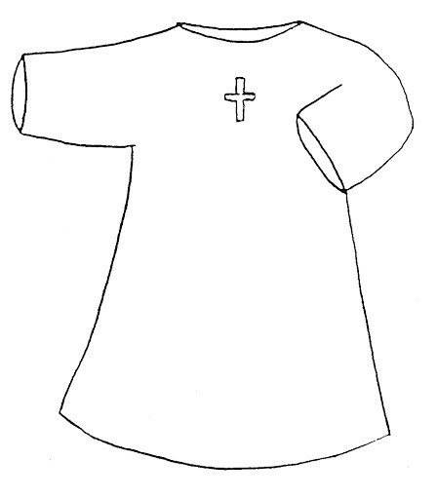
At Baptism People put on a White Garment to show
they are putting on the New Life of Christ
R-3
S-07
Click the worksheet button to go to the worksheet
Notes:
Copy and distribute the white garment worksheet to each child. Refer to the Colossians reading on the worksheet from the previous slide and decorate the white garment that symbolises the new life of Christ with words and phrases that describe what it means to be clothed in the new life of the risen Christ, and to live with the virtues he lived with.

Slide 8
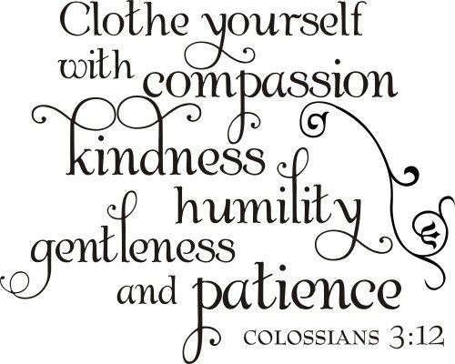
Are these the virtues someone living
the life of the Risen Christ lives by?
Share what these virtues from Paul’s letter look like in people’s attitudes and behaviour.
Create an artwork to illustrate this.
R-3
S-08
Notes:
Respond to the title question and follow the directions.
Make a display with the artworks to share your learning.

Slide 9
Letting the Virtues of Jesus become
your normal way of being by …
Being mindful that when all members of the Church use Lent to renew their commitment to the Christian life the whole Church grows in holiness and strength - God’s Mana and Tapu.
Taking time in Lent to recall your baptismal promises and trying to live them more deeply. This is what spiritual growth and holiness means.
Using Lent as a good time to check up on how well you are doing as a follower of Jesus and making his values part of your life.
Treating people as Jesus did and being aware of how you speak and behave towards others every day so it becomes a habit and your normal way of being.
Following Jesus means living as he did, demonstrating his attitudes and virtues just as naturally as if we are breathing.
Click the audio button to stop ‘We Believe’
R-3
S-09
Click the audio button to play ‘We Believe’
Click restart shape to restart Slide
Click top card to discard it
Notes:
Use the flip cards to expand children’s thinking about developing the virtues Jesus lived by and demonstrated so they become their normal way of living in the world.
Explain that the attitudes and values that we live by come from our belief in Jesus and how he lived and treated people. Our beliefs are summarised in our baptismal promises which was when we first put on the life of the risen Christ and we have to remind ourselves that the white garment we wore when we were baptised is a sign of the way we want to live all through our lives. Lent is the time we think about this deeply.
Sing using the MP3 ‘We Believe’

Slide 10
Check up
1)
Why is Lent a good time to prepare to renew your Baptismal Promises?
What does each ritual in the baptismal ceremony tell us about sharing in the new life of Jesus after he rose from the dead?
2)
3)
Name the 5 virtues St Paul promotes in his letter to the Colossians that describe what living with the Risen Christ means.
4)
Why is spiritual growth and renewal important for the followers of Jesus?
5)
Which activity do you think helped you to learn best in this resource?
6)
Questions I would like to ask about the topics in this resource are …
R-3
S-10
Click the worksheet button to go to the worksheet
Notes:
This formative assessment strategy will help teachers to identify how well children have achieved the Learning Intentions of the resource.
Teachers can choose how they use the slide to assess each item.
A worksheet of this slide is available as an option for children to complete.
The last two items are feed forward for the teacher.
Recording the children’s responses to these items is recommended as it will enable teachers to adjust their learning strategies for future resources and target the areas that need further attention.

Slide 11
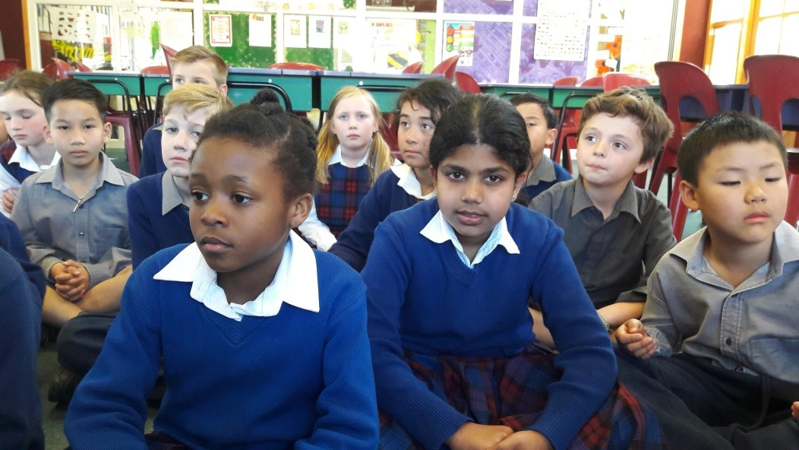
Time for Reflection
R-3
S-11
Click the audio button to stop reflective music
Click the audio button to play reflective music
Notes:
The MP3 is played to help create a reflective atmosphere and bring the children to stillness and silence as the teacher invites them to reflect on what it means to take on the life of Jesus after he rose. Use this time to wonder how well they are living with the virtues Jesus lived with as St Paul wrote about in his letter to the Colossians. Try to keep these in their mind so they can live by them every day as their normal way of being.

Slide 12
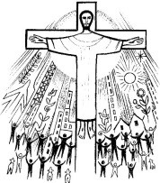
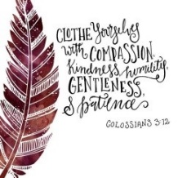
Sharing our Learning about LENT with family whānau, other classes and parish
Compose a rap about getting rid of negative words and behaviours, forgive each other, clothe yourself in love aroha, live with peace in your heart and sing psalms, hymns and spiritual songs – all this will help your spirit to grow in the risen life of Christ.
Use mime to show the 5 virtues that St Paul wrote about in his letter to the Colossians that help people to be clothed in the life of the risen Christ.
Have a conversation with someone about what Jesus said in Luke 9:23 and what it means for children of your age to carry your cross and support others to carry their cross.
Create a presentation to share in other classes about the meaning of the word Lent and how it is a season of renewal and what people can do to help them grow spiritually and renew their faith in Jesus. Include an explanation of the symbols of Lent in the Northern and Southern Hemispheres.
Make up your own way of showing and sharing what you have learned and decide whom you would like to share it with.
Make a poster of the Baptismal Vows people make and explain what they mean. Ask children to find out who made the vows for them when they were baptised and how they keep faithful to their vows today.
Create art works to share illustrating the virtues people need to deal with the hard things they have in their lives. Include prayers and stories.
Using the information on Slides 7 & 8 in Lesson 1, share with children about your age how the Holy Spirit works in people.
Click Lent images to move through ways of Sharing our Learning
R-3
S-12
Notes:
This slide provides some choices for children to show and share what they have learned. Examples could be photographed as evidence of children’s learning.
You may like to put a copy of the Sharing our Learning page in children’s RE Learning Journals. You could talk through the choices using the slide and let children make their choice from their own copy.
Children could work on their choice at school and/or at home and you may like to set a day for sharing. Please let parents and whānau know what you expect them to do with this.
The resource is focussed on the YR 6 LENT Achievement Objective which is covered in Resources 1-3.
YR 6 LENT AO Children will be able to:
recognise LENT as a time of spiritual growth and renewal in the risen life of Christ both for individuals and the Church community.

Slide 13
Imagine St Paul writing this to the Christians in Colossae while he was imprisoned
Name:____________________________
Date:____________
As God’s chosen ones, holy and beloved, clothe yourselves with compassion, kindness, humility, meekness and patience.
Bear with one another and if anyone has a complaint against another, forgive each other;
Just as the Lord has forgiven you, so you also must forgive.
Above all, clothe yourselves with love, which binds everything together in perfect harmony.
Let the peace of Christ rule in your hearts, to which indeed you were called in the one body, and be thankful.
Let the word of Christ dwell in you richly; teach one another in all wisdom;
and with gratitude in your hearts sing psalms, hymns and spiritual songs to God.
And whatever you do, in word an d deed, do everything in the name of the Lord Jesus, giving thanks to God the Father through him.
Worksheet
R-3
S-06
Click the up arrow to return to the presentation

Slide 14
At Baptism People put on a White Garment to show
they are putting on the New Life of Christ
Name:____________________________
Date:____________
R-3
S-07
Worksheet
Click the up arrow to return to the presentation
Notes:
Copy and distribute a worksheet to each child.
Refer to the Colossians reading and describe what it means to be clothed in the new life of the risen Christ, to live with the virtues he lived with and how they were to worship God. Children record ideas on the white garment on the worksheet.

Slide 15
Check up
Name:____________________________
Date:____________
1) Why is Lent a good time to prepare to renew your Baptismal Promises?
2) What does each ritual in the baptismal ceremony tell us about sharing in the new life of Jesus after he rose from the dead?
3) Name the 5 virtues St Paul promotes in his letter to the Colossians that describe what living with the Risen Christ means.
4) Why is spiritual growth and renewal important for the followers of Jesus?
5) Which activity do you think helped you to learn best in this resource?
6) Questions I would like to ask about the topics in this resource are …
R-3
S-10
Worksheet
Click the up arrow to return to the presentation

Slide 16
Sharing our Learning about LENT with family whānau, other classes and parish
Name:____________________________
Date:____________
Create a presentation to share in other classes about the meaning of the word Lent and how it is a season of renewal and what people can do to help them grow spiritually and renew their faith in Jesus. Include an explanation of the symbols of Lent in the Northern and Southern Hemispheres.
Using the information on Slides 7 & 8 in Lesson 1, share with children about your age how the Holy Spirit works in people
Have a conversation with someone about what Jesus said in Luke 9:23 and what it means for children of your age to carry your cross and support others to carry their cross.
Create art works to share illustrating the virtues people need to deal with the hard things they have in their lives. Include prayers and stories.
Use mime to show the 5 virtues that St Paul wrote about in his letter to the Colossians that help people to be clothed in the life of the risen Christ.
Make a poster of the Baptismal Vows people make and explain what they mean. Ask children to find out who made the vows for them when they were baptised and how they keep faithful to their vows today.
Compose a rap about getting rid of negative words and behaviours, forgive each other, clothe yourself in love aroha, live with peace in your heart and sing psalms, hymns and spiritual songs – all this will help your spirit to grow in the risen life of Christ.
Make up your own way of showing and sharing what you have learned and decide whom you would like to share it with.
R-3
S-12
Worksheet
Click the up arrow to return to the presentation

