Slide 1
Lent is a Season for Turning Back to God through Prayer
R-1
S-01
Notes:
Use this slide as a focussing strategy to introduce the resource topic. Read the title together and invite children to share something they know about how people use prayer in Lent to help them turn back to God.

Slide 2
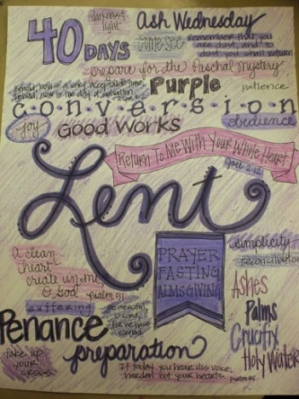
Learning Intentions
The children will…
1)
recognise Lent as a season for turning back to God through prayer
2)
identify ways people can pray alone, with family whānau and in parishes during Lent
R-1
S-02
Click boxes to reveal text
Notes:
Read through the Learning Intentions with the class and identify some ideas/questions that might be explored in the resource.

Slide 3
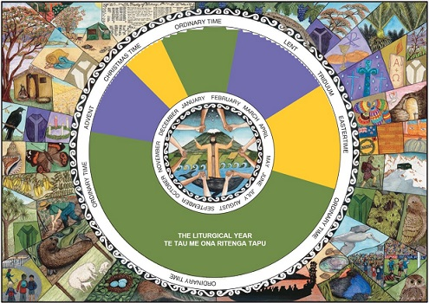
Checking up on the Seasons of the Liturgical Year
Name the purple seasons on the calendar and explain what happens during them.
Name the yellow seasons on the calendar and explain what happens during them.
Name the green seasons on the calendar and explain what happens during them.
What else do you know about the Liturgical Year?
In what ways is the Liturgical Calendar useful?
R-1
S-03
Click coloured buttons to reveal pointers, click a second time to hide them.
Notes:
Adapt Teaching and Learning Experience 1
Read through the bullet points and use the coloured buttons to focus children’s attention on the seasons on the calendar.
Invite children to share other ideas they have about the Liturgical Year.
Share why the Liturgical Calendar is useful and give examples of how it is useful in their classroom.
Give a special focus to Prayer Karakia during Lent.
Highlight it with the prayer focus and add an end of the day reflection about using Lent to make God a more important part of their life.

Slide 4
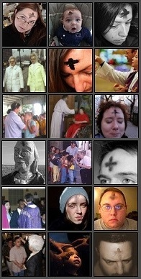
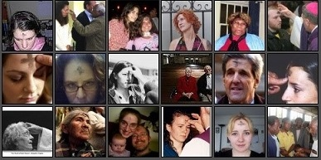
What do you know about Ash Wednesday?
Ash Wednesday is the first day of
People receive a cross of ashes to remind
Prayer and quiet reflection each day
During Lent we try to give up things that
In Lent we can try new ways to pray
the Penitential season of Lent.
them to turn their lives back to God.
helps people grow closer to Jesus.
distract us from being close to God.
that help us to journey with Jesus.
distract us from being close to God.
them to turn their lives back to God.
that help us to journey with Jesus.
the Penitential season of Lent.
helps people grow closer to Jesus.
R-1
S-04
Click the end of the sentences or the items on the list to add the rest of the sentence.
Notes:
ANSWERS 1) D, 2) B, 3) E, 4) A, 5) C
Adapt Teaching and Learning Experience 1
Invite children to look at the image and make a comment about what it tells us about Ash Wednesday.
Invite children to suggest items to complete the statements on screen and check them with the floater tool.
Invite children to look at the images and make a comment about what it tells us about Ash Wednesday.
Invite children to suggest items to complete the statements on screen and check them with the floater tool.
Adapt Teaching and Learning Experience 1

Slide 5
What can children do to walk closely with Jesus through Lent?
Look closely at the poster.
Chose one item about Lent.
Explain what it means to you.
How does it help you to walk closely with Jesus?
Share your ideas about how you keep close to Jesus.
Make posters to help others to walk with Jesus during Lent.
R-1
S-05
Notes:
Children look closely at the image.
Follow the directions.
Display the posters around the school as a way of sharing children’s learning.

Slide 6
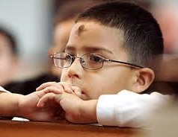
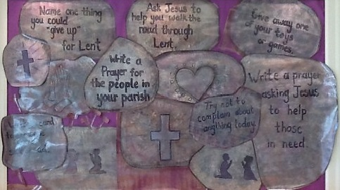
Lent is a season for spending time in Prayer Karakia
People become closer to God when they spend time with God.
How do you like to spend time with God?
You can make a plan to spend time with God in prayer during Lent.
Think about when would be the best time each day for you to be close to God so your friendship with God can grow.
Sometimes you talk to God and other times you just sit in silence and feel God is near.
When do you feel God is near and you are in God’s presence?
God speaks to us when we stop and listen to what God says to us.
What happens when you listen in your heart to God’s voice?
Sometimes we forget to give God time and distractions separate us from God.
What distracts you from spending time with God?
R-1
S-06
Click the buttons to reveal text
Notes:
Use the revealed text and question to generate discussion – children could record their prayer plans for Lent in their RE Journals.
Set up a special Lenten Prayer Space with Bibles, pictures of the Holy Week stories, prayer cards, music and invite children to bring things to add. Encourage children to spend time in the space each day.
This will show the class how they can put into practice what they are learning about during Lent.
Use the Children’s Home activity in the Teacher’s Book (p25) or in the Resource Documents on the Resource Home page. See also worksheet from Slide 10. Add to RE Learning Journals.

Slide 7
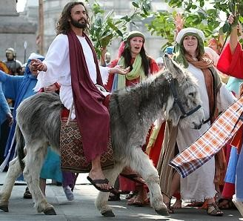
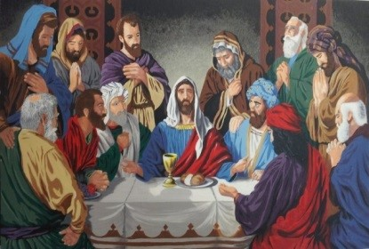
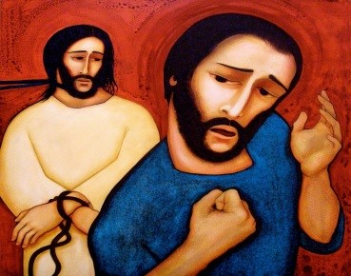
In Lent we journey with Jesus to his death through Prayer Karakia
Jesus rides into Jerusalem on Palm Sunday.
Jesus shares his Last Supper with his friends.
Peter denies Jesus three times.
Luke 19:29-38
Matthew 26:20-30
Matthew 26:69-75
As you look at each picture and listen to the story imagine -
You can see what is going on in the image in front of your eyes as if you are there.
Look at the face of Jesus – what would you like to say to him?
Share with Jesus what causes you or your family pain and ask him to help you deal with it.
Tell Jesus you are sorry for the pain you have caused him and the people in your life.
Remind yourself that this is how you can share in Jesus’ journey during Lent.
R-1
S-7a
Click the pictures to reveal title and passage.
Notes:
Adapt Teaching and Learning Experience 1.
Follow the bullets and make this a time for reflection and prayer.
You could use it as your prayer time this week.

Slide 8
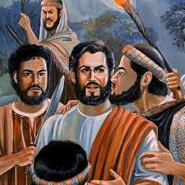
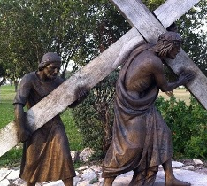
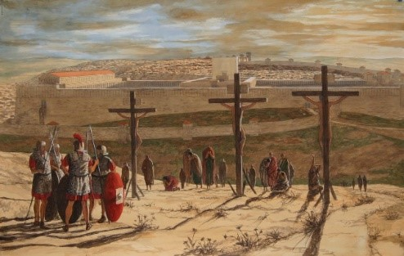
In Lent we journey with Jesus to his death through Prayer Karakia
Judas betrays Jesus with a kiss.
Jesus carries his cross to Calvary.
Jesus dies on his cross.
Mark 14:43-50
Luke: 23:26-28
Mark 15: 33-39
As you look at each picture and listen to the story imagine -
You can see what is going on in the image in front of your eyes as if you are there.
Look at the face of Jesus – what would you like to say to him?
Share with Jesus what causes you or your family pain and ask him to help you deal with it.
Tell Jesus you are sorry for the pain you have caused him and the people in your life.
Remind yourself that this is how you can share in Jesus’ journey during Lent.
R-1
S-7b
Click the pictures to reveal title and passage.
Notes:
Adapt Teaching and Learning Experience 1.
Follow the bullets and make this a time for reflection and prayer.
You could use it as your prayer time this week.

Slide 9
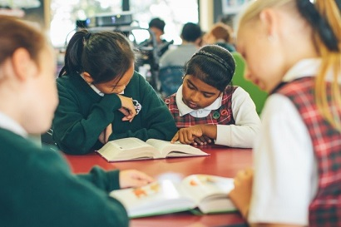
Using Gospel Stories to lead us to Prayer Karakia
Reflecting on these stories helps us to think about when people have let us down and hurt us, when we have been untruthful, and when people have helped us during hard times in our lives.
When we read the Gospel stories about the events that led up to Jesus’ death it helps us to realise what Jesus did for us and we can talk to him about how we are grateful to him for this.
These stories tell about some of the saddest times in Jesus’ life when he felt hurt and alone and let down by his closest friends – we know these feelings too and we can share them with Jesus.
We read about Jesus giving himself through the bread and wine to the disciples at the Last Supper knowing he was going to die on the cross in a few hours and we imagine how hard that was for him.
When we take time to listen to and imagine these events in Jesus’ life they can lead us to talk to him and we can relate his stories to the events in our lives and in other people’s lives.
R-1
S-08
Click the pins on the right to reveal post-it notes.
Notes:
Adapt Teaching and Learning Experience 2 & 3
Use this imagination prayer style during class prayer so that the children become familiar with it.
Encourage them to see coherence in the events from the gospels with the events in people’s lives and in the world. Help them to recognise people who are like Simon of Cyrene and who help others deal with the hard things in their lives, who feel lonely and dejected, and those who make mistakes and say sorry and make up for them.
Talk about empathy and what it means and how people show it especially with people who are sad and hurt. Explain Jesus showed great empathy for people especially the sick and the poor.Talk about empathy and what it means and how people show it especially with people who are sad and hurt. Explain Jesus showed great empathy for people especially the sick and the poor.

Slide 10
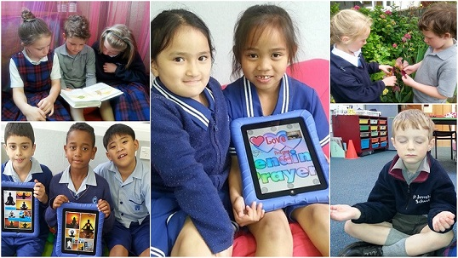
Taking time to pray each day
We can write prayers on our ipad to share with others.
How do you like to pray?
How does prayer help you to turn your thoughts and your hearts back to God?
Meditation helps us to feel God’s Spirit in our heart and recognise God’s peace within us.
How does meditation lead you to prayer karakia?
When we read the Gospel stories in Lent we share Jesus’ journey and we grow close to him.
How does reading stories about Jesus help you to pray to him?
Being outside in creation can help us to pray.
The beauty around us reminds us to give praise and thanks to God the creator.
When do you like to praise God?
Karakia Prayer helps us to turn our mind to God and imagine God listening to us.
Making a habit of praying often helps us to grow closer to God.
What helps you to remember to pray?
R-1
S-09
Click cards on the right to move through (5 total) click arrow to start over.
Notes:
Adapt Teaching and Learning Experience 3
Take time to let children respond to the questions and share their responses.

Slide 11
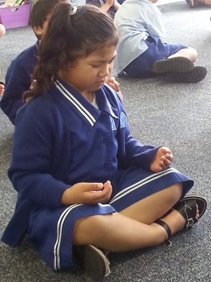
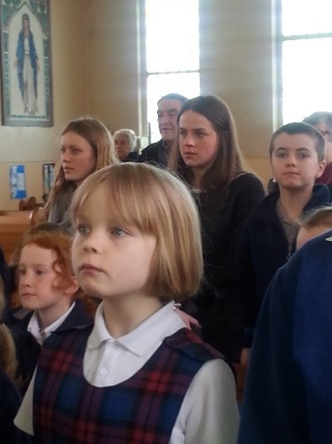
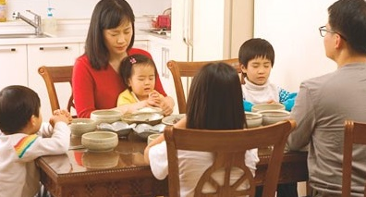
Praying alone, praying with our family and praying with our Parish in Lent
When I pray alone I …
Praying alone helps lead me to God because …
When I pray in our church with people in our parish I like …
When the people in our parish pray together it helps us to feel …
When I pray with my family we …
Praying with my family helps us to realise that God is part of our family because …
R-1
S-10
Click on worksheet icon for worksheet.
Notes:
Adapt Teaching and Learning Experiences 3, 4 & 5
Children complete worksheets and add to their RE Learning Journal.

Slide 12
Check Up
1)
The purpose of the season of Lent is to give people time to…
2)
How does prayer help people turn their lives back to God?
3)
Using one of the Holy Week stories as an example explain how: - listening and reflecting on a story leads people to appreciate what Jesus did for them, - praying about how they live their own lives, - doing these things helps them to grow closer to God.
4)
Name the way you prefer to pray and give reasons for your choice.
5)
Which activity do you think helped you to learn best in this resource?
6)
Questions I would like to ask about the topics in this resource are…
R-1
S-11
Click in each caption space to reveal text
Notes:
This formative assessment strategy will help teachers to identify how well the children have achieved the Learning Intentions of the resource.
Teachers can choose how they use the slide in their range of assessment options.
A worksheet of this slide is available for children in Years 5-8 to complete.
The last two items are feed forward for the teacher.
Recording the children’s responses to these items is recommended as it will enable teachers to adjust their learning strategies for future resources and target the areas that need further attention.

Slide 13
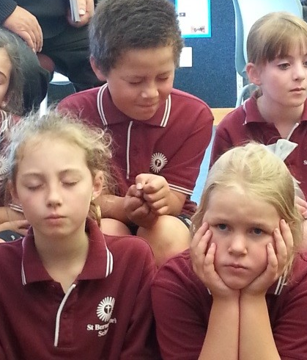
Time for Reflection
R-1
S-12
Click the audio button to stop reflective music
Click the audio button to play reflective music
Notes:
The MP3 is played to help create a reflective atmosphere and bring the children to stillness and silence as the teacher invites them to recall the feeling of being close to God in prayer. Bring to mind their favourite Holy Week story and let it help them to notice things they need to change. Recall how reflecting on the events in Jesus’ last week before he died can help them to feel closer to him as if they are sharing in what is happening to him.

Slide 14
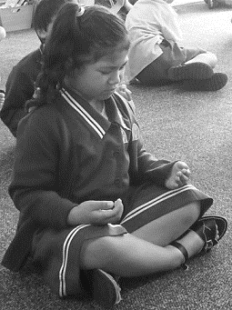
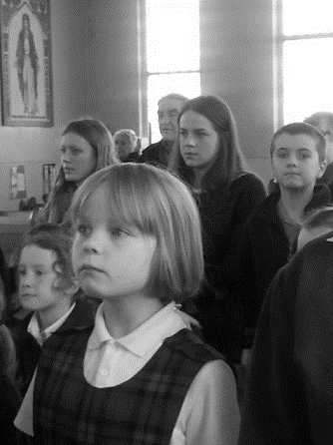
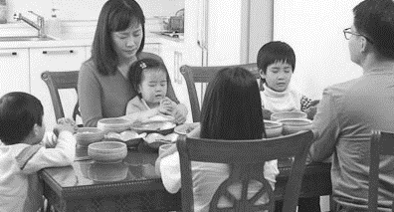
Praying alone, praying with our family and praying with our Parish in Lent
Name___________________________ Date_______________
When I pray alone I …
Praying alone helps lead me to God because …
When I pray in our church with people in our parish I like …
When the people in our parish pray together it helps us to feel …
When I pray with my family we …
Praying with my family helps us to realise that God is part of our family because …
R-1
S-10
Worksheet
Click the up arrow to return to the lesson

