Slide 1
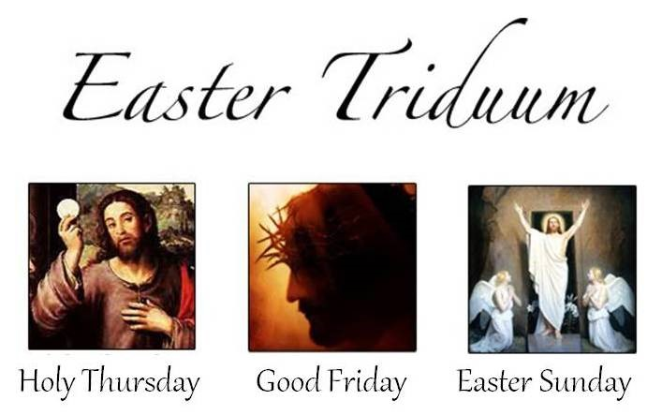
The Days of the Easter Triduum
R-2
S-01
Notes:
Slide 1 The Days of the Easter Triduum
Use this slide as a focussing strategy to introduce the resource. Read the title together and invite students to share something they know about the Easter Triduum and the events that are celebrated during it.

Slide 2
Learning Intentions
The children will:
1)
Identify what the Church recalls in the Gospel readings on Holy Thursday, Good Friday and the Easter Vigil
2)
Identify one reason why the ceremonies of the Easter Triduum are so important for Christians to celebrate.
R-2
S-02
Click the box to reveal the Learning Intention
Notes:
Slide 2 Learning Intentions
Read through the Learning Intentions with the class and identify some ideas/questions that might be explored in the resource.
Recap the readings from Resource 1.
Remember to add some new symbols to the prayer focus - wine glass, bread, bowl, water and towel, bible open at the John 13:1-15. Try to create a reflective mood for children to get a sense of moving towards Good Friday. Remind them about trying to recall what Jesus went through on these days and try to keep him company as he enters the last week of his life.
Please Note that on Slide 4 The Mass of the Chrism there is some information you will need to source related to your diocese regarding the celebration of this Mass. Your Parish priest would be able to help with this. You may like to invite him to talk to the children about this Mass and why it is special for the priests.

Slide 3
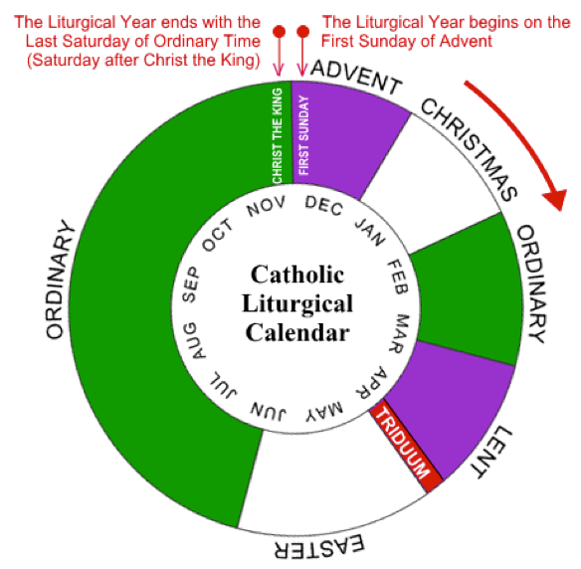
What do you know about the Easter Triduum?
What does the word ‘Triduum’ mean?
What days in Holy Week does the Easter Triduum refer to?
Where does the Triduum fit in the Liturgical Year?
Why is the Triduum such an important time in the life of the Church?
Why does the Church celebrate the Triduum?
R-2
S-03
Notes:
Slide 3 What do you know about the Easter Triduum?
Read each item and discus its meaning. Refer to information below.
What does the word Triduum mean? – Triduum is Latin for ‘three days’.
What days in Holy Week does the Easter Triduum refer to? In Judaism, a day commences at dusk and lasts until the following dusk, thus in the Jewish calendar the first day of Passover begins after dusk on the 14th day of Nisan and ends at dusk on the 15th day of the month of Nisan. In Christian Churches The Triduum – the ‘three days’- refers to the time from: Day 1 - Holy Thursday evening (dusk) of the Last Supper, until Good Friday evening Day 2 - from Good Friday evening until Holy Saturday evening; Day 3 - from the Holy Saturday evening Easter Vigil until vespers (evening prayer) on Easter Sunday. Where does the Triduum fit in the Liturgical Year? The Triduum comes at the end of Holy Week which is the last week of Lent and leads into the Easter season.
Why is the Triduum such an important time in the life of the Church? The Triduum recalls the most important events in the life of Jesus and reminds his followers of what he has done for them.
Why does the Church celebrate the Triduum? The Church celebrates the Triduum to make the events of Jesus’ life, death and resurrection present again for Christians through the liturgy that includes the Scripture readings, prayer, symbols and rituals, music and gesture. The Triduum marks the 3 holiest days in the year for Christians.
Please Note Slide 4
The information about the blessing of the holy oils, at the Chrism Mass, anointing and what it means and what Sacraments it is used in will be useful when the children work on the Sacrament Strand which focuses on the Sacrament of Confirmation. The next slide is about the Chrism Mass which is celebrated before Holy Thursday.

Slide 4
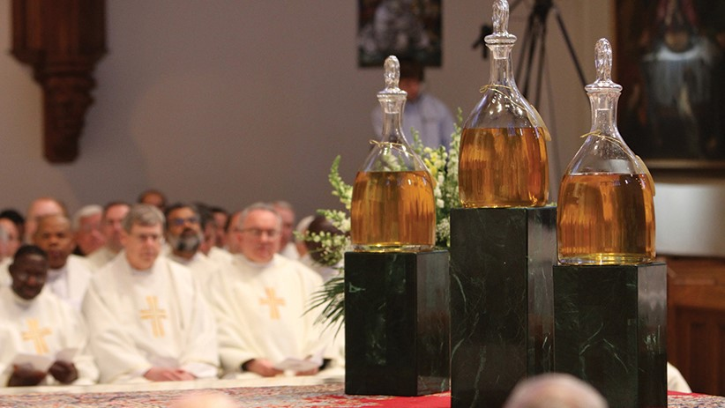
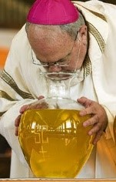
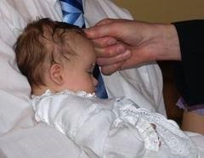
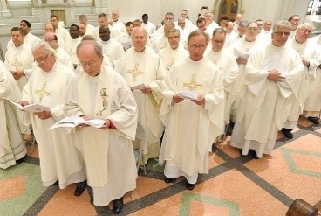
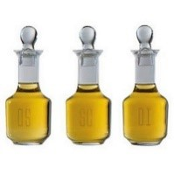
The Mass of the Chrism
14) Think about the Sacraments that include anointing in their rite. Can you think of someone you know who may be anointed during the next year with one of the oils that are blessed at the Chrism Masses in your diocese during this Holy Week?
14
13) After the Mass, the oil is put into smaller bottles for each area of the diocese. They are taken back to the deaneries (areas of the diocese) and distributed for use in each parish or pastoral area. This is done in time for the oils to be presented in each parish at the Mass of the Lord’s Supper on Holy Thursday evening. Remember to notice this during the Holy Thursday Mass.
13
12) The other special ritual during the Chrism Mass is the renewal by the priests of the promises they made when they were ordained a priest to serve the People of God faithfully. They also pledge their loyalty and support to their bishop, to one another and to the Pope. How do you think the community respond when they see and hear this promise?
12
11) Through the Sacrament of Holy Orders men commit themselves to a closer relationship with Christ, his mission and service to the People of God. The anointing with the Oil of Chrism is the sign of the commitment to fulfil a specific role in God’s plan under the influence of the Holy Spirit. Talk to your priest about the day he was ordained a priest and made this commitment.
11
10) In the Sacrament of Confirmation the bishop anoints the forehead of the candidate with Chrism saying
“Be sealed with the gift of the Holy Spirit”. Share an experience you have seen or had of this.
10
9) In the Sacrament of Baptism right after the water has been poured, the priest anoints the person on the crown of his/her head with Chrism saying,
“God has freed you from sin and given you a new birth by water and the Holy Spirit. He now anoints you with the Chrism of salvation”. Share an experience you have seen or had of this.
9
8) The Sacraments that include anointing are Baptism, Confirmation and Ordination to the priesthood and episcopacy (ordained a bishop).
The Oil of Chrism is used in these Sacraments and it gives a permanent, irremovable character which is the seal of the Holy Spirit that lasts forever.
Talk together about what this means.
8
7) The Oil of the Sick is brought to the sanctuary by members of the medical profession.
The Oil of Catechumens is brought by some of those who are to be baptised at Easter.
The Oil of Chrism is brought forward by people who are to be ordained. The Bishop breathes on the oils and blesses them calling on the Holy Spirit to pour out his gifts of the Spirit on all who will be anointed with them.
Why would the bishop breathe on the oils?
7
6) During the Mass the three oils are presented to the bishop with the bread, wine and water at the Offertory when the rite of blessing and consecration is celebrated. In some places the blessing of the
Oil of the Sick is done at the end of the Eucharistic prayer and the blessing of the Oil of Catechumens and the Consecration of the Chrism takes place after Communion.
Who presents the holy oils to the bishop?
6
5)There are three different oils that are blessed at the Chrism Mass: the Oil of the Sick,
the Oil of Chrism,
and the Oil of Catechumens.
The oils are used whenever there is a celebration of a Sacrament that includes anointing.
Can you name the Sacraments in which people are anointed?
5
4) The blessing and use of oil in sacred rites was common in the world of the Old Testament. This liturgy goes back to the 4th century maybe earlier. In present times the People of God - bishops, priests, deacons and the lay people gather before the Holy Thursday Mass to repeat this blessing of the holy oils to be used to anoint people in the Sacraments during the coming year.
Do you know what oils are used?
4
3) The Chrism Mass is very important in the life of the community for two reasons.
During the Mass 1) the bishop blesses the holy oils to be used throughout the following year,
2) the priests and deacons renew their promises to serve God and his people. Do you know what ‘anointing’ means and how it came to be used?
3
2) There are local variations about the time and place Chrism Masses are celebrated. In some areas, because of the geographic size and spread of the diocese, the bishop may celebrate a Chrism Mass in several centres to enable more people to participate in this special celebration.
Where is/are the Chrism Mass/es in your diocese celebrated?
2
1) Chrism Masses are celebrated by the bishop in his diocese during Holy Week. Ideally the Mass is celebrated in the Cathedral with all the priests and deacons and representative groups of lay people of the diocese present. Who attends the Chrism Mass in your diocese?
1
Click the video button to play ‘Presentation of Holy Oils-Holy Thursday’
R-2
S-04
Click top card to reveal others
Click the reset button to restart
Notes:
Slide 4 The Mass of the Chrism
Read the Flip Cards
Watch the clip
https://www.youtube.com/watch?v=PLbOtMjwGYU
Presentation of Holy Oils-Holy Thursday (3:31 minutes)
If there is a Chrism Mass in your area it would be valuable for the children to attend to help them gain a deeper understanding of the use of oils and anointing in the life of the Church. Use this resource before the Mass.
Some responses to the questions on the Flip Cards
Who attends the Chrism Mass in your diocese? Bishop … , Fathers …., Deacon … names of people in their community.
Where is/are the Chrism Mass/es in your diocese celebrated? The Chrism Mass/es are held in the Cathedral of ….because it is the ‘mother’ church of our diocese and in the Churches of …
Do you know what anointing means and how it came to be used? Anointing with oil is an action to symbolise a person has been chosen for a special purpose e.g. a king, a priest, a child of God. It is God who anoints a person not the oil – the oil is a symbol of what God is doing. Oil is also a symbol used to strengthen people. Jesus Christ was anointed by God with the Holy Spirit to spread the Good News and free those who have been held captive by sin (Luke 4:18-19). This is the Gospel reading at the Holy Thursday Mass of the Last Supper.
Do you know what oils are used for anointing? The Oil of the Sick and the Oil of Catechumens are plain olive oil – the Oil of Chrism is perfumed with balsam.
Can you name the Sacraments in which people are anointed? The Sacraments of Baptism, Confirmation, Holy Orders. See cards 8,9,10
Who presents the holy oils to the bishop? The Oil of Catechumens is presented by a catechumen who is about to be baptised.
The Oil of the Sick is presented by a medical professional.
The Oil of Chrism is presented by young people who are about to be ordained or confirmed.
Why does the bishop breathe on the oils? The bishop breathes on the open glass containers filled with fragrant chrism oil at the annual Chrism Mass as a reminder of Christ breathing on the Apostles after his resurrection, telling them to “receive the Holy Spirit.”

Slide 5
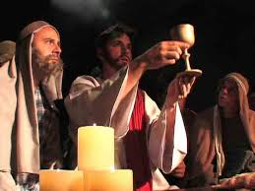
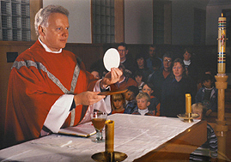
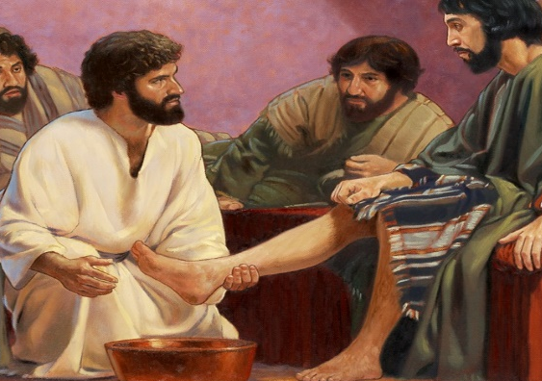
In the Holy Thursday Liturgy the Church celebrates Jesus’ Last Supper
Read John 13:1-15
Record the similarities between
the Last Supper and
the Holy Thursday Liturgy
R-2
S-05
Click in the white boxes and write your text
Notes:
Slide 5 In the Holy Thursday Liturgy the Church celebrates Jesus’ Last Supper
Holy Thursday is sometimes referred to as Maundy Thursday. The word Maundy comes from a Latin word “mandatum,” which means “commandment.” The ceremony is called the mandatum because it was at the washing of his disciples' feet before the Last Supper that Christ gave us the new commandment (novum mandatum) to love one another as he has loved us (John 13:4-17).
Remind the children that the school is part of the Church and that the purpose of the liturgies the school does to mark the events of Holy Week help children and the whole school community to recall the events. These liturgies usually include Gospel accounts of the events adapted for children.
Suggested ideas to record on the slide
The events take place in the evening and preparations have been made for the gathering.
Those present gather together for a special meal around the table.
The feet of the followers of Jesus are washed by Jesus as a sign of service to others.
The rituals of the Last Supper are repeated today because it was in fact the first Mass.
Jesus is at the centre of the celebration and he shares himself with those who are present.
They share stories, eat bread and drink wine which has been changed into Jesus’ body and blood.
Jesus is truly present– in his word, his priest, his people and in the gifts of bread and wine.
After the meal, the followers of Jesus are invited to spend quiet time with him – there is usually a special space set aside for this in the church for people to do this.
When the Last Supper was over the room was left empty. At the end of the Mass the altar is stripped bare and the door of the tabernacle is left open.

Slide 6
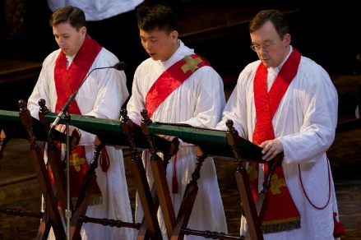
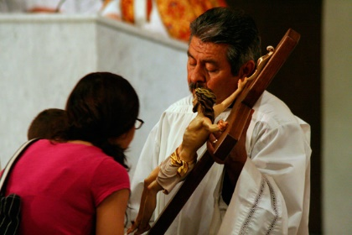
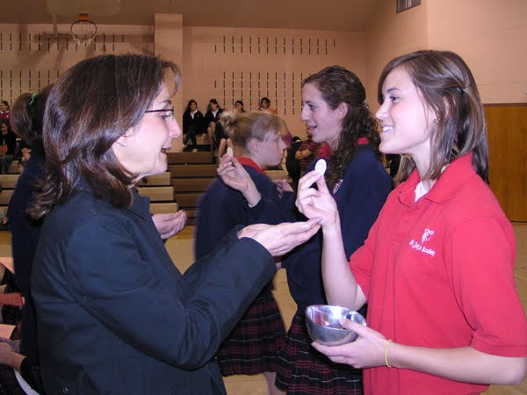
In the Good Friday Liturgy the Church lives again
Jesus’ death on the Cross
The Celebration of the Passion of the Lord is usually held at 3pm.
It begins with the Liturgy of the Word when the Passion of our Lord according to John is read by several readers.
Prayer of the Faithful follows the Gospel when some specific groups of people are prayed for.
After the Liturgy of the Word comes the Veneration of the Cross.
The people come forward to kiss the cross as a gesture of sorrow and honour.
During the Veneration, hymns are sung. At the end, the cross is held high for all to see and returned to the altar where it is surrounded by lighted candles.
Following the Veneration of the Cross, the ciborium is brought to the bare altar and the priest prepares to distribute communion in the way it is usually done during the Mass.
When this is completed, the altar cloth is removed and people leave the church in silence as they reflect on the death of Jesus on the cross.
R-2
S-06
Click the pictures to reveal the text
Notes:
Slide 6 In the Good Friday Liturgy the Church lives again Jesus’ death on the Cross
Read the revealed text and use it to start a discussion about the Good Friday Liturgy.
The mood of the Good Friday liturgy is of quiet, sadness and remembering the crucifixion and death of Jesus. Mass is not celebrated on Good Friday. The Good Friday Liturgy is normally celebrated at 3pm, the time believed to be when Jesus died.
It is in 3 parts: The Liturgy of the Word, The Veneration of the Cross and Communion.
In some places other services such as the Stations of the Cross are held in the evening of Good Friday to mark the day.
Some local communities join with other Christian Churches in the area for a joint service to mark this day – the holiest day in the year. They arrange ecumenical ceremonies based around the passion according to St John. These can involve carrying a large cross through the streets, stopping at churches on the way and marking special moments in the story on the way. These services can also focus on the seven last sayings of Jesus as recorded in the Gospels.
FAQ Why is the day Jesus died called “Good Friday”?
We call the day we remember the death of Jesus Good Friday because it was good for all humanity because it led to the Resurrection of Jesus and his victory over death, sin and suffering. Easter Sunday celebrates Jesus’ new risen life which those who believe in him can share in at the end of their lives. Easter brings new life and is the highest point in the whole Christian year.

Slide 7
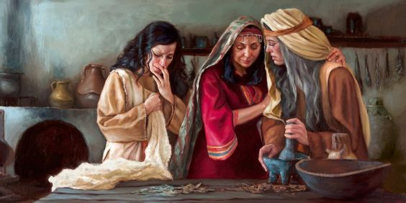
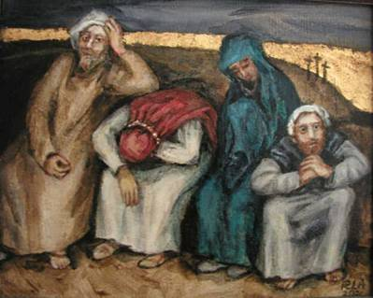
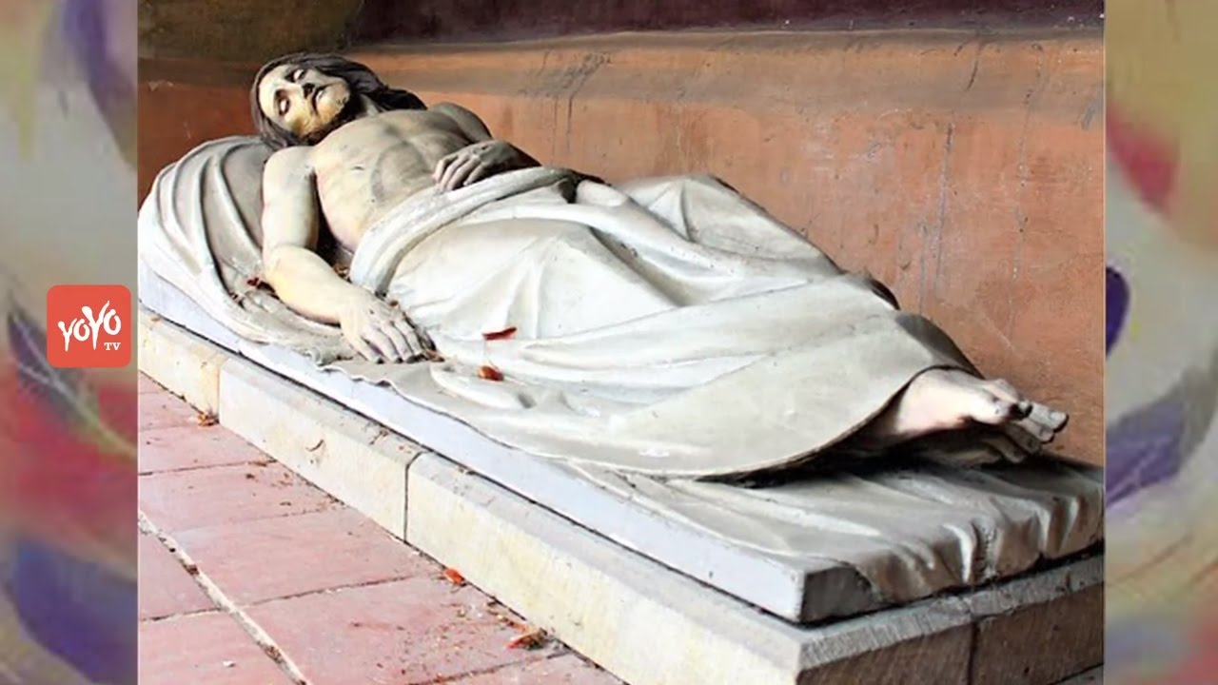
Holy Saturday is a day of quiet waiting
On the first Holy Saturday Jesus' disciples mourned his death and, since it was a sabbath day, (the Jewish Sabbath is Saturday) they rested. They recalled the horror of the previous day and wondered what life would be like without their master and teacher.
At the tomb, the guards that had been stationed there kept watch over the place to make sure that the disciples did not steal Jesus' body.
According to Luke’s gospel the women returned home "and prepared spices and ointments. On the sabbath they rested according to the commandment." (Luke 23:56). It was the women’s role to anoint the body of people who died. They planned to do that early in the morning of Easter Sunday.
On Holy Saturday, we, as the followers of Jesus today, try to keep a sense that we are at the tomb of Jesus reflecting on his passion and death and awaiting what is to come. The community does not gather for any liturgical celebration while they wait for Jesus to rise on Easter Sunday.
R-2
S-07
Click the pins on the right to reveal post-it notes.
Notes:
Slide 7 Holy Saturday is a day of quiet waiting
Look closely at the images – who is in each one, what they are doing and how they are feeling.
Read the PINs and add to the comments made earlier.
Some children may have experienced the same sense of quiet sadness if they have had someone die in their family.

Slide 8
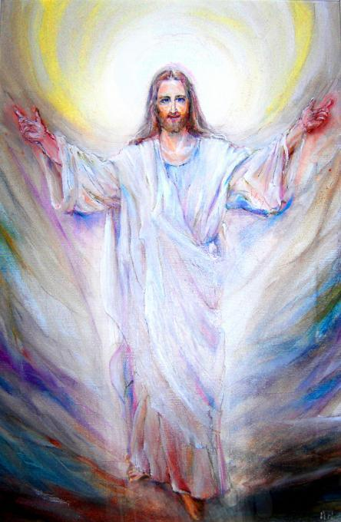
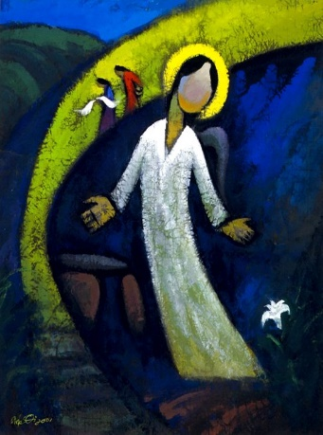
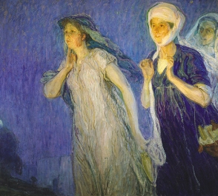
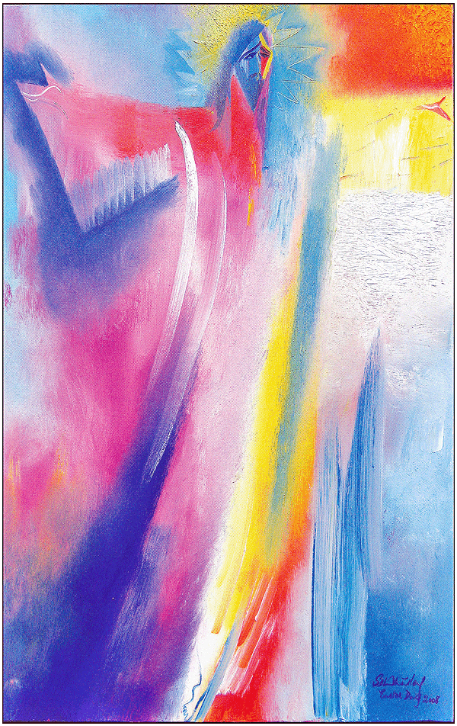
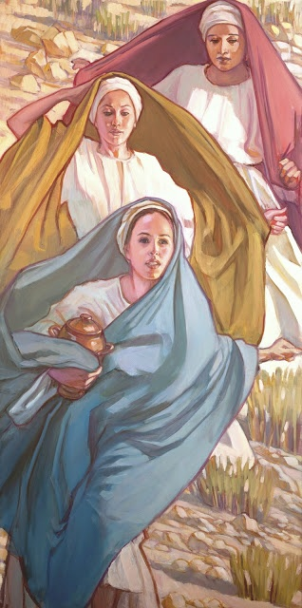
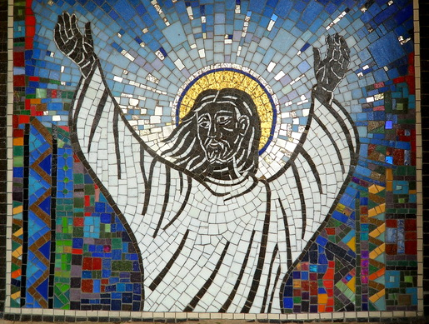
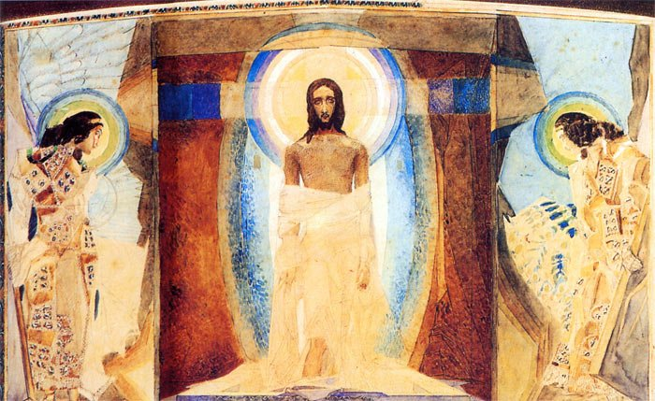
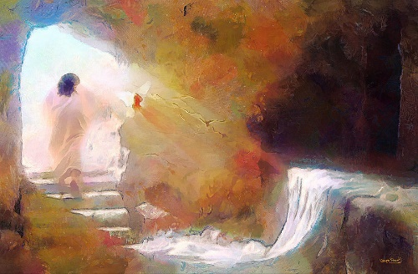
The Events of the First Easter the day of
Jesus’ Resurrection
R-2
S-08
Click the video button to play ‘Resurrection’
Notes:
Slide 8 The Events of the First Easter the day of Jesus’ Resurrection
Make a copy of the worksheet for each child to complete and add to their RE Learning Journal.
Look at the Resurrection Images. Notice how different the artist’s styles are. Choose your favourite and imagine you are in the picture. What would you say to the people in the image? Can you imagine what it would feel like to witness the Resurrection of Jesus?
To actually see the only person in human history to return from death to life?
Watch the clip
https://www.youtube.com/watch?v=KDlCFqy7KG4
Resurrection 1:48 minutes
The clip is suitable for prayer, interpretive movement or silent listening, reflecting and imagining.

Slide 9
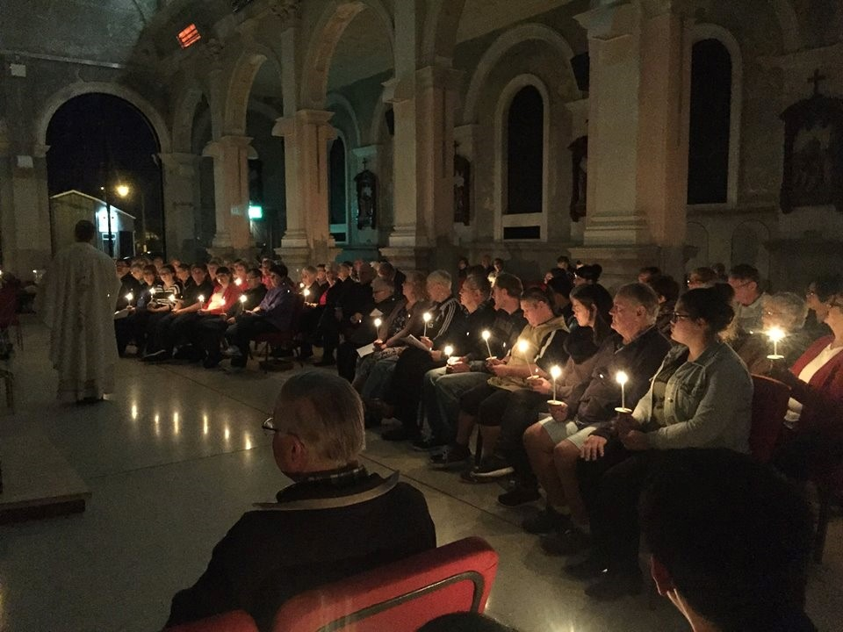
On Easter Saturday Evening the community gathers to celebrate the Easter Vigil
The celebration of the Easter Vigil helps Catholics to recall and deepen their belief about what the Resurrection of Jesus means in their lives.
When Jesus rose from the dead he had a new body and a new and glorious life that will never end. This is a mystery we cannot fully understand.
Because of his love for people, Jesus’ Resurrection means that all people will be raised with him from the dead to share in his new and glorious life with God, as brothers and sisters of Christ. This is why we have Easter eggs because eggs are a sign of new life.
The power of Jesus’ love aroha given in his life and death frees people from all sin.
It is these beliefs about the Resurrection that make it the most important event in human history and in the life of the People of God and the major celebration in the life of the Church every Liturgical Year.
Click the video button to play ‘Catholic - Easter Vigil’
Click the down-button to move the blind down
R-2
S-09
Notes:
Slide 9 On Easter Saturday Evening the community gathers to celebrate the Easter Vigil
Read the statements on the blind reveal and use them to add to children’s knowledge of the Easter Vigil and what Catholics believe about the Resurrection.
Watch the clip: Catholic - Easter Vigil (5:04 minutes)
https://www.youtube.com/watch?v=gO5romstsQY

Slide 10
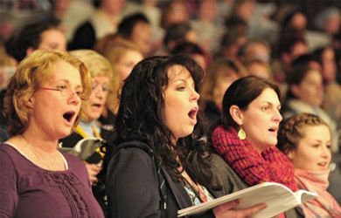
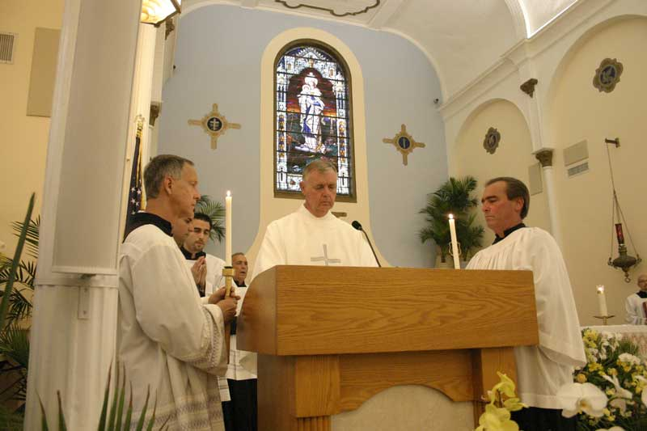
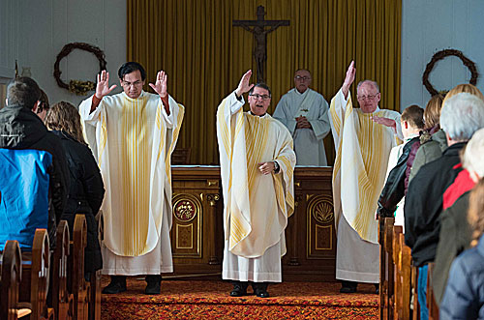
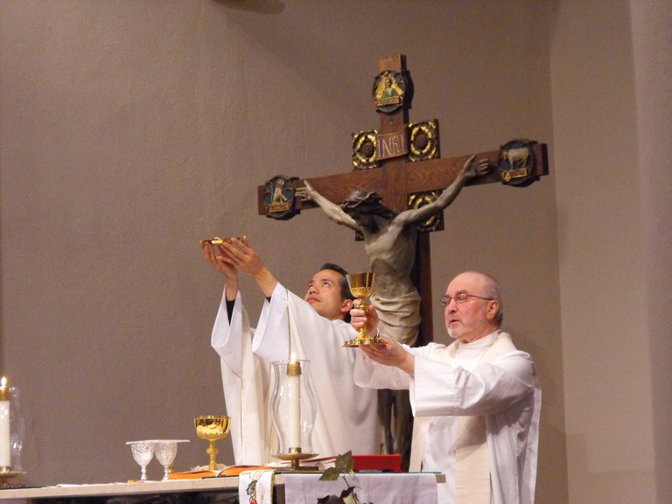
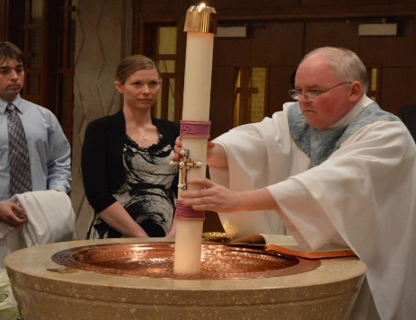
The Celebration of the Easter Vigil
Rites of Initiation People who have been preparing to become part of the Church (catechumens) are usually received at the Easter Vigil. This includes being baptised, confirmed and receiving communion.
Liturgy of the Eucharist follows the usual pattern.
Concluding Rites include a solemn blessing and Alleluia.
The Procession of the Paschal Candle. The paschal candle, representing the light of Christ rising from the tomb, is brought into the darkened church. The smaller candles held by the community are lit from the paschal candle as they make their way into the Church, symbolising the new life each of us receives from Christ. Point out to children that just as the church brightens as the light of Christ spreads from person to person, so too is the world transformed when we spread the light of Christ in it.
The Exsultet is an ancient hymn of praise for God’s saving work in human history especially in the Resurrection of Christ.
The Liturgy of the Word can include up to seven readings, five from the Old Testament and two from the New Testament and each is followed with a sung psalm. Each of the readings relates to another stage of salvation history, that is, the history of God’s saving work among his people.
The Blessing of the Baptismal Water the water is blessed and sprinkled on the community.
The Easter Fire is lit outside the doors of the church. The Liturgy begins with the blessing of this paschal fire and the lighting of the paschal candle from the fire. (Paschal is a Latin word meaning “Easter”).
A vigil is the liturgical commemoration of a notable feast, held on the evening preceding the feast.
The Easter Vigil takes place after sunset on Holy Saturday, to highlight the Church’s vigil, or waiting, for the Resurrection of Jesus. The Liturgical colours of gold, yellow or white are used to express the great celebration of the Resurrection.
The Easter Vigil Liturgy
The Liturgy of the Word
Reset
Slide
The Procession of the Paschal Candle.
The Exsultet
Concluding Rites
Liturgy of
the Eucharist.
The Easter Fire
Rites of initiation
Baptism
The Blessing of the Baptismal Water
Click the I-button to reveal more information
R-2
S-10
Click top card to discard it
Click the images to reveal text
Notes:
Slide 10 The Celebration of the Easter Vigil
Use the matching activity on the slide to help children to recognise the parts of the Easter Vigil.
Can you put them in order as they occur in the liturgy?
Print off a copy of the worksheet for each child to complete and add to their RE Learning Journal.

Slide 11
Check up
Write what you know about -
the Mass of the Chrism
when holy oil is used in the Church
what ‘anointing’ means (Slide 4)
1)
2)
What Gospel is read on Holy Thursday and explain why this was chosen? (Slide 5)
3)
Name and explain the 3 parts of the Good Friday Liturgy. (Slide 6)
4)
Choose 5 words to describe the mood of Christians on Holy Saturday. (Slide 7)
5)
Why is Easter Sunday the most important day in the year for all Christians? (Slide 8, 9)
6)
Describe 3 important parts of the Easter Vigil. (Slide 10)
7)
Which activity do you think helped you to learn best in this resource?
8)
Questions I would like to ask about the topics in this resource are …
R-2
S-11
Click the worksheet button to go to the worksheet
Notes:
Slide 11 Check Up
This formative assessment strategy will help teachers to identify how well children have achieved the Learning Intentions of the resource.
Teachers can choose how they use the slide to assess each item.
A worksheet of this slide is available as an option for children to complete.
The last two items are feed forward for the teacher.
Recording the children’s responses to these items is recommended as it will enable teachers to adjust their learning strategies for future resources and target the areas that need further attention.

Slide 12
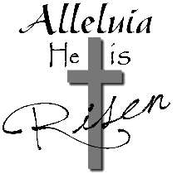
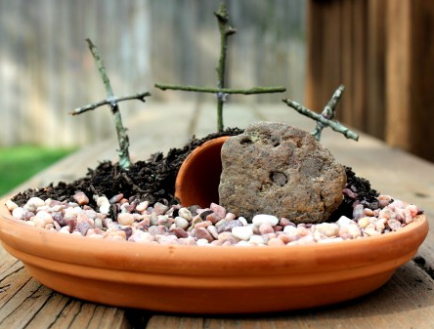
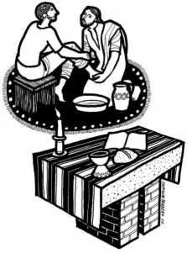
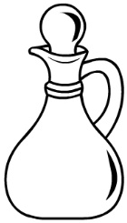
Sharing our learning
Find out the time of the HOLY WEEK ceremonies in your parish and pastoral area and talk to your family about which ones you could attend. Make a memo for your family and put it on the fridge.
Use the Liturgical Year Calendar to illustrate what you have learned about the Liturgical Year and what you know about Holy Thursday,
Good Friday, Holy Saturday and Easter Sunday and share it with a family member.
Have a conversation with a family member about the Mass of the Chrism and talk about the use of the holy oils in the Sacraments and
what anointing means. Share an experience you have had or seen of
anointing.
Make an Easter Garden to share at home
For your own garden you will need:
A tray.
Soil.
Grass seeds or moss.
Small stones.
A large stone.
A piece of small white cloth.
A small flower pot.
6 sticks to make into 3 crosses.
Make up a small focus at home to draw your family’s attention to Holy Week
You could use something purple and red and some symbols e.g. a wine glass, a bread roll, a red rose/flower, a bible open at the Triduum stories, a small bowl and cloth. On Easter Sunday use a yellow cloth and add a round stone and some Easter eggs.
Share your Resurrection Art work and symbol with your family and share what you have learned about the meaning of Easter this year.
Make an Easter power point to show some younger family members over the Easter break. Include pictures and captions about the story of Jesus’ Resurrection. Explain why eggs are an Easter symbol – share some.
Make up your own way of showing and sharing what you have learned and decide whom you would like to share it with.
R-2
S-12
Notes:
Slide 12 Sharing our learning
This slide provides some choices for children to show and share what they have learned. Examples could be photographed as evidence. Add a copy of the Sharing our Learning page in children’s RE Learning Journals. You could talk through the choices using the slide and let children make their choice from their own copy.
Children could work on their choice at school and/or at home and you may like to set a day for sharing. Please let parents and whānau know what you expect them to do with this.
The slide is focussed on Year 6 HOLY WEEK Achievement Objective which is covered Resource 1 and 2.
HOLY WEEK AO) Children will be able to: recognise Holy Week and Easter as the most significant time in the year for Christians and its importance as an event in history and in the life of the Church

Slide 13
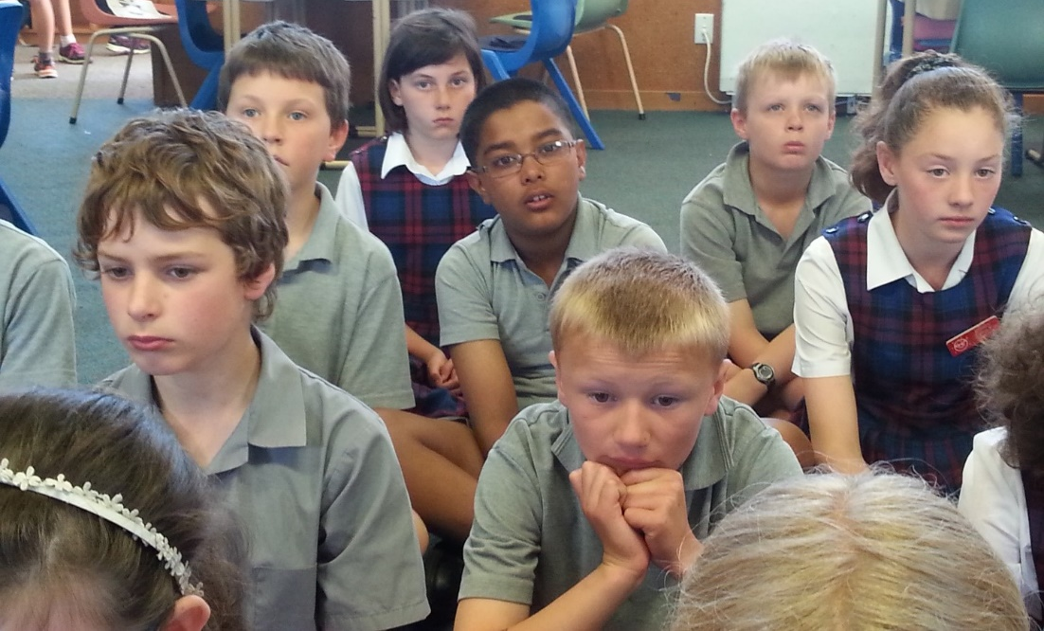
Time for Reflection
R-2
S-13
Click the audio button to stop reflective music
Click the audio button to play reflective music
Notes:
Slide 13 Time for Reflection
The MP3 is played to help create a reflective atmosphere and bring the children to stillness and silence as the teacher invites them to reflect on the changing moods of the days of the Easter Triduum – Holy Thursday, Jesus sharing his last meal and messages with his friends. Good Friday, the sadness of Jesus’ betrayal and Peter’s denial, being tried and sentenced to death on the cross. Holy Saturday, quiet waiting in sadness at what had happened to Jesus. Easter Sunday, the joy of Jesus’ resurrection and what it means for them.

Slide 14
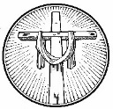
Thinking about the Easter Story
There are 3 Gospel versions of the Resurrection story. One for each of the 3 years of the Liturgical Cycle.
Year A is Matthew 28:1-10, Year B Mark 16:1-7, Year C Luke 24:1-12. One version is read at the Easter Vigil each year. Read one version and record the 5 important moments in the story.
1)
2)
3)
4)
5)
Make a human statue tableau of the 5 moments and photograph it, and display
it in the school or parish foyer over the Easter season.
Look at the Resurrection images on the slide. Select one that captures the mystery
and wonder of the event. Reflect on the image and record some words that drew
you to this image.
Create your own art work of the Resurrection to be part of an Easter Art Exhibition.
Try to express what the Resurrection means for you and all Christian people. Get
some ideas from the Resurrection story on the slide.
Create a symbol of Easter in the frame
and write one new understanding
you have of it this year.
Celebrate it well!
R-2
S-08
Name ____________________ Date _____________

Slide 15
The Easter Vigil Liturgy
Name ____________________ Date _____________
A _____ is the liturgical commemoration of a notable feast, held on the evening preceding the feast.
The E_____ V____ takes place after s_____ on Holy Saturday, to highlight the Church’s vigil, or waiting, for the Resurrection of Jesus. The Liturgical colours of gold, yellow or white are used to express the great celebration of the Resurrection.
The E_____ F___ is lit outside the doors of the church. The Liturgy begins with the blessing of this paschal fire and the lighting of the paschal candle from the fire. (Paschal is a Latin word meaning “Easter”).
The P____________ of the Paschal Candle. The paschal candle, representing the light of Christ rising from the tomb, is brought into the darkened church. The smaller candles held by the community are lit from the paschal candle as they make their way into the Church, symbolising the new life each of us receives from Christ. Point out to children that just as the church brightens as the light of Christ spreads from person to person, so too is the world transformed when we spread the light of Christ in it.
The E_______ is an ancient hymn of praise for God’s saving work in human history especially in the Resurrection of Christ.
The L______ of the Word can include up to seven readings, five from the Old Testament and two from the New Testament, and each is followed with a sung psalm. Each of the readings relates to another stage of salvation history, that is, the history of God’s saving work among his people.
The B_______ of the B________ Water the water is blessed and sprinkled on the community.
Rites of I_________ People who have been preparing to become part of the Church (catechumens) are usually received at the Easter Vigil. This includes being baptised, confirmed and receiving communion.
Liturgy of the E__________ follows the usual pattern.
Concluding Rites include a solemn blessing and Alleluia.
R-2
S-10

Slide 16
Check up
Name:____________________________
Date:____________
1) Write what you know about -
the Mass of the Chrism
when holy oil is used in the Church
what ‘anointing’ means
2) What Gospel is read on Holy Thursday and explain why this was chosen?
3) Name and explain the 3 parts of the Good Friday Liturgy.
4) Choose 5 words to describe the mood of Christians on Holy Saturday.
5) Why is Easter Sunday the most important day in the year for all Christians?
6) Describe 3 important parts of the Easter Vigil.
7) Which activity do you think helped you to learn best in this resource?
8) Questions I would like to ask about the topics in this resource are …
Worksheet
R-2
S-11
Click the up arrow to return to the presentation

Slide 17
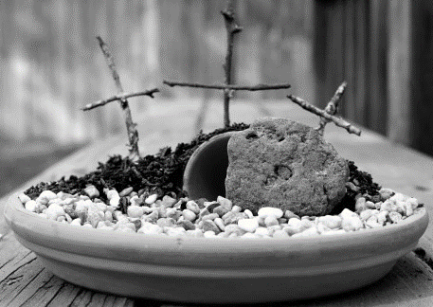
Sharing our Learning about HOLY WEEK
Date:____________
Name:____________________________
Find out the time of the HOLY WEEK ceremonies in your parish and pastoral area and talk to your family about which ones you could attend. Make a memo for your family and put it on the fridge.
Use the Liturgical Year Calendar to illustrate what you have learned about the Liturgical Year and what you know about Holy Thursday, Good Friday, Holy Saturday and Easter Sunday and share it with a family member.
Make up a small focus at home to draw your family’s attention to Holy Week. You could use something purple and red and some symbols e.g. a wine glass, a bread roll, a red rose/flower, a bible open at the Triduum stories, a small bowl and cloth. On Easter Sunday use a yellow cloth and add a round stone and some Easter eggs.
Have a conversation with a family member about the Mass of the Chrism and talk about the use of the holy oils in the Sacraments and what anointing means. Share an experience you have had or seen of anointing.
Share your Resurrection Art work and symbol with your family and share what you have learned about the meaning of Easter this year.
Make an Easter Garden to share at home.
For your own garden you will need:
A tray.
Soil.
Grass seeds or moss.
Small stones.
A large stone.
A piece of small white cloth.
A small flower pot.
6 sticks to make into 3 crosses.
Make an Easter power point to show some younger family members over the Easter break. Include pictures and captions about the story of Jesus’ Resurrection.
Explain why eggs are an Easter symbol – share some.
Make up your own way of showing and sharing what you have learned and decide whom you would like to share it with.
Worksheet
R-2
S-12
Click the up arrow to return to the presentation

