Slide 1
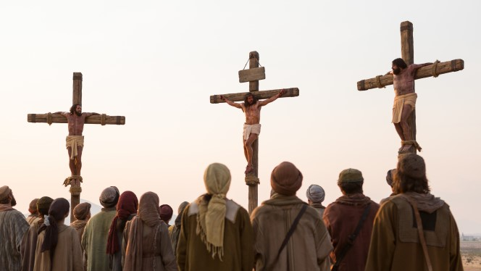
Good Friday – Jesus dies on a Cross
R-2
S-01
Notes:
Slide 1 Good Friday – Jesus dies on a Cross
Use this slide as a focussing strategy to introduce the resource topic. Read the title together and invite children to share something they know about Good Friday when Jesus dies on the cross. Draw the children’s attention to the image and the background and invite them to share some words that describe what they see and how it makes them feel.

Slide 2
Learning Intentions
The children will:
1)
describe what happened to Jesus on the day called Good Friday
2)
name ways Christian people remember the death of Jesus on a cross.
R-2
S-02
Click the boxes to reveal text.
Notes:
Slide 2 Learning Outcomes
Read through the Learning Intentions with the class and identify some ideas/questions that might be explored in the resource. Remember to add some new symbols to the prayer focus – cross, images of Jesus’ journey to the cross, images of the people mentioned in this resource. Enshrine the bible this week and have it open at the Gospel of John Chapters 18 and 19. Read parts of these chapters at prayer time and during the day. Play the MP3 of “Jesus, Remember Me” while children are working. Try to create a reflective mood for children to get a sense of moving through Holy Week towards Good Friday. Remind them about trying to recall what Jesus went through on these days and try to keep him company as he enters the last week of his life. Use times of silence this week to honour what Jesus did for all humanity on Good Friday.

Slide 3
What happened between Palm Sunday and Good Friday?
?
What we know already about what happened between Palm Sunday and Good Friday
R-2
S-03
Type children’s ideas in the white box.
Notes:
Slide 3 What happened between Palm Sunday and Good Friday?
Type the children’s responses into the white box.
Adapt Teaching and Learning Experience 1.

Slide 4
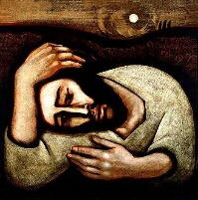
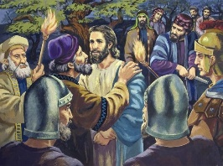
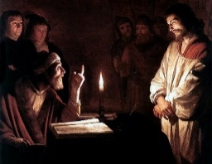
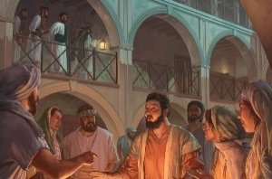
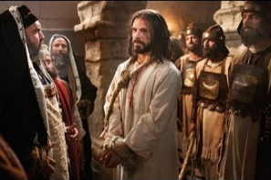
The Events that followed the Last Supper
Jesus left the supper room and went to the Garden of Gethsemane. He asked the disciples to sit with him while he prayed. Jesus was very distressed as he knew what was going to happen to him. The disciples went to sleep and despite Jesus’ request he was left alone and felt very disappointed in them.
Just as Jesus came to check that the disciples were still sleeping, some soldiers and police arrived with lanterns and weapons. Judas, who was with them came up to Jesus and said, “Greetings, Rabbi.” and he kissed him. Then the soldiers arrested Jesus and led him away.
Then Jesus was questioned about his teaching and his disciples by the high priest, Annas. Jesus said he had taught in synagogues and in the temple and not in secret. He told Annas to ask those who had heard what he had said. He was struck in the face for saying this.
Later Peter was standing near the fire in the courtyard warming himself when a woman said to him, “Were you not one of his friends?” and Peter replied, “I am not.” This happened 3 times and then the cock crowed. Peter went out and cried.
Jesus was taken before Caiaphas the high priest, the scribes, the council and elders. They were all looking for false testimony against Jesus so they could put him to death. They questioned Jesus and accused him of blasphemy. They made fun of him, spat at him and struck him in the face.
A) Jesus is brought before Annas the high priest (Caiaphas’ father in law)
B) Peter denies Jesus three times.
C) Jesus’ agony in the garden.
D) Jesus is betrayed by Judas.
E) Jesus is bound and taken before Caiaphas.
Click the correct options A-E to reveal text.
Click video icon for “The Crucifixion”
R-2
S-04
Notes:
Slide 4 The Events that followed the Last Supper
Click on title and read the text that appears – see order below.
Children look at the images and name the one that happens next to click and read until the last one – Jesus is taken before Caiaphas Ask children to imagine how Jesus is feeling in each of these incidents.
Order of events after the Last Supper
1ST - C) Jesus’ agony in the garden.
2ND - D) Jesus is betrayed by Judas.
3RD - A) Jesus is brought before Annas the high priest (Caiaphas’ father in law).
4TH - B) Peter denies Jesus three times.
5th – E) Jesus is bound and taken before Caiaphas.
Teacher Resource - Map of Jerusalem page 30– copy for each child to add words or symbols to while working through this resource. Copy as worksheet or from resource pages on front screen. Children add to the RE Journals.
Watch the clip - https://www.youtube.com/watch?v=eyElZpwhviQ
The Crucifixion 6:38 minutes
Create an art work that tells the story of Good Friday. This can be part of an exhibition to share with you school and your parish.
To be used in Check Up task Item 3, Slide 11. This can be part of an Art Exhibition to share with your school and your parish. See Sharing Our Learning on Slide 12, R3.

Slide 5
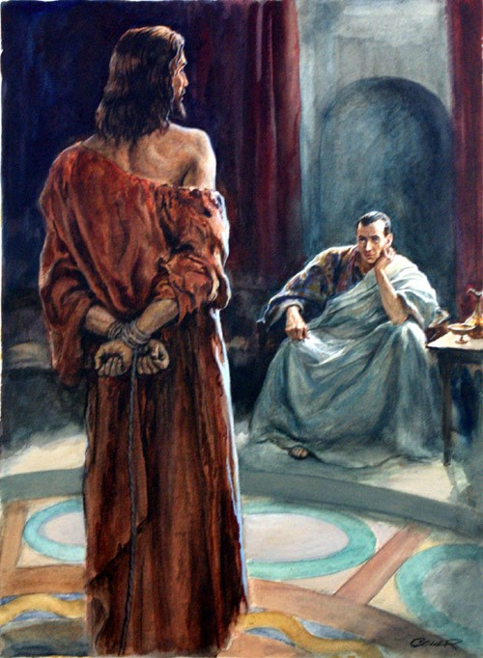
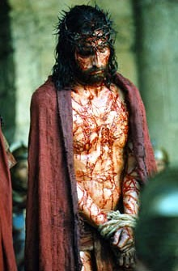
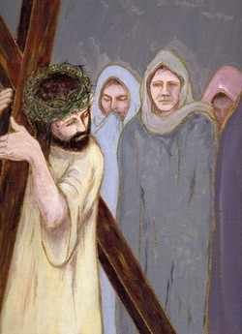
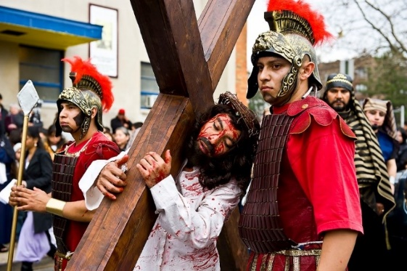
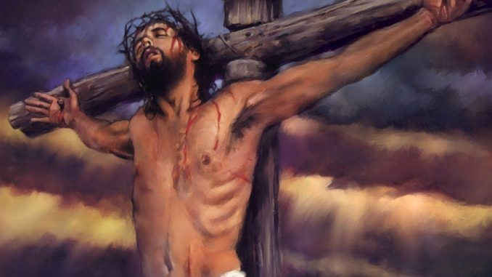
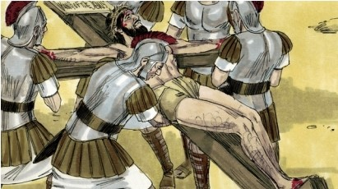
The Events that led up to Jesus’ Death on the Cross on Good Friday
From noon until 3 o’clock darkness came over the land and the earth shook. People were terrified and said, “Truly this man was God’s Son.” Jesus cried out to his Father as he bowed his head and died.
This is Jesus…
When they reached the place of crucifixion the soldiers nailed Jesus to the cross. They made a sign and put it on the cross. The sign said, This is Jesus the King of the Jews.
Many people had gathered to watch Jesus carry his cross up the hill where he was to be crucified. Jesus was so weak he fell 3 times. The soldiers ordered a man named Simon of Cyrene to help him carry the cross.
The soldiers stripped Jesus and put a scarlet cloak on him. They twisted some thorns and made a crown and put it on his head and mocked him saying, “Hail King of the Jews.” Then they led him away to be crucified.
As Jesus struggled up the hill of Calvary he met some women. One was his mother Mary, one was Veronica who wiped his face with a towel and others were some women from Jerusalem who were weeping for Jesus.
Early on Friday morning Jesus was bound and brought before Pilate. Pilate questioned Jesus, “Are you the King of the Jews?” Jesus said, “You say that I am. My kingdom is not of this world.” Pilate had Jesus flogged and handed him over to be crucified.
Click the cards on the right to move through (6 total). Click the arrow to restart.
R-2
S-05
Click the audio button to stop ‘Look At The Cross’
Click the audio button to play ‘Look At The Cross’
Notes:
Slide 5 The Events that led up to Jesus’ Death on the Cross on Good Friday
Look at the image in silence and then read the text
When the story is finished, sing using the MP3 ‘Look at the Cross’.

Slide 6
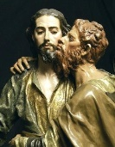
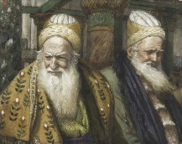
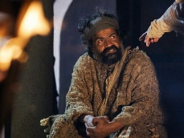
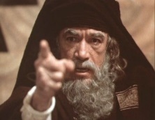
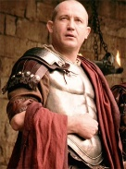
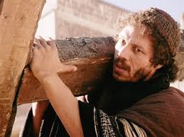
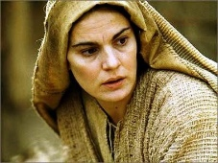
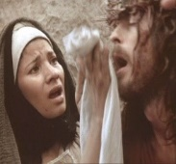
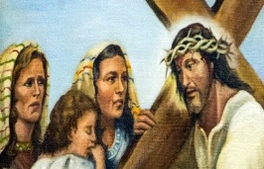
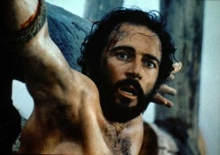
Who are you? – people Jesus met during his last day on earth
I betrayed Jesus with a kiss, my name is __________________
I questioned Jesus about his teaching, my name is____________
I denied Jesus 3 times, my name is _______________
I accused Jesus of blasphemy, my name is _______________
I handed Jesus over to be crucified, my name is _______________
Judas.
Annas.
Peter.
Caiaphas.
Pilate.
I helped Jesus carry his cross, my name is _______________
I watched my Son die on the cross, my name is __________________
I wiped the blood-stained face of Jesus, my name is _______________
We wept for Jesus as he passed by carrying his cross, we are __________________
I hung on the cross beside Jesus and am now in heaven. I am __________________
Simon of Cyrene.
Mary, Mother of Jesus.
Veronica.
the women of Jerusalem.
the good thief.
Pilate
Judas
Veronica
Peter
Simon of Cyrene
Caiaphas
Mary, Mother of Jesus
Annas
the good thief
the women of Jerusalem
Click the worksheet icon for a worksheet.
R-2
S-06
Click the names at the bottom to reveal answers.
Click the audio button to play ‘Jesus Remember me’
Click the audio button to stop ‘Jesus Remember Me’
Notes:
Slide 6 Who are you? – people Jesus met during his last day on earth
Adapt Teaching and Learning Experiences 2,3,4,5,6,7
Make a copy of the worksheet for children to complete and add to their RE Learning Journal.
This slide could be used to create a 20 Questions Quiz. Children could work in pairs and choose one of the people Jesus met. They could research who they were and play the game with the class. Remember YES or NO answers only.
Information below for teacher to share with children
Pontius Pilate – Pontius Pilate was a Roman governor of Judea during the reign of Tiberius Caesar. The people of Jerusalem did not think very highly of him. Pilate's responsibility was to collect taxes and to keep the peace among the people.
Judas Iscariot– known as Judas Iscariot (died 33 AD) was one of the twelve original disciples of Jesus Christ. Judas is known for the kiss and betrayal of Jesus to the Sanhedrin for 30 silver coins. Though we don’t know exactly why Judas betrayed Jesus, we do know that Jesus felt betrayed by his disciple, with whom he had shared so much of his life.
Veronica - Veronica was moved with pity when she saw Jesus carrying his cross to Golgotha and gave him her veil that he might wipe his forehead. Jesus accepted the offering, held it to his face, and then handed it back to her—the image of his face miraculously imprinted upon it. The story of Veronica (from Latin: vera – true, icon – image) is not found in the Bible, but comes from a very early tradition in the Church.
Peter – one of Jesus’ first disciples, a fisherman, brother to Andrew, first to call Jesus Son of the living God, loved and was loved by Jesus dearly, denied he was his friend 3 times, was himself crucified as his follower, first Pope of the Church.
Simon of Cyrene - is often presented as a black man who helped Jesus carry his cross. It is believed he was in Jerusalem to worship at the temple during Passover. He had 2 sons named Alexander and Rufus, who with their mother were among the early Christians
Caiaphas - Joseph Caiaphas, known simply as Caiaphas in the New Testament, was the Jewish high priest who is said to have organized the plot to kill Jesus. Caiaphas is also said to have been involved in the Sanhedrin trial of Jesus. The Sanhedrin was an assembly of twenty-three to seventy-one men appointed in every city in the Land of Israel
Mary Mother of Jesus – was a Jewish woman from the town of Nazareth. Mary was chosen by God to be the mother of his Son Jesus. She was the only person to be present with Jesus at his birth and his earthly death. She met him on his way to his death and stood with him at the cross and held him in her arms after his death.
Annas – Jewish High Priest, had 5 sons. Caiaphas was his son-in-law. Annas is mentioned in John’s Gospel - not in other accounts. Jesus was first brought before Annas, and after a brief questioning of him (John 18:19-23) he was sent to the home of Caiaphas, where some members of the Sanhedrin had met, and the first trial of Jesus took place.
The women of Jerusalem – are not named but were faithful followers of Jesus who were deeply distressed to see him suffering on the way to his death.
The good thief- also known as the penitent thief and as Saint Dismas. He is the thief in the Gospel of Luke who asks Jesus to "remember me" when Jesus "comes into" his kingdom. Jesus promised him he would be with him in paradise.

Slide 7
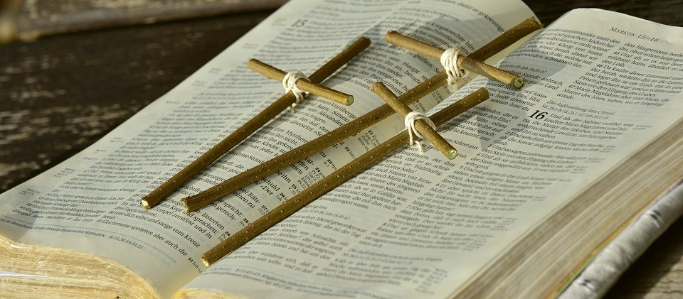
Why did Jesus Die on the Cross?
Jesus came to live on earth to show people how to live as God wants them to and to teach them about how much God loves them and how they could build God’s kingdom of justice, peace and love here on earth.
Some people became Jesus’ followers and listened to his teaching about loving and serving others, praying to God, helping those in need, speaking up when there is unfairness.
In Judea where Jesus lived the Jewish leaders felt Jesus was a threat to their authority when he broke unnecessary laws that were hard on people and spoke out against unjust taxes that made life very hard for people especially the poor.
Jesus knew what he was doing would get him into trouble with the chief priests and the Roman leaders. But he did not hide from them or stop teaching them about this.
R-2
S-07
Click the green arrow to move the curtain down, click the red arrow to move it up.
Notes:
Slide 7 Why did Jesus Die on the Cross?
Take time to read the statements yourself on Slides 7 before discussing them with the children. Use them to generate ideas to discuss and ask questions about.

Slide 8
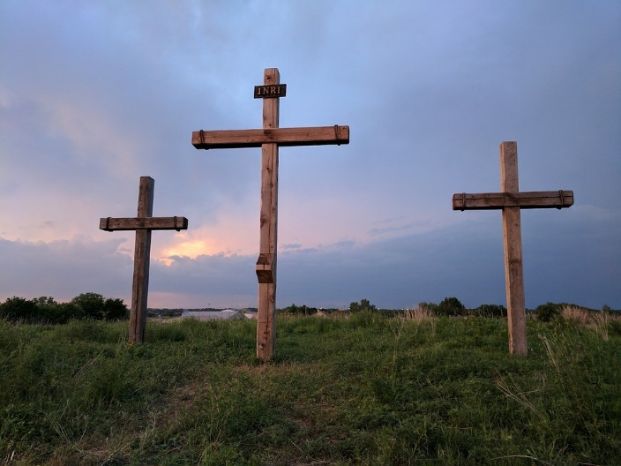
Jesus died to save all people from their sins, so they could have a new life
Jesus knew what was going to happen to him when he rode into Jerusalem on Palm Sunday. He knew the Jewish leaders were wanting to kill him and silence him forever.
He knew the Roman soldiers saw him as a trouble maker and they were waiting for an opportunity to get rid of him because he disturbed the peace.
The Jewish leaders decided they needed to silence Jesus as he was becoming very popular with the people wherever he went.
The people wanted to make him their king because he cared about them, he healed their sick and disabled people and forgave their sins so they could start to live in a new and happier way.
Jesus was prepared to face his death to save people, not just the ones in Judea that he knew and loved but all people in all places at all times and that is what he did. His death saved all people and gave them a new life.
Jesus died on the cross to make the weak powerful, to make the sinners holy, and to raise all people up to the dignity of being children of God.
R-2
S-08
Click the pins to reveal post-its.
Notes:
Slide 8 Jesus died to save all people from their sins, so they could have a new life
Children listen as each PIN is read and when they are finished invite them to talk to Jesus and thank him for giving his life so we can have a new life as sons and daughters of God.

Slide 9
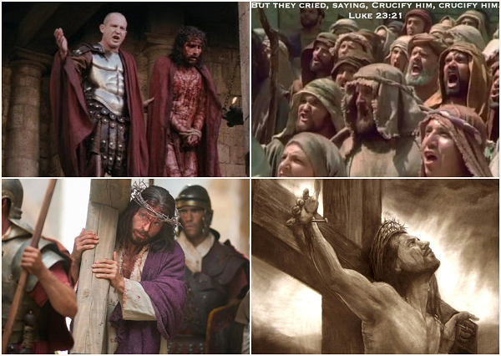
The Events of Good Friday are recorded in the Gospels
Read John 18:28 – 19:30
Trace Jesus’ journey to Calvary
Words to describe Jesus on the way…
The other people in the story are …
What are the most important incidents in the story?
R-2
S-09
Notes:
Slide 9 The Events of Good Friday are recorded in the Gospels
Adapt Teaching and Learning Experience 3,4,5 6,7
Read a suitable version of the story to the children. As they follow the story they can mark the places and write a few words to name what happened in each spot, for example Jesus is condemned, rejected, crucify him, carries the cross, Jesus dies. Use the starters to get children talking. Add words to the Map of Jerusalem worksheet already used in Slide 4.

Slide 10
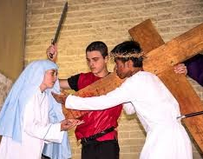
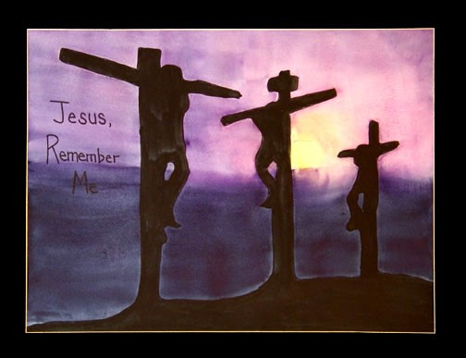
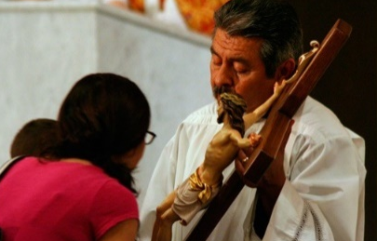
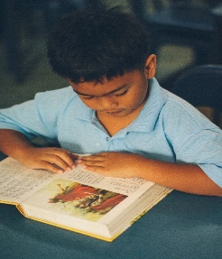
Christians remember the death of Jesus by …
R-2
S-10
Type ideas in white boxes
Notes:
Slide 10 Christians remember the death of Jesus by …
Invite children to share what people do on Good Friday to remember Jesus. They look closely at each picture and suggest statements that describe what the people are doing. Teacher records this in the type on box beside the image. Use words to start such as: recall the dramatisation of, listen to, venerate, participate in the liturgy, join in a procession to, read my bible and …

Slide 11
Check Up
1)
Name 5 things that happened to Jesus on Good Friday. (Slide 4, 5)
2)
Name 5 of the main people that are part of the Good Friday story and write a sentence saying what each person’s part was in the story. (Slide 6)
3)
Share your artwork from Slide 4 that tells the story of Good Friday with another child and pass on what you have learned about Good Friday.
4)
Why did Jesus die on the cross? (Slides 7, 8)
5)
Name 5 ways Christian people remember the death of Jesus on Good Friday. (Slide 10)
6)
Which activity do you think helped you to learn best in this resource?
7)
Questions I would like to ask about the topics in this resource are …
R-2
S-11
Click the boxes to reveal text.
Notes:
Slide 11 Check Up
This formative assessment strategy will help teachers to identify how well the children have achieved the Learning Intentions of the resource.
Teachers can choose how they use the slide in their range of assessment options.
A worksheet of this slide is available for children in Years 5-8 to complete.
The last two items are feed forward for the teacher.
Recording the children’s responses to these items is recommended as it will enable teachers to adjust their learning strategies for future resources and target the areas that need further attention.

Slide 12
Time for Reflection
R-2
S-12
Click the audio button to stop reflective music
Click the audio button to play reflective music
Notes:
Slide 12 Time for Reflection
The MP3 is played to help create a reflective atmosphere and bring the children to stillness and silence as the teacher invites them to reflect on what happened to Jesus on Good Friday. In their heart thank Jesus for dying on the cross that they and all people can become children of God and be with God forever after they die.

Slide 13
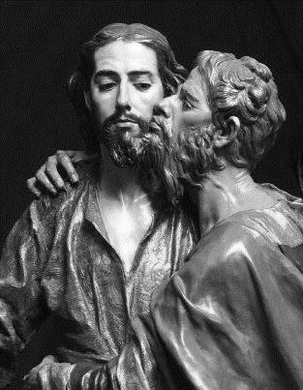
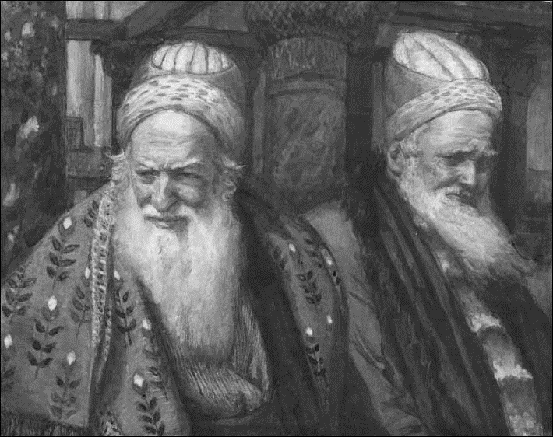
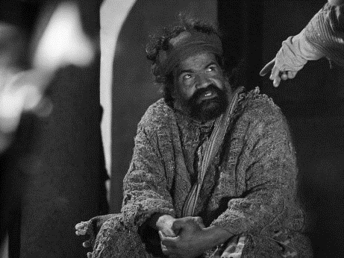
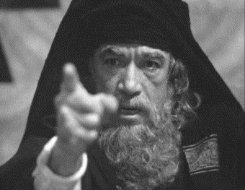
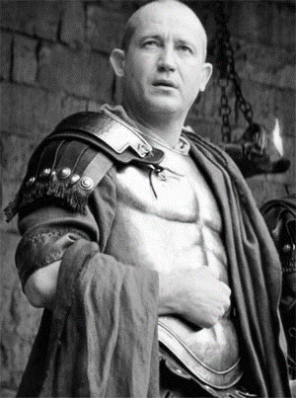
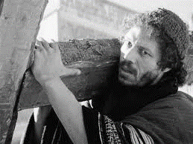
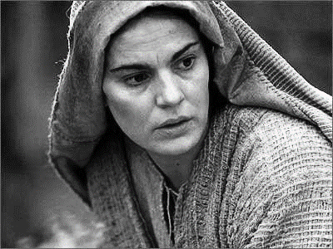
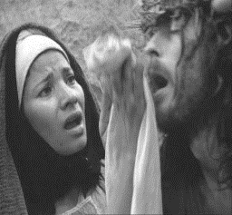
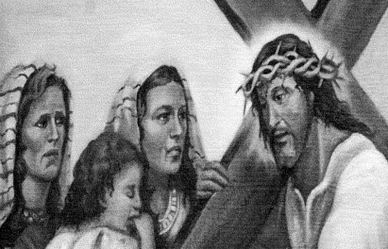
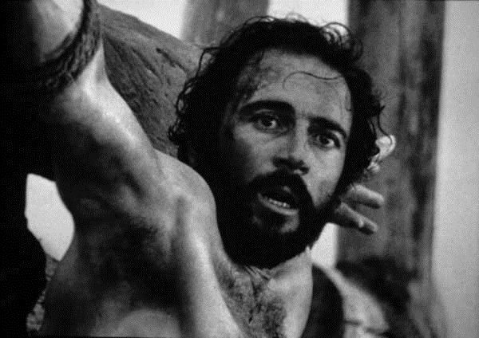
Who are you? – people Jesus met during his last day on earth
Name ________________________ Date ______
I betrayed Jesus with a kiss, my name is __________________
I questioned Jesus about his teaching, my name is____________
I denied Jesus 3 times, my name is _______________
I accused Jesus of blasphemy, my name is _______________
I handed Jesus over to be crucified, my name is _______________
I helped Jesus carry his cross, my name is _______________
I watched my Son die on the cross, my name is _______________
I wiped the blood-stained face of Jesus, my name is _______________
We wept for Jesus as he passed by carrying his cross, we are __________________
I hung on the cross beside Jesus and am now in heaven. I am __________________
Pilate
Judas
Veronica
Peter
Simon of Cyrene
Caiaphas
Mary, Mother of Jesus
Annas
the good thief
the women of Jerusalem
Worksheet
R-2
S-6
Click the up arrow to return to the presentation

