Slide 1
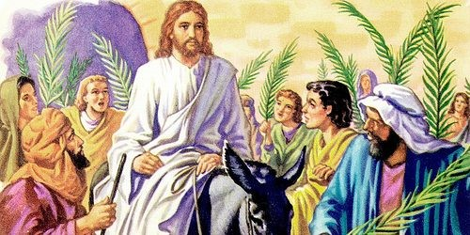
Palm Sunday – the first day of Holy Week
R-1
S-01
Notes:
Slide 1 Palm Sunday – the first day of Holy Week
Use this slide as a focussing strategy to introduce the resource topic. Read the title together and invite children to share something they know about what happened on Palm Sunday and how Palm Sunday is celebrated in their parish.

Slide 2
Learning Intentions
The children will:
demonstrate an understanding of Palm Sunday as an event in Holy Week
1)
recall the symbols and rituals which remind us of Jesus’ final entry into Jerusalem.
2)
R-1
S-02
Click the box to reveal the Learning Intention
Notes:
Slide 2 Learning Intentions
Read through the Learning Intentions with the class and identify some ideas/questions that might be explored in the resource.
Create a Palm Sunday prayer focus the week before Palm Sunday using suitable images and symbols. Add to these during Holy Week. Read the Holy Week bible stories during prayer time and let the children dramatise them and sing the songs they know related to them.
Give children some special ‘close to Jesus’ time of quiet. You may like to create a special quiet place for children to go to look at Holy Week books and symbols.
Look at the images on the slides and talk about each one with the children to give them a sense of what the events of Holy Week are about.
Explain that Easter Sunday is not really in Holy Week because it is the beginning of
the Easter Season. Mention that Good Friday and Easter Sunday are holidays and
children learn about them before they celebrate them. Encourage the children to
share what they are learning about Holy Week with their family by using the Sharing
our Learning worksheet (Slide 12, Resource 3). You may like to give the children a
copy of the parish bulletin and work through it with them marking the times of the
Easter ceremonies they could attend.

Slide 3
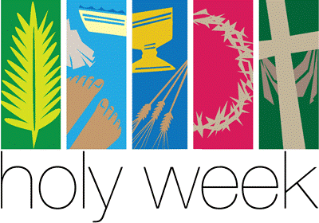
Holy Week is Jesus’ last week on earth
On Palm Sunday Jesus rode into Jerusalem on a donkey. The people welcomed him and waved palms and shouted, “Hosanna, Hosanna to the King”.
On Holy Thursday Jesus shared his last meal with his disciples. Before they sat down to eat Jesus washed their feet to show how much he cared for them.
At the meal Jesus blessed the bread and wine and he told them it was his body and blood and to eat and drink this and remember him.
On Good Friday Jesus died on the cross. He was buried that night in a tomb.
Click the small pictures to reveal text
R-1
S-03
Notes:
Slide 3 Holy Week is Jesus’ last week on earth
Look closely at the image and explain that Holy Week is the most important week in Jesus’ life and it is also the most important week for his followers to remember and celebrate. Children close their eyes and check if they say something that happened on each special day in Holy Week.

Slide 4
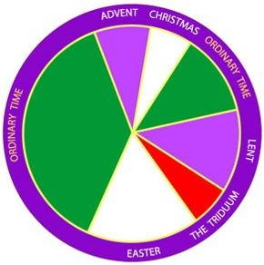
Holy Week is a special part of the Liturgical Year
There are very special days in Holy Week when we remember what happened to Jesus. Holy Week is the last week of Lent. Point to this in the Liturgical Calendar.
Name the special days in Holy Week and say the name of the season they come after and point to it.
Name the greatest season in the whole Liturgical Year, and say what it follows and point to it.
Easter is the greatest celebration because Jesus rose from the dead. What colour shows it is a celebration season and name and point to the other season we celebrate in this colour. Yellow is another colour used for celebrations seasons.
R-1
S-04
Press the button to advance the arrow
Notes:
Slide 4 Holy Week is a special part of the Liturgical Year
Adapt Teaching and Learning Experience 1.
Make a copy of the worksheet for each child to complete and add to their RE Journal to refer to throughout the year. Remind children that the Liturgical Year begins on the first Sunday of Advent and ends on the feast of Christ the King.

Slide 5
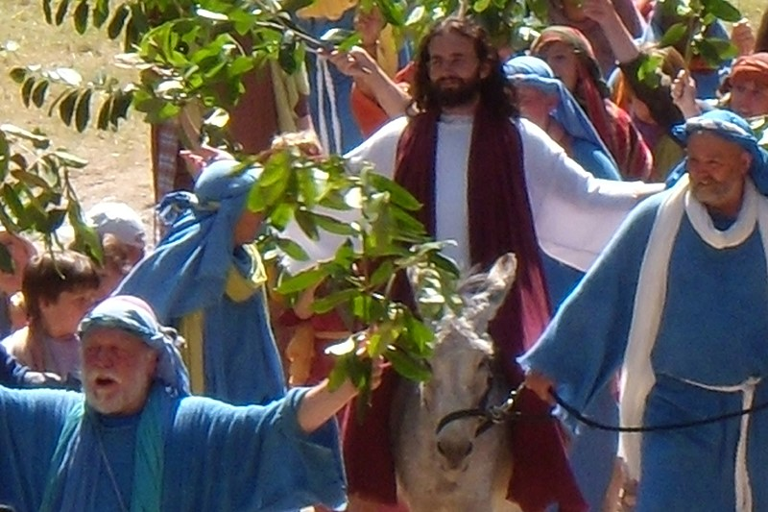
Our Journey through Holy Week begins with Palm Sunday
Jesus knew he was going to die. He knew the Jewish leaders did not like how he was living his life, teaching the people and curing the sick. They wanted to get rid of him.
Jesus knew he would have his last meal with his friends this week and he would teach them some important lessons because he would be leaving them.
He knew this was the week he would be put to death on a cross. He did this out of love for all people so that they could rise like him after death and live forever with God.
Jesus knew this would be the week he would make his last journey to Jerusalem and be welcomed by the people who wanted him to be their King.
Click the pins on the right to reveal post-it notes.
R-1
S-05
Click the video button to play ‘KING of GLORY - The King Enters Jerusalem’
Notes:
Slide 5 Our Journey through Holy Week begins with Palm Sunday
Read the post it notes with the children and use them to generate conversation about what was going to happen to Jesus and how he came to save us.
Adapt Teaching and Learning Experiences 2, 3.
Read the Palm Sunday story from the bible at morning prayer. (Mark 11:1-11)
Watch the clip
https://www.youtube.com/watch?v=IXaJ45-IVF8
KING of GLORY ~ Scene 56 of 70 ~ The King Enters Jerusalem
3:08 minutes
Teachers please preview this clip – you may want to stop it at 2:41 minutes.
Explain to children that palms were a sign of honour and the people waved them because they honoured Jesus and wanted him to be their king. Much of the land in Judea where Jesus lived was desert and it was very dry. Palm trees grew where there was water and that is why it was a special tree branch for the people to wave.

Slide 6
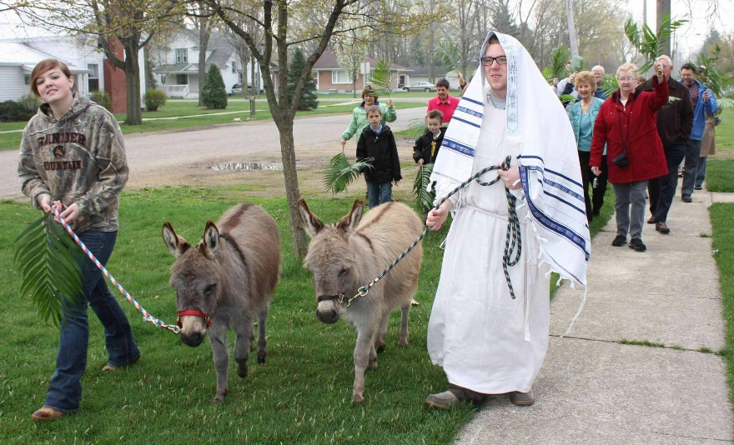
What do people who follow Jesus today do on Palm Sunday?
At Mass on Palm Sunday the priest blesses the palms
with holy water to make them holy symbols for the people.
Each person is given a blessed palm
to help them be part of the crowd welcoming Jesus to Jerusalem.
Some parishes act out the first Palm Sunday procession
with a donkey and people waving their palms.
The palm is a symbol to help us
stay close to Jesus and share his journey through Holy Week.
We take our palm home and keep it
to remind us that Holy Week is beginning.
with a donkey and people waving their palms.
to remind us that Holy Week is beginning.
with holy water to make them holy symbols for the people.
stay close to Jesus and share his journey through Holy Week.
to help them be part of the crowd welcoming Jesus to Jerusalem.
R-1
S-06
Click lower statements to complete the sentence correctly
Notes:
Slide 6 What do people who follow Jesus today do on Palm Sunday?
ANSWERS 1) C, 2) E, 3) A, 4) D, 5) B
Adapt Teaching and Learning Experience 4.
A basket of palms kept on the prayer table during Holy Week is useful to help children reflect on the Palm Sunday story. Bring the smell of the palms to the children’s attention as a reminder of this important week. Tell the children that these palms are kept and burnt to make the ashes for Ash Wednesday next year. Children share experiences they have had or have heard about of Palm Sunday processions in their parish.

Slide 7
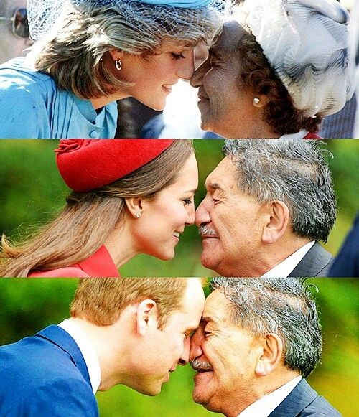
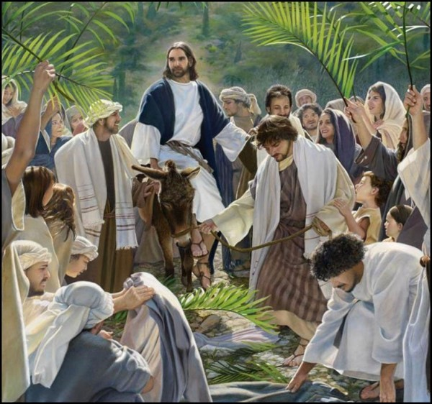
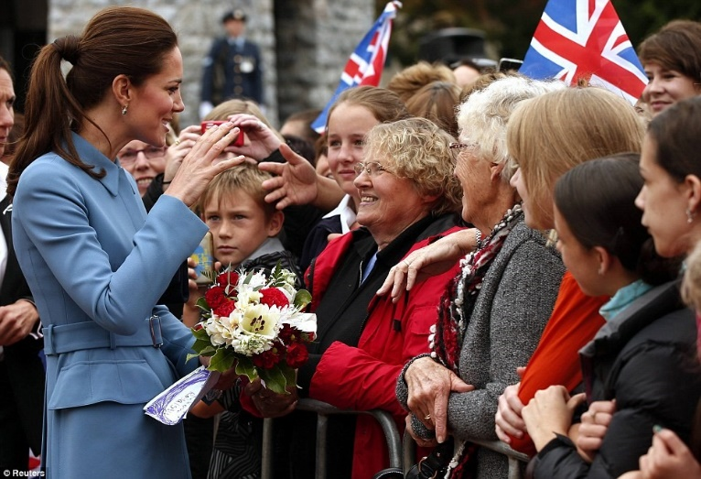
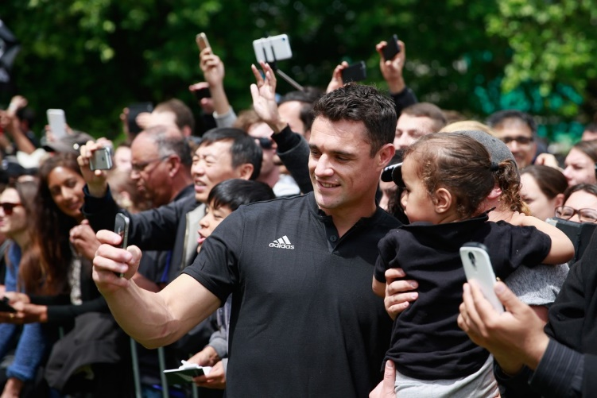
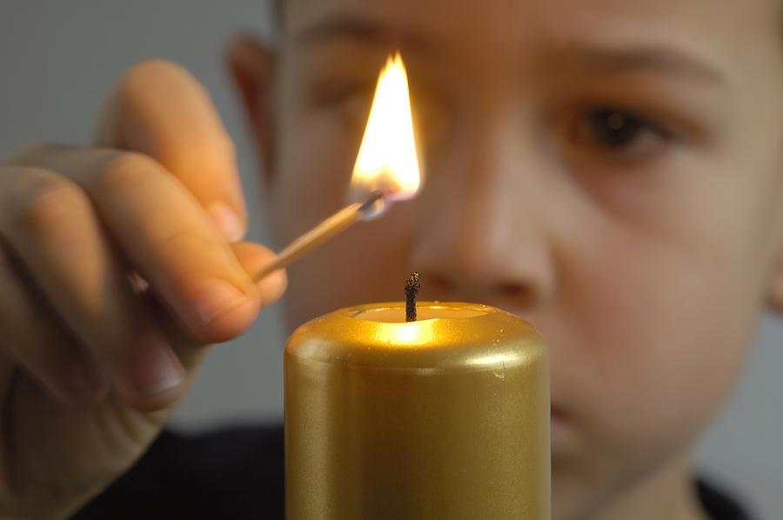
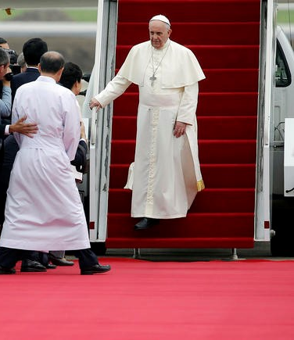
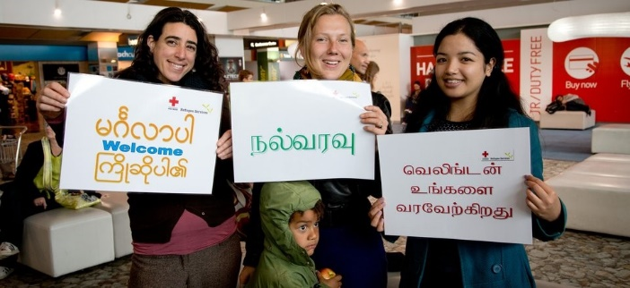
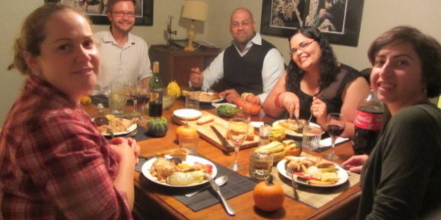
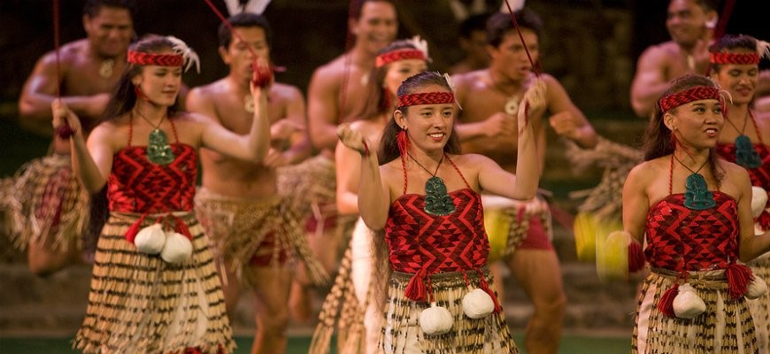
There are many different rituals used to welcome people
What special rituals and words did the people use to welcome Jesus on
Palm Sunday?
What rituals and words do we use on Palm Sunday?
9
We welcome famous people by waving flags, smiling, giving them flowers and telling them we are pleased they have come to visit us.
8
We have welcome parades for famous sports people and we take photos and selfies to remember the day we met them. We cheer for them and say,
“well done!”
7
A hongi is another Māori ritual to welcome people. When people hongi, they press their noses together and share the same breath to show the visitors they are welcome here.
6
Māori people sing and dance to welcome people to our country in their own special way. They say,
“Haere mai. Welcome to Aotearoa.”
5
We welcome refugees at the airport by smiling at them and displaying posters with words of welcome in their language.
4
At home we have special meals to welcome people.
We tell stories to each other. We share fun and laughter together.
3
We call the special things we do to welcome people ‘welcome rituals’.
For important people like Pope Francis a red carpet is rolled out.
We shake hands and say, “Welcome, you are very welcome, we are pleased you have come to see us.”
2
A ritual is a set way of doing things that is repeated over time. Families, schools, cultures and countries have rituals that help us to understand and celebrate the meaning of what is happening. Rituals can be made up of words, actions, songs or special objects.
1
R-1
S-07
Click the top card to discard it
Notes:
Slide 7 There are many different rituals used to welcome people
Use Flip Card 1 to explain to children what a ritual is and share examples. Work through the FC and encourage children to recall welcome rituals they have experienced or have seen on television. You may like to create a welcome ritual for your classroom.

Slide 8
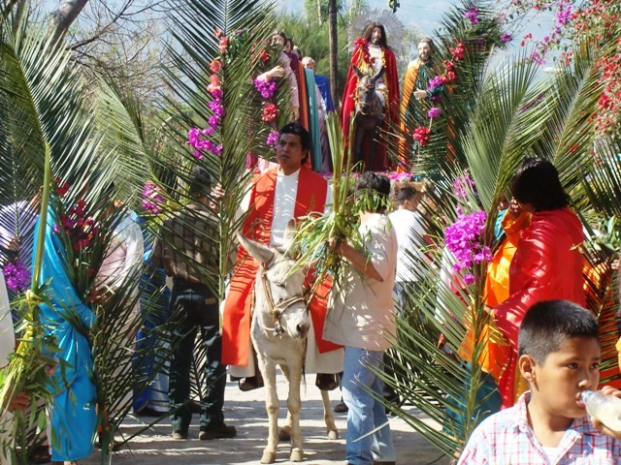
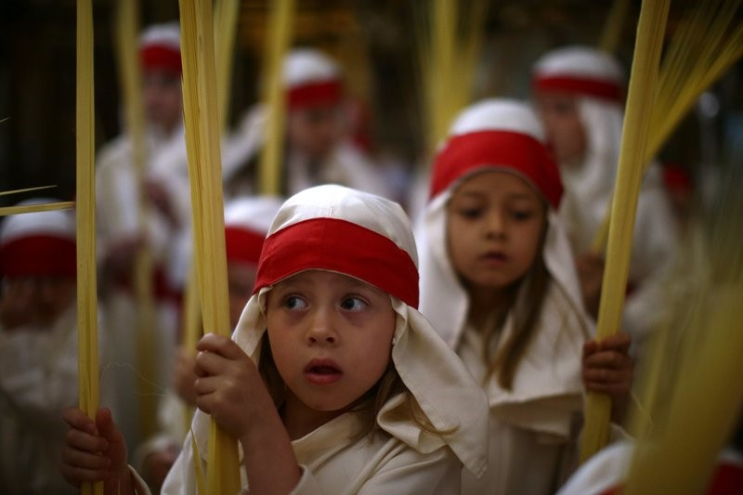
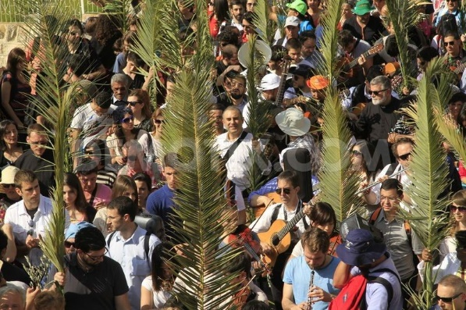
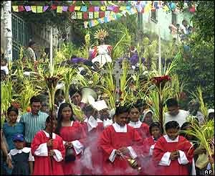
On Palm Sunday Christians all over the world repeat the welcome ritual Jesus received on the first Palm Sunday
Complete the sentences
The Palm Sunday ritual is …
The Palm Sunday symbol is …
The Palm Sunday word is …
Palm Sunday is the …
Make a mural of the Palm Sunday story with self- portraits of the children in the crowd. Display it where it can be seen by everyone.
Click the audio button to stop ‘Jesus is our King’
Click the audio button to play ‘Jesus is our King’
R-1
S-08
Notes:
Slide 8 On Palm Sunday Christians all over the world repeat the welcome ritual Jesus received on the first Palm Sunday
Adapt Teaching and Learning Experiences 5 & 6.
Explain to the children that people who follow Jesus celebrate Palm Sunday in different countries all over the world. Look closely at the images of the Palm Sunday processions and notice all the different types of palms the people have. You could dramatise the Palm Sunday story and photograph it to include in a Holy Week Power Point Presentation or use the mural idea on the slide.

Slide 9
Check up
1)
Retell the story of Palm Sunday to a partner.
2)
A ritual is something that people use to …
3)
A symbol is something that people use to …
4)
Draw a picture of yourself as part of a picture of a Palm Sunday procession with a caption to describe how you felt waving your palm to welcome Jesus.
5)
Which activity do you think helped you to learn best in this resource?
6)
Questions I would like to ask about the topics in this resource are …
R-1
S-09
Click the worksheet button to go to the worksheet
Notes:
Slide 9 Check Up
This formative assessment strategy will help teachers to identify how well children have achieved the Learning Intentions of the resource.
Teachers can choose how they use the slide to assess each item.
A worksheet of this slide is available as an option for children to complete.
The last two items are feed forward for the teacher.
Recording the children’s responses to these items is recommended as it will enable teachers to adjust their learning strategies for future resources and target the areas that need further attention.

Slide 10
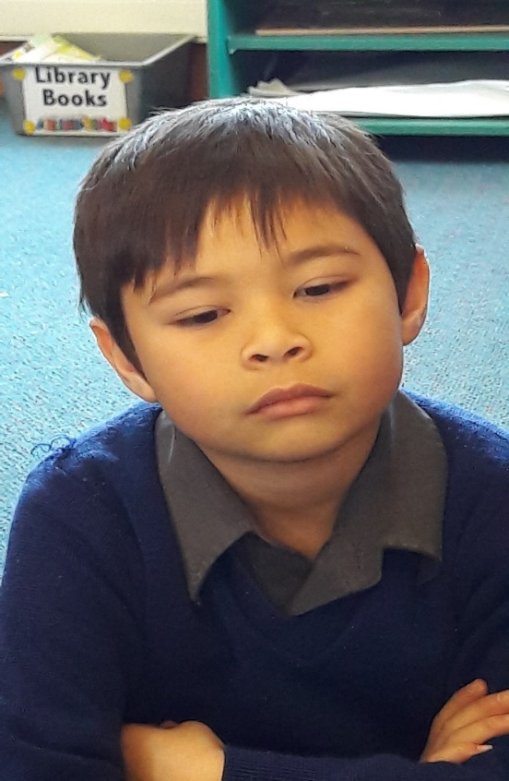
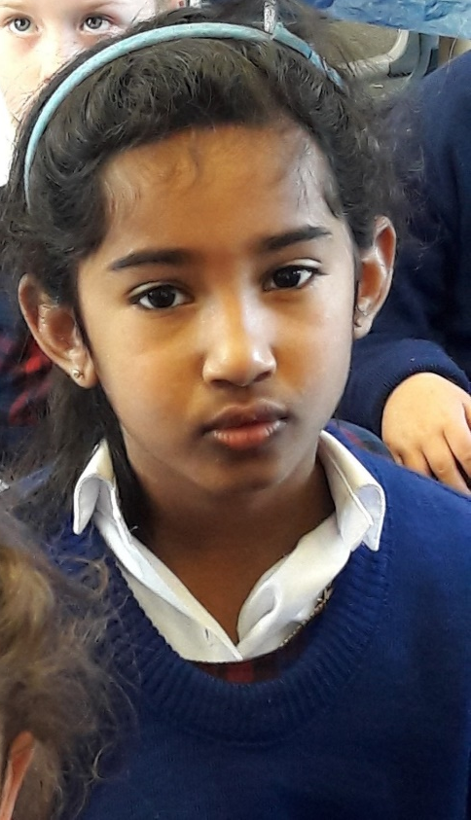
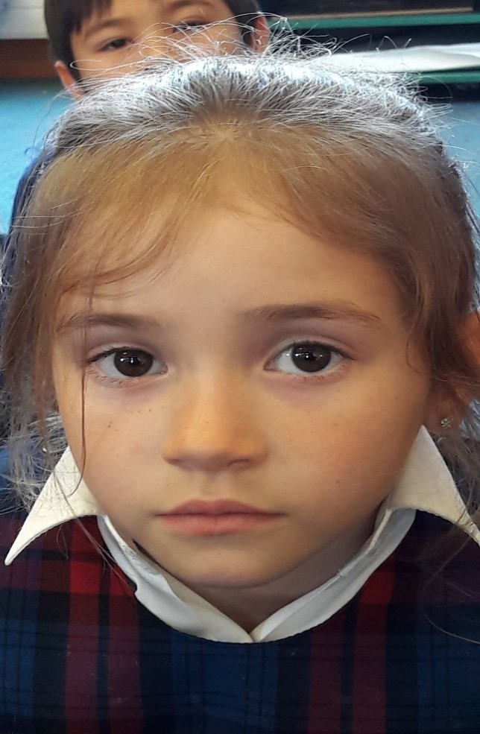
Time for Reflection
R-1
S-10
Click the audio button to stop reflective music
Click the audio button to play reflective music
Notes:
Slide 10 Time for Reflection
The MP3 is played to help create a reflective atmosphere and bring the children to stillness and silence as the teacher invites them to think about how they welcome people into their home, their game or their group. Are they kind and welcoming to new people in their class?

Slide 11
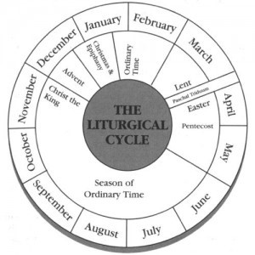
Holy Week is a special part of the Liturgical Year
Name:____________________________
Date:____________
Colour the seasons of your Liturgical Calendar
Colour Advent and Lent in purple or violet
Colour Christmas and Easter white or yellow
Colour Holy Week or the Paschal Triduum red
Colour the feast of Pentecost red
Colour the 2 Ordinary Times green
Colour Christ the King white or yellow.
R-1
S-04
Worksheet
Click the up arrow to return to the presentation

Slide 12
Check up
Name:____________________________
Date:____________
1) Retell the story of Palm Sunday to a partner.
2) A ritual is something that people use to …
3) A symbol is something that people use to …
4) Draw a picture of yourself as part of a picture of a Palm Sunday procession with a caption to describe how you felt waving your palm to welcome Jesus.
5) Which activity do you think helped you to learn best in this resource?
6) Questions I would like to ask about the topics in this resource are …
R-1
S-09
Worksheet
Click the up arrow to return to the presentation

