Slide 1
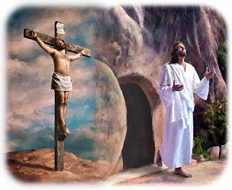
Sad Time - Glad Times
R-3
S-01
Notes:
Slide 1 Sad Time – Glad Times
Use this slide as a focussing strategy to introduce the resource topic. Read the title together and invite children to share something they know about the sad times in Holy Week and the glad time of Easter that follows.

Slide 2
Learning Intentions
The children will:
1)
identify the three days from Holy Thursday to Easter Sunday as the most important days for Jesus’ followers
2)
name ways that people can remember and celebrate the dying and rising of Jesus today.
R-3
S-02
Click the borders to reveal text
Notes:
Slide 2 Learning Intentions
Read through the Learning Intentions with the class and identify some ideas/questions that might be explored in the resource.
Adjust the prayer focus as Holy Week progresses. Include the Holy Week bible stories during prayer time and let the children dramatise them and sing the songs they know.
Give children some special ‘close to Jesus’ time of quiet. You may like to create a special quiet place for children to go to look at Holy Week books and symbols.
Look at the images on the slide and talk about each one with the children and what Holy Week event they are about.
Explain that Easter Sunday is not really in Holy Week because it is the beginning of the Easter Season. Mention that Good Friday and Easter Sunday are holidays so they learn about them before they celebrate them. Encourage the children to share what they are learning about Holy Week with their family. You may like to provide them with a copy of the parish bulletin with the times of the Easter ceremonies they could attend.

Slide 3
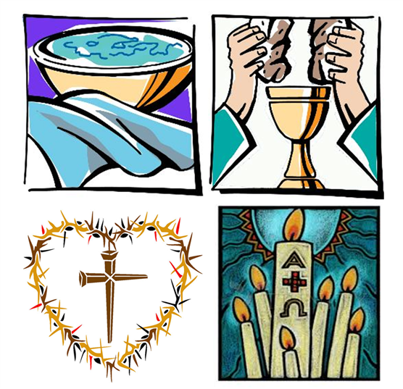
From Holy Thursday to Easter Sunday – the most important days of the year for those who follow Jesus
Holy Thursday – Jesus washes the disciples’ feet.
Holy Thursday – the Last Supper when Jesus shares his last meal on earth.
Good Friday – the day Jesus dies on the cross and is buried.
Easter Sunday – Jesus rises from the dead.
R-3
S-03
Click on the 4 different images to reveal the text.
Notes:
Slide 3 From Holy Thursday to Easter Sunday – the most important days of the year for those who follow Jesus Adapt Teaching and Learning Experience 1. Read the title and say the names of the days starting with Holy Thursday until Easter Sunday. Explain that we call this week Holy Week because this is the week that Jesus died and after 3 days in the tomb he rose again. Talk about what the symbols mean for each day.

Slide 4
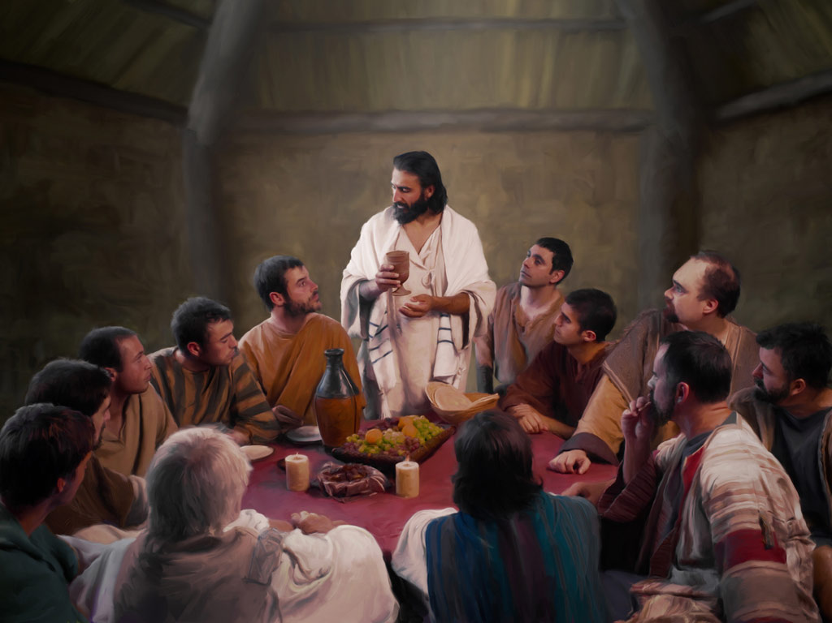
On Holy Thursday Jesus had his Last Supper on earth with his followers
At the table he took the bread and broke it and shared it with them. Jesus explained to them that the bread was his body and the wine was his blood and when they did this they would
remember him. Do you think this helped the followers of Jesus to remember him?
Jesus wanted to give his followers something to remember him by. He decided to use something they would eat and drink everyday so they would be reminded of him
every day.
What do you think
this was?
Jesus didn’t want the disciples to forget everything he had taught them. He wanted them to pass on to others all they had learned from him about loving and serving God and others.
What do you think he said to them?
Jesus had some last things he wanted to say to his friends because he knew the next day he would die on the cross. What do you think Jesus wanted to say to
his friends?
The meal they had was called the Last Supper and Jesus and his friends shared it in an upstairs room in a house
in Jerusalem. What do you think they had to eat and drink?
After Jesus had washed the feet of his friends the disciples and followers they had a meal together. Jesus told them he was going to die but he would come back in 3 days.
Do you think the disciples understood what Jesus was saying?
R-3
S-04
Click top card to discard it. Click the video button to play ‘The Last Supper’
Notes:
Slide 4 On Holy Thursday Jesus had his Last Supper on earth with his followers Explain that we find the stories about Jesus in the Bible and show them this story in John’s Gospel. Read the story together using the flip cards. Read each question and let children share their responses.
Watch the clip – it continues from the previous Resource 2
https://www.youtube.com/watch?v=vScHI_fxJGM
The Last Supper (3:49 MINUTES) – pause clip at 2:00 minutes after the washing of the feet.

Slide 5
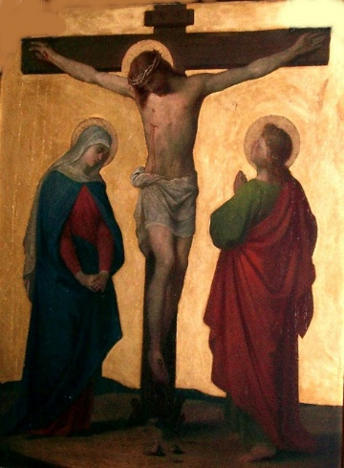
On Good Friday Jesus died on the Cross
Jesus fell 3 times on the way. He met his mother and the women who cried for him. The soldiers made fun of him and made Simon of Cyrene help Jesus carry the cross. When he reached the top of the hill they nailed him to the cross.
After the Last Supper Judas told the soldiers where Jesus was and he was arrested by the soldiers and taken before Pontius Pilate who was the governor.
After questioning Jesus Pilate handed him over to be crucified. The soldiers led Jesus away. They put a crown of thorns on his head, beat him and made him carry his cross up the hill
of Calvary.
Jesus was on the cross for 3 hours and then he died. The sky went dark and the earth shook when Jesus died. The people were terrified. They now believed Jesus truly was God’s Son. His body was taken from the cross, washed and placed in a tomb. But this isn’t the end of the story.
Click the pins on the right to reveal post-it notes.
Click the video button to play ‘Jesus is Nailed to the cross and dies’
R-3
S-05
Click the audio button to stop ‘Good Friday’.
Click the audio button to play ‘Good Friday’.
Notes:
Slide 5 On Good Friday Jesus died on the Cross
Read the PINs and talk about what happened to Jesus and
watch the clip “Jesus Is Nailed to the cross and dies.”
3:05 Minutes https://www.youtube.com/watch?v=KAwe9qNA9Fw
Adapt Teaching and Learning Experiences 2&3.
Explain that Jesus died on the cross to make up for all the selfish acts and mean words that people do and say that cause hurt to others. He died to show people how much he loves them and how much he loves God. He died to teach us to love one another as he loves us. Jesus always forgives people when they make mistakes and say sorry and ask to be forgiven. Include a simple prayer of sorrow in class prayer.
Sing the song “Good Friday” with the MP3.

Slide 6
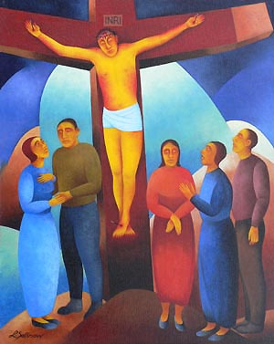
Good Friday was a very sad day for Jesus and his family but it
was a glad day for every person on earth
1. In Jesus’ day people were punished for doing
bad things by being hung on a cross to die.
2. Jesus did only good things and he died
to save us because he loves us so much.
3. Jesus died because his enemies did not like how
he was living and treating people with kindness and love.
4. Jesus’ death is not the end of his story because he showed
us on Easter Sunday that he is stronger than death when he rose.
5. Now Jesus lives in heaven and we carry on the way he
lived and when we die we too will be raised up like he was.
a) lived and when we die we too will be raised up like he was.
b) to save us because he loves us so much.
c) us on Easter Sunday that he is stronger than death when he rose.
d) bad things by being hung on a cross to die.
e) he was living and treating people with kindness and love.
R-3
S-06
Click a sentence ending from the white box to correctly position it.
Notes:
Slide 6 Good Friday was a very sad day for Jesus and his family but it was a glad day for every person on earth
Show the children where the story about Jesus dying on the cross is in the bible. Talk about how Mary his mother and all his friends would have been feeling when this happened. Read the sentences and choose one of the statements in the white box to complete it. Check it with the floater. Talk about the ideas in the sentences.
ANSWERS 1) d, 2) b, 3) e, 4) c, 5) a

Slide 7
After his death the friends of Jesus washed
his body and laid it in a tomb
ON GOOD FRIDAY - A rich man named Joseph took Jesus’ body, wrapped it in a clean
linen cloth and laid it in a new tomb that was hewn out of rock. He rolled a great stone
over the door of the tomb.
ON HOLY SATURDAY The chief priests asked Pilate to place a guard at the tomb in case Jesus’ disciples came to steal his body and trick people that he has risen as he said he would. Jesus’ friends were very sad and lost without him.
ON EASTER SUNDAY Mary Magdalene and the other Mary went to the tomb. Suddenly there was
a great earthquake and an angel in shining white clothes appeared. The guards shook with fear
and the angel spoke to the women
“Do not be afraid. Jesus is not here. He has been raised. Come and see where he was.” The women saw the empty tomb and left in fear and with great joy they ran to tell Jesus’ followers that Jesus had been raised from the dead and was now alive again. We call this JESUS’ RESURRECTION.
R-3
S-07
Click the down-button to move the blind down. Click the worksheet button to go to worksheet.
Notes:
Slide 7 After his death the friends of Jesus washed his body and laid it in a tomb Use the blind reveals to explain to the children what happened on each day after Jesus died. Read what happened on each day. Talk about how all the sadness of Jesus’ death turned to joy when he rose to life at his resurrection. Print a copy of the worksheet for children to complete the worksheet at home.

Slide 8
Holy Week is the most important week of the
year for all people who follow Jesus
I | S | W | E | E | K | G | B | R | A
M | A | H | A | N | D | D | E | O | L
P | T | O | U | S | F | V | C | S | L
O | F | O | L | L | O | W | A | E | F
R | M | N | Z | U | R | P | U | P | O
T | O | E | W | N | R | A | S | E | R
A | S | W | L | I | F | E | E | O | W
N | T | H | E | D | I | E | D | P | E
T | H | E | J | E | S | U | S | L | E
H | O | L | Y | E | A | R | H | E | K
Holy Week is the most important week of the year for all people who follow Jesus because he died for us and rose to a new life
R-3
S-08
Click the words in the sentence to reveal its position in the Word Find. Click the worksheet button to go to worksheet
Notes:
Slide 8 Holy Week is the most important week of the year for all people who follow Jesus Print a copy of the Word Find worksheet for children to complete and add to their RE Leaning Journal. These can be checked on the screen. Children find each word in the sentence below on the matrix and highlight it in the sentence and in the Word Find. When completed ask the children to identify the stories of Holy Week using the symbols in the image.

Slide 9
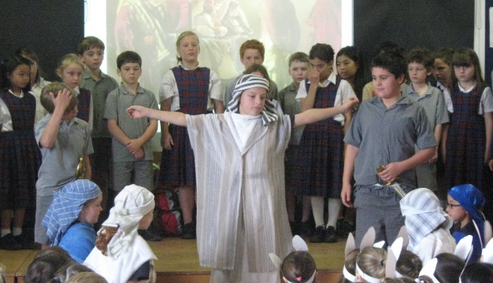
Celebrating the dying and rising of Jesus
We can celebrate Jesus’ death and resurrection
In our school
In our parish
At home with our family
R-3
S-09
Click in a white box to type
Notes:
Slide 9 Celebrating the dying and rising of Jesus
Discuss what is going on in the image. Children think of examples for teacher to type on each box. Teacher types children ideas in lists under the headings on the white space. Explain that because we are followers of Jesus we learn about his life and his teaching and how he treated people with love and kindness. He wants us to live like he did.

Slide 10
Check Up
1)
Name the days in Holy Week starting with Holy Thursday.
2)
Say what happened on Holy Thursday, Good Friday and Easter Sunday.
3)
Give 2 reasons why these days are so important for Christian people who follow Jesus.
4)
What could you use to remind you of how much Jesus loves you?
5)
Which activity do you think helped you to learn best in this resource?
6)
Questions I would like to ask about the topics in this resource are …
R-3
S-10
Click the borders to reveal text
Notes:
Slide 10 Check Up
This formative assessment strategy will help teachers to identify how well children have achieved the Learning Intentions of the resource.
Teachers can choose how they use the slide in their range of assessment options.
A worksheet of this slide is available for children in Years 5-8 to complete.
The last two items are feed forward for the teacher.
Recording the children’s responses to these items is recommended as it will enable teachers to adjust their learning strategies for future resources and target the areas that need further attention.

Slide 11
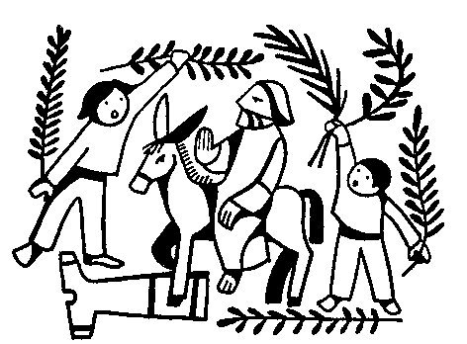
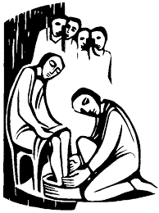
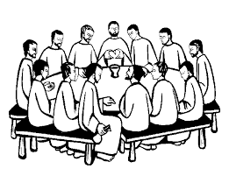
Sharing our Learning about HOLY WEEK with family whānau
Make a poster or a comic strip to help you explain the days of Holy Week and what happens on each day. Share it with your family whānau and display it on your family notice board.
Talk about how your family welcomes people to your home. Share the story about how Jesus was welcomed into Jerusalem on Palm Sunday. Recall some different ways people welcome others.
Make up a play about the Last Supper and act it out for people at home. You could use the bible stories to help you with the play. Prepare what you will need for the play and what actions and words will be used. Remember to include Jesus’ message about caring for others.
Have a conversation with someone who knows about Holy Week and share what you know. Plan to have a Last Supper meal together and talk about Jesus’ Last Supper with his disciples.
Make up your own way of showing and sharing what you have learned and decide who you would like to share it with.
R-3
S-11
Click the worksheet button to go to the worksheet.
Notes:
Slide 11 Sharing our Learning about HOLY WEEK with family whānau
This slide provides some choices for children to show and share what they have learned. Examples could be photographed as evidence of children’s learning.
You may like to put a copy of the Sharing our Learning page in children’s RE Learning Journals. You could talk through the choices using the slide and let children make their choice from their own copy.
Children could work on their choice at school and/or at home and you may like to set a day for sharing. Please let parents and whānau know what you expect them to do with this.
The slide is focussed on Achievement Objective for Year 2 Holy Week which is covered in Resources 1, 2, 3.
Year AO) Children will be able to: recognise that the historic events of Holy Week relate to people’s lives today.

Slide 12
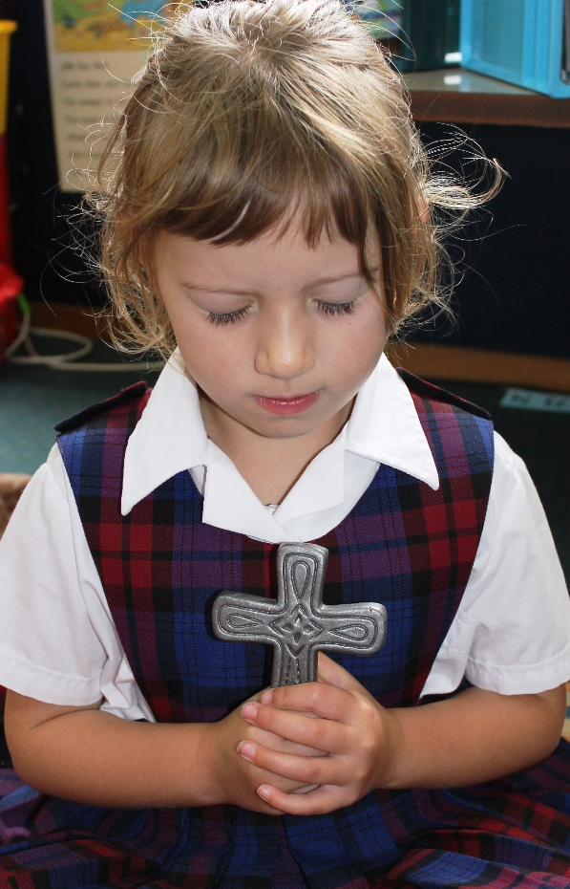
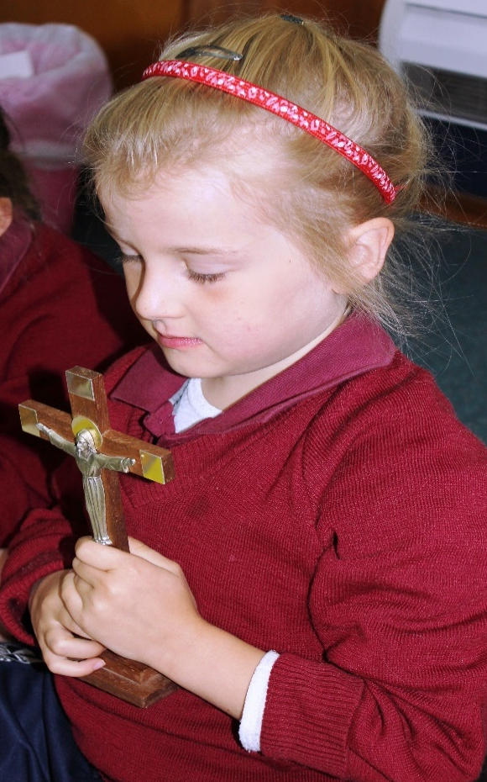
Time for Reflection
R-3
S-12
Click the audio button to stop reflective music
Click the audio button to play reflective music
Notes:
Slide 12 Time for Reflection
The MP3 is played to help create a reflective atmosphere and bring the children to stillness and silence as the teacher invites them to tell Jesus they are sorry for the times they forget to love others and tell him they will keep trying harder to be a kind and loving person as he was.

Slide 13
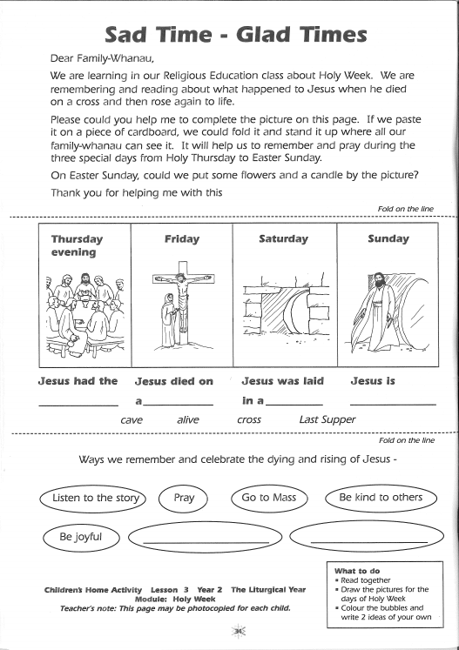
R-3
S-07
Worksheet
Click the up arrow to return to the lesson
Notes:
Slide 7 Sad Time – Glad Times WORKSHEET
This worksheet relates to slide 7.
Print a copy of the Sad Time - Glad Times worksheet from RE book for each child to complete and add to their RE Learning Journal.

Slide 14
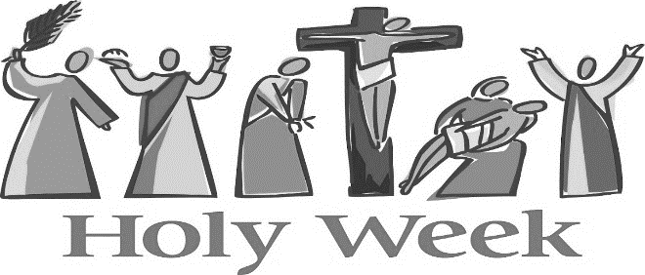
Holy Week is the most important week of the
year for all people who follow Jesus
I | S | W | E | E | K | G | B | R | A
M | A | H | A | N | D | D | E | O | L
P | T | O | U | S | F | V | C | S | L
O | F | O | L | L | O | W | A | E | F
R | M | N | Z | U | R | P | U | P | O
T | O | E | W | N | R | A | S | E | R
A | S | W | L | I | F | E | E | O | W
N | T | H | E | D | I | E | D | P | E
T | H | E | J | E | S | U | S | L | E
H | O | L | Y | E | A | R | H | E | K
Holy Week is the most important week of the year for all people who follow Jesus because he died for us and rose to a new life
R-3
S-08
Worksheet
Click the up arrow to return to the lesson
Notes:
Slide 8 Holy Week is the most important week of the year for all people who follow Jesus WORKSHEET
This worksheet relates to slide 8.
Ask the children to identify the stories of Holy Week using the symbols in the image.
Children find each word in the sentence below on the matrix and highlight it in the sentence and in the Word Find.

Slide 15
Sharing our Learning about HOLY WEEK with family whānau
Make a poster or a comic strip to help you explain the days of Holy Week and what happens on each day. Share it with your family whānau and display it on your family notice board.
Talk about how your family welcomes people to your home. Share the story about how Jesus was welcomed into Jerusalem on Palm Sunday. Recall some different ways people welcome others.
Make up a play about the Last Supper and act it out for people at home. You could use the bible stories to help you with the play. Prepare what you will need for the play and what actions and words will be used. Remember to include Jesus’ message about caring for others.
Have a conversation with someone who knows about Holy Week and share what you know. Plan to have a Last Supper meal together and talk about Jesus’ Last Supper with his disciples.
Make up your own way of showing and sharing what you have learned and decide who you would like to share it with.
R-3
S-11
Worksheet
Click the up arrow to return to the lesson
Notes:
Slide 11 Sharing our Learning about HOLY WEEK with family whanau WORKSHEET
This worksheet relates to slide 11.
This slide provides some choices for children to show and share what they have learned. Examples could be photographed as evidence of children’s learning.
You may like to put a copy of the Sharing our Learning page in children’s RE Learning Journals. You could talk through the choices using the slide and let children make their choice from their own copy.
Children could work on their choice at school and/or at home and you may like to set a day for sharing. Please let parents and whānau know what you expect them to do with this.
The slide is focussed on Achievement Objective for Year 2 Holy Week which is covered in Resources 1, 2, 3.
Year AO) Children will be able to: recognise that the historic events of Holy Week relate to people’s lives today.

