Slide 1
Holy Week is a Holy Time
R-1
S-01
Notes:
Slide 1 Holy Week is a Holy Time
Use this slide as a focussing strategy to introduce the resource topic. Read the title together and invite children to share something they know about Holy Week.
Create a Palm Sunday prayer focus the week before Palm Sunday using suitable images and symbols. Add a towel and a bowl, a cup and a bread roll and a cross and other symbols during Holy Week. Read the Holy Week bible stories during prayer time and let the children dramatise them and sing the songs they know related to them.
Give children some special ‘close to Jesus’ quiet times. You may like to create a special quiet place for children to go to look at Holy Week books and symbols.
Take time to look at the images on the slides and talk about each one with the children to give them a sense of what the events of Holy Week are about.
Explain that Easter Sunday is not really in Holy Week because it is the beginning of the Easter Season. Mention that Good Friday and Easter Sunday are holidays so children learn about them before they celebrate them. Encourage the children to share what they are learning about Holy Week with their family by using the Sharing our Learning worksheet (Slide 12, in Resource 3). You may like to give the children a copy of the parish bulletin and work through it with them marking the times of the Easter ceremonies they could attend.

Slide 2
Learning Intentions
The children will:
1)
recognise Holy Week as a time to be very close to Jesus
2)
recall the story of the first day of Holy Week, Palm Sunday
3)
name ways that people can welcome Jesus and others
this Holy Week.
R-1
S-02
Click the borders to reveal text
Notes:
Slide 2 Learning Intentions Read through the Learning Intentions with the class and identify some ideas/questions that might be explored in the resource.

Slide 3
What is Holy Week?
Holy Week is the last week of Lent and it leads
up to the great celebration of Easter.
Some of the most important things that
Jesus did happened in Holy Week.
Holy Week is a very special week in the year
for all the followers to be close to Jesus.
We follow Jesus so we remember what happened to
him in Holy Week and we celebrate what he did for us.
We listen to the Holy Week stories about Jesus, we sing songs about him and we thank him for loving us so much.
R-1
S-03
Click each picture to reveal answers
Notes:
Slide 3 What is Holy Week? Find Holy Week on the Liturgical Calendar. Talk about when it occurs in the year and what seasons come before and after it. Read through each item as it appears and use it as a starter to lead into a discussion on Holy Week. Note the coloured text and talk about what the colour means.

Slide 4
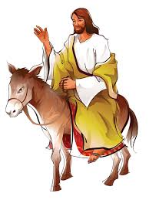
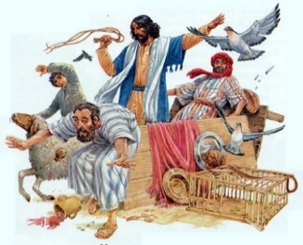
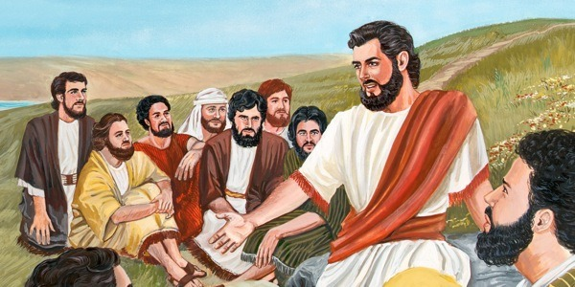
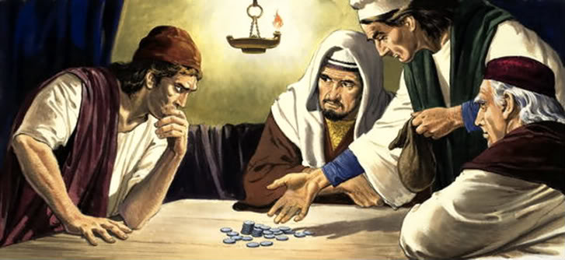
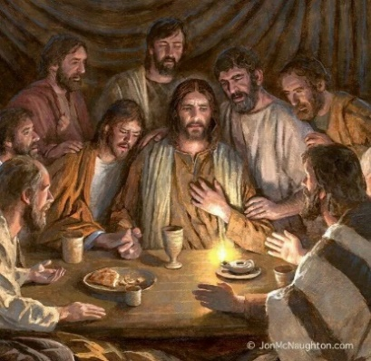
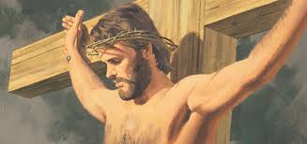
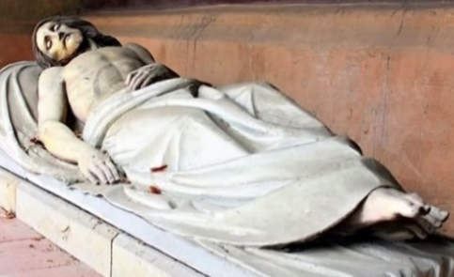
The Stories of Holy Week – match them with their pictures
Sunday is Palm Sunday when Jesus rode
into Jerusalem.
1
2
3
Monday is the day Jesus drove the money changers out of the Temple.
Tuesday is the day Jesus was doing the last
of his teaching with the people.
4
5
Wednesday is Spy Wednesday when Judas planned to hand Jesus over to the soldiers.
Thursday is Holy Thursday when Jesus and the disciples gathered for his Last Supper.
6
7
Friday is Good Friday the day Jesus died
on his cross.
Saturday is Holy Saturday when Jesus
lay dead in his tomb.
R-1
S-04
Click the panels in sequence to reveal the image and text.
Notes:
Slide 4 The Stories of Holy Week Adapt Teaching and Learning Experience 2. Children name any Holy Week stories they know. Discuss each one as they appear. Use the stories in class prayer this week and encourage children to create art works around them.

Slide 5
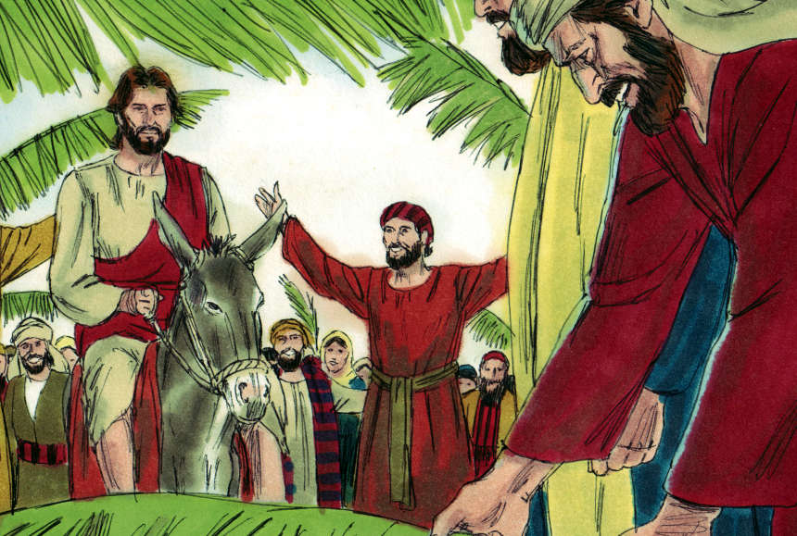
The first day of Holy Week is Palm Sunday
Who do you know in the picture?
Jesus and the people who followed him.
What is happening?
Jesus is being welcomed into Jerusalem.
What are the people doing and saying?
They are waving palms and shouting
“Welcome Jesus, welcome to the king!”
What do we call this day?
We call this day Palm Sunday.
This day is the first day of what special week?
Palm Sunday is the first day of Holy Week
R-1
S-05
Click each palm to reveal answers
Notes:
Slide 5 The first day of Holy Week is Palm Sunday Adapt Teaching and Learning Experience 3. Let children answer each question and check it with a click.

Slide 6
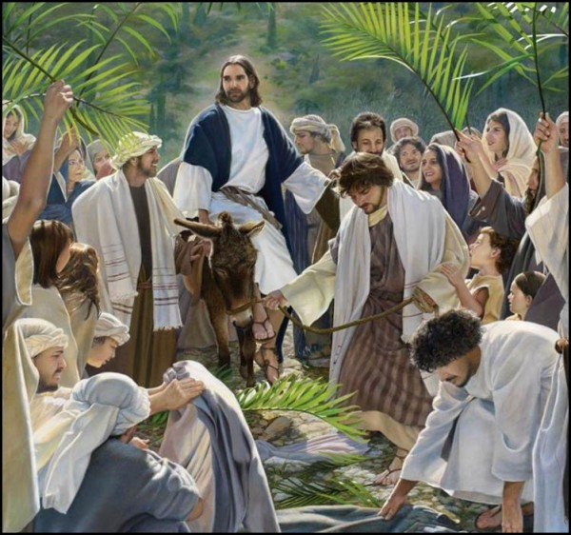
The Story of Palm Sunday in the Bible
Read the story of Palm Sunday
R-1
S-06
Click the video button to play ‘Hosanna Palm Sunday’. Click worksheet button to go to worksheet.
Notes:
Slide 6 The Story of Palm Sunday in the Bible
Adapt Teaching and Learning Experience 2. Read the story of the Palm Sunday Matthew 21:1-11 using a suitable text then watch the clip ‘Hosanna Palm Sunday’
https://www.youtube.com/watch?v=pMKNbLd0dfg
SUGGESTION Teachers Preview clip.
Hosanna Palm Sunday - includes a flash back to the feeding of the 5,000
4:41 Minutes. Recap the story after viewing the clip with the children.
Children need to complete the worksheet for this slide and add it to their RE Learning Journal to be used as part of Assessment item 2. (Slide 11, Check Up)

Slide 7
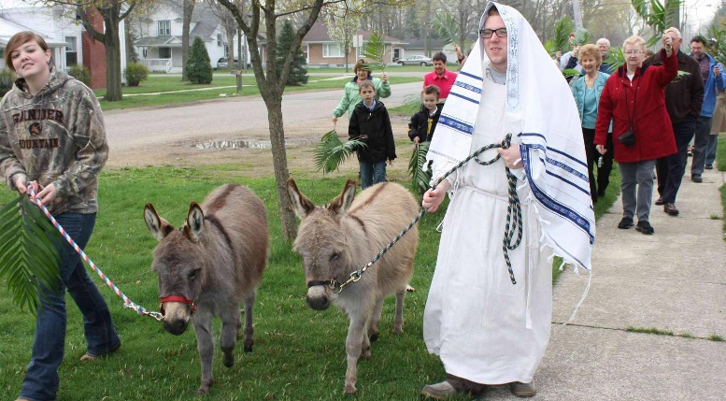
How we celebrate Palm Sunday in our Parish Community
Some parishes bless the baskets of palms outside the church before Mass starts and the people process into the church singing Palm Sunday hymns. The people listen to the gospel which tells the Palm Sunday story.
They walk around the streets near their church and shout, “Hosanna to the King. Welcome, Jesus our King.” as they walk along.
Some parishes have a Palm Sunday procession. The people follow Jesus and the donkey and they wave their palms.
They sing hymns and wave their palms. They remember the story of the first Palm Sunday when Jesus came into Jerusalem.
People take their blessed palms home and keep them for the year. Leftover palms will be burned and the ashes used for the crosses people will wear on their foreheads on next Ash Wednesday.
R-1
S-07
Click the pins on the right to reveal post-it notes.
Notes:
Slide 7 How we celebrate Palm Sunday in our Parish Community Read the post it notes and question the children about what happens in their parish on Palm Sunday.

Slide 8
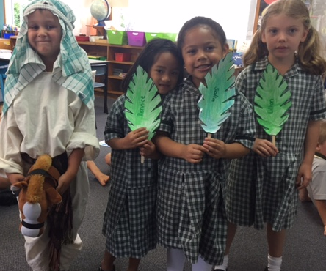
How we celebrate Palm Sunday in our school
1.
In our school we celebrate Palm Sunday
by reading the story from the bible.
2.
We make palms and talk about why the people waved
palms and shouted ‘Hosanna’
to welcome Jesus.
3.
We make a play about what happened on Palm Sunday
and we can wave our palms
like the people in Jerusalem did.
4.
We can talk to Jesus in our hearts and tell him
that we love him and want to follow him.
5.
We can make people welcome when
they visit our home and our classroom.
A) and we can wave our palms like the people in Jerusalem did.
B) that we love him and want to follow him.
C) by reading the story from the bible.
D) they visit our home and our classroom.
E) palms and shouted ‘Hosanna’ to welcome Jesus.
R-1
S-08
Click a sentence ending from the list to correctly complete sentences.
Click the audio button to stop ‘Come into the streets with me’
Click the audio button to play ‘Come into the streets with me’
Notes:
Slide 8 How we celebrate Palm Sunday in our school Adapt Teaching and Learning Experiences 3 & 4. Children share the ways they celebrate Palm Sunday in their school. Explain how acting out the story helps people to be part of the story as if it were really happening and that is why we do this at school and in our parish. Sing “Come into the streets with me”.
ANSWERS 1) C, 2) E, 3) A, 4) B, 5) D

Slide 9
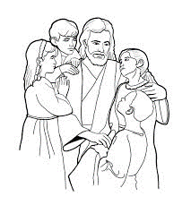
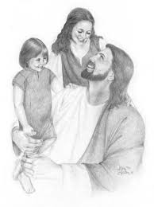
Holy Week is a holy time – what does ‘holy’ mean?
T | O | C | A | I | L | W | K | E | M
R | T | L | N | N | I | E | I | S | E
G | O | O | D | N | S | E | N | P | A
W | A | S | J | P | T | K | D | E | N
I | H | E | E | R | E | H | B | C | S
A | K | W | S | A | N | O | E | I | J
A | L | A | U | Y | I | L | I | A | E
N | I | N | S | I | N | Y | N | L | S
D | K | D | G | N | G | W | G | L | U
B | E | I | N | G | H | O | L | Y | S
Holy means being close to Jesus, being good and kind like he was, and praying and listening to
Jesus especially
in Holy Week.
R-1
S-09
Click the words in the sentence to reveal its position in the Word Find. Click the worksheet button to go to worksheet
Notes:
Slide 9 Holy Week is a holy time – what does ‘holy’ mean? Find each word in the sentence below on the matrix and highlight it in the sentence and in the Word Find. Read the sentence and talk about it. Add the Word Find to your RE Learning Journal.

Slide 10
We welcome Jesus into our hearts in Holy Week when we …
-are helpful and show kindness to everyone because that’s what he did!
-listen to Jesus when he talks to us just like he listens when we talk to him.
-share stories about what Jesus did just as he liked to share stories.
-welcome people when we meet them and include them just as Jesus did.
-become loving friends with Jesus because that is what he wants us to do.
-follow Jesus and treat people with love because that is how
we become his followers.
R-1
S-10
Click the down-button to move the blind down.
Notes:
Slide 10 We welcome Jesus into our hearts in Holy Week when we … Adapt Teaching and Learning Experience 5. Read each way we welcome Jesus into our hearts in Holy Week. Encourage children to think of more examples from their own experience. Explain to them that using the examples on the slide will help them to grow closer to Jesus especially in Holy Week.

Slide 11
Check Up
1)
Holy Week is a special week because … (Slides 3&4)
2)
Use your worksheet from Slide 6 tell a partner the story of Palm Sunday.
3)
Demonstrate 2 ways you can make people feel welcome.
4)
Explain what ‘holy’ means and how children can become holy in Holy Week. (Slide 8)
5)
Share ways your school and your parish celebrate Palm Sunday.(Slides 6 & 7)
6)
What days can you name in Holy Week? ( Slides 1, 3&4)
7)
Which activity do you think helped you to learn best in this resource?
8)
Questions I would like to ask about the topics in this resource are …
R-1
S-11
Click the borders to reveal text
Notes:
Slide 11 Check Up
This formative assessment strategy will help teachers to identify how well children have achieved the Learning Intentions of the resource.
Teachers can choose how they use the slide in their range of assessment options.
A worksheet of this slide is available for children in Years 5-8 to complete.
The last two items are feed forward for the teacher. Note the Slide references will enable you to return to them and re-teach them if necessary.
Recording the children’s responses to these items is recommended as it will enable teachers to adjust their learning strategies for future resources and target the areas that need further attention.

Slide 12
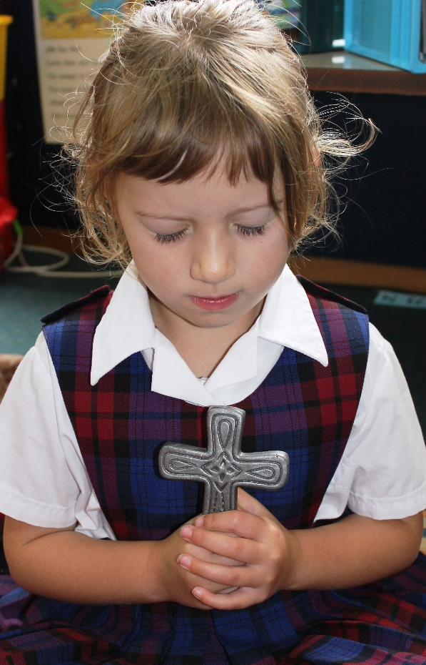
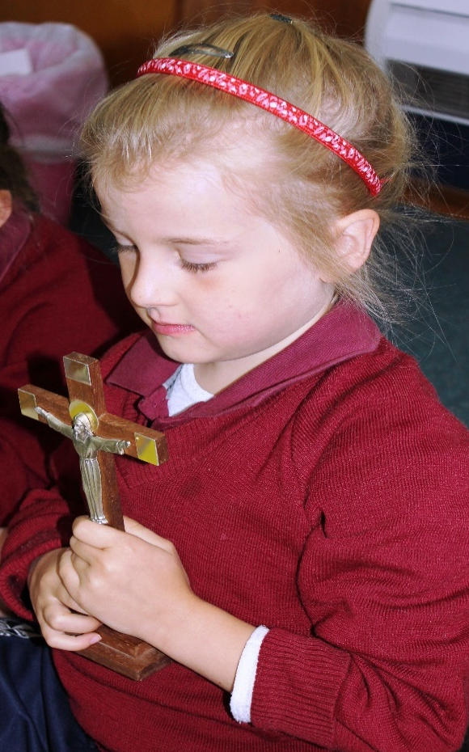
Time for Reflection
R-1
S-12
Click audio button to play reflective music
Notes:
Slide 12 Time for Reflection MP3 is played to help create a reflective atmosphere and bring the children to stillness and silence as the teacher invites them to think about how they can be close to Jesus during Holy Week and spend some quiet time talking to him when they go to bed. They can tell him they love him, and want to be his friend.

Slide 13
The Story of Palm Sunday
Name__________­­­­­­ Date _________
1) The disciples brought Jesus the donkey to ride.
2) Jesus rode the donkey into the
city of Jerusalem.
3) Many people waved palm branches and shouted ‘Hosanna’ to welcome Jesus.
4) They wanted Jesus to be their king because they knew he would care for them.
R-1
S-06
Worksheet
Click the up arrow to return to the resource
Notes:
Children need to complete this worksheet and put it in their RE Learning Journal to be used as part of Assessment item 2 (Slide 11, Check up)

Slide 14
Holy Week is a holy time – what does ‘holy’ mean?
T | O | C | A | I | L | W | K | E | M
R | T | L | N | N | I | E | I | S | E
G | O | O | D | N | S | E | N | P | A
W | A | S | J | P | T | K | D | E | N
I | H | E | E | R | E | H | B | C | S
A | K | W | S | A | N | O | E | I | J
A | L | A | U | Y | I | L | I | A | E
N | I | N | S | I | N | Y | N | L | S
D | K | D | G | N | G | W | G | L | U
B | E | I | N | G | H | O | L | Y | S
Holy means being close to Jesus, being good and kind like he was, and praying and listening to
Jesus especially
in Holy Week.
R-1
S-09
Worksheet
Click the up arrow to return to the lesson

