Slide 1
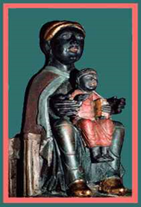
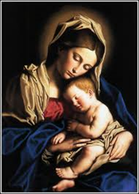
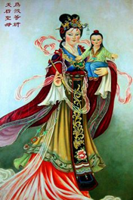
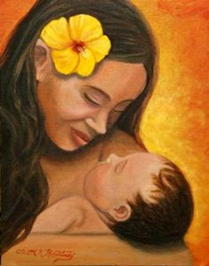
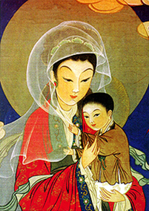
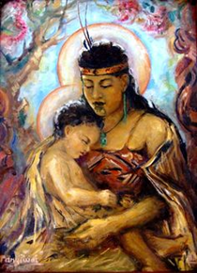
The Feast of Mary, Mother of God Maria te Whaea o te Atua - January 1
Collage image of Mary and Jesus portrayed in other cultures
L-2
S-01
Notes:
Slide 1 The Feast of Mary, Mother of God Maria te Whaea o te Atua – January 1
Use this slide as a focussing strategy to introduce the lesson topic. Read the title together and invite students to share something they know about 2 more feasts in the Christmas season- Mary, Mother of God and the feast of the Holy Family.

Slide 2
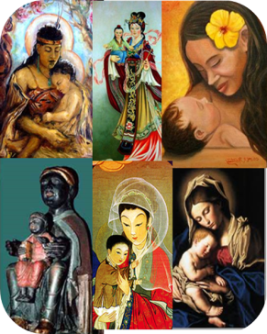
Learning Intentions
The students will:
1)
identify events recorded in the Scriptures about the Holy Family
2)
explain why Mary is called the Mother of God te Whaea o Te Atua
L-2
S-02
Click the borders to reveal text
Notes:
Slide 2 Learning Outcomes
Read through the Learning Intentions with the class and identify some ideas/questions that might be explored in the lesson.

Slide 3
The Feast of Mary, Mother of God Maria te Whaea o te Atua - January 1
In the year 431 the Church officially gave Mary the title Mother of God Te whaea of te Atua.
Around the year 300 the Greek Church called Mary, Theotokus – Theo means God and kotus means bearer, so Theotokus means Mary is the God Bearer.
This comes from the Christian belief that Jesus is God.
The title Mother of God only makes sense if it is thought about in terms of Jesus.
The feast of Mary the Mother of God honours Mary as the mother of Jesus.
The feast of Mary the Mother of God honours Mary as the mother of Jesus.
The title Mother of God only makes sense if it is thought about in terms of Jesus.
This comes from the Christian belief that Jesus is God.
Around the year 300 the Greek Church called Mary, Theotokus – Theo means God and kotus means bearer, so Theotokus means Mary is the God Bearer.
L-2
S-03
Click top right card to turn page
Notes:
Slide 3 The Feast of Mary, Mother of God Maria, te Whaea o te Atua – January 1
Students add these feasts to their Liturgical Calendar worksheet that was used in Lesson 1.
Mary, the Mother of God Maria, te Whaea o te Atua - January 1
The Holy Family – The Sunday after Christmas
Note the images of Mary as the Mother of God from various cultures – this is how cultures inculturate religious images to enable people to see the image of Mary reflecting the women of their culture.
Identify your favourite image and say why you chose it.

Slide 4
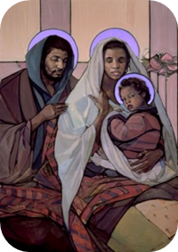
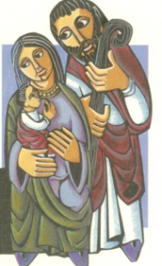
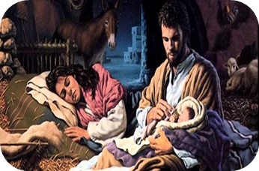
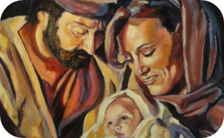
The Holy Family as portrayed in various cultures by different artists
L-2
S-04
Click the Worksheet button to go to the worksheet
Notes:
Slide 4 The Holy Family as portrayed in various cultures by different artists
Use the worksheet to record your ideas about the Holy Family images.
When completed share ideas and summary statements.

Slide 5
The Feast of the Holy Family celebrates family whānau life
The readings honour Mary and Joseph for fulfilling all God asks of a family - to love their children, to obey God’s word, to worship God and keep God’s laws, to teach and encourage their children to love God and live good and happy lives as God’s people.
There are only 4 events recorded in the Gospels about the life of the Holy Family.
The first when Jesus was born, the second when he was circumcised at the Temple, the third when the family fled to Egypt and later returned to Nazareth and the fourth when Jesus was lost in the Temple and found after 3 days.
The everyday life the Holy Family led together in Nazareth we have to imagine within the context of their Jewish culture and customs of the time. These included the defined roles of the father and the mother, and Joseph and Mary would have taken their roles seriously and done everything they could to bring Jesus up to be the best man he could be.
L-2
S-05
Click the pins on the right to reveal post-it notes.
Notes:
Slide 5 The Feast of the Holy Family celebrates family whānau life
Adapt the Teaching and Learning Experience 2
Read each post it note and talk about it with a partner.

Slide 6
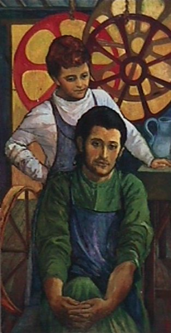
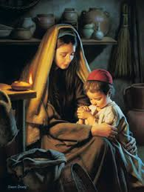
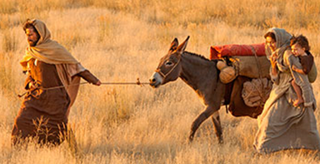
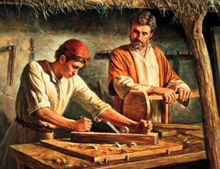
Everyday family life in the Holy Family
Jesus would have learned to pray at Mary’s knee.
She would have taught him about God.
Joseph set up his carpentry business in Nazareth and as Jesus grew he taught him how to make things with wood. He would have taught him the value of hard work and high standards.
On their journey from Egypt back to Nazareth Mary would have explained to Jesus that his grandparents, Anne and Joachim, would be waiting to greet them on their return.
Joseph would have taught Jesus how to be a kind and thoughtful man – as he was.
L-2
S-06
Click the images to reveal text lines
Notes:
Slide 6 Everyday family life in the Holy Family
Read each text reveal and discuss what it tells you.
What do you think makes Joseph, Mary and Jesus an ordinary family?
What makes them the Holy Family?

Slide 7
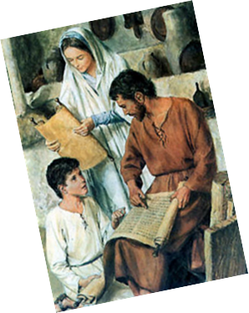
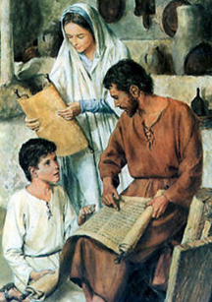
Joseph and Mary would have done a lot of what your parents do with you
Jesus attended the Temple school for boys
where he learned the Old Testament of his ancestors.
Mary and Joseph supported his learning and helped him
with his homework. Even though Jesus was God’s son
their life in Nazareth as a family was like most other Jewish families living in a small village in Judea.
Complete the sentences
Jesus helped Mary to …
Joseph and Jesus made …
Jesus’ cousin would have …
Jesus’ friends sometimes came …
Mary and Joseph taught Jesus …
As he grew Mary and Joseph noticed that Jesus …
L-2
S-07
Complete the sentences by writing in the white boxes
Notes:
Slide 7 Joseph and Mary would have done a lot of what your parents do with you
Read the title and the information at the top of the slide.
Suggest ideas to complete the sentences and decide which one to record.

Slide 8
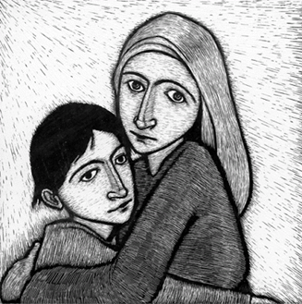
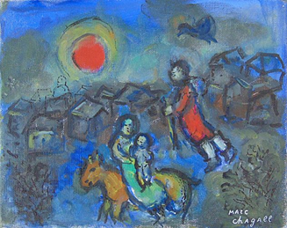
What do these stories tell about life in the Holy Family?
Look closely at the images and the expressions on the faces of the people and note what they tell you
In groups read one of the stories and use your imagination to get a sense of the backstory for each one – share your ideas
Think about how the story exposes the values of the Holy Family – explain this and give examples
Research the artist, Marc Chagall, who painted the 2nd image. Find 3 interesting facts about his life and work to share with your class.
X
Jesus is presented in the Temple Luke 2: 22-32
The escape to and return from Egypt
Matthew 2: 13-23
Jesus is lost and
found in the Temple
Luke 2:41-52
L-2
S-08
Click the I-button to reveal information
Notes:
Slide 8 What do these stories tell about life in the Holy Family?
Look carefully at the images and think about the Scripture story that goes with it. Follow the instructions on the pop up.
The first image shows that religious and cultural practices were important in the Holy Family.
The second image shows keeping safe and secure was important.
The third image shows Mary and Joseph experienced the ordinary worries of family life.

Slide 9
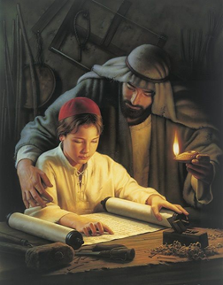
“And Jesus increased in wisdom and in years and in divine and human favour.” Luke 2:52
As children about the same age as Jesus when he was lost for 3 days, what do you think this verse from Luke’s gospel means and how would your parents have reacted had it been you?
What signs are you aware of that you are increasing in divine (God’s) favour (pleasure) and human favour? Share some examples.
Reflect on how you are growing to be the person God has created you to be and how this is making God, your parents and the people around you pleased and proud of you.
How well do you think you are increasing in wisdom and years? How do your family whānau and friends respond to these changes they see in you?
L-2
S-09
Click the pins on the right to reveal post-it notes.
Click the audio button to stop ‘May God Bless and Keep You’
Click the audio button to play ‘May God Bless and Keep You’
Notes:
Slide 9 “And Jesus increased in wisdom and in years and in divine and human favour.” Luke 2:52
Read and discuss the post it notes and share what they mean.
Reflect silently on the ideas in post its 2, 3 and 4.
Recall comments people in your family make to you about your growth and development. Remember it is good to take these comments seriously as they are made by people who love and care about you and are interested in you and the person you are becoming.
Sing using the MP3 ‘May God Bless and Keep You’

Slide 10
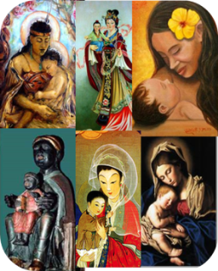
Check up
1)
Name the 3 events recorded in the Scripture’s about the Holy Family.
2)
Choose one event and explain what it says about the life of the Holy Family. Name an equivalent example from life in your family and compare Joseph and Mary’s response to the response your parents would make.
3)
Explain why Mary is called the Mother of God.
4)
Choose one image of Mary and Jesus on the title slide and reflect on how different cultures visualise them and how this helps people to relate to Mary and Jesus.
5)
Which activity do you think helped you to learn best in this lesson?
6)
Questions I would like to ask about the topics in this lesson are …
Click in each caption space to reveal text
Click on the worksheet button to go to the worksheet.
L-2
S-10
Notes:
Slide 10 Check Up
This formative assessment strategy will help teachers to identify how well students have achieved the Learning Intentions of the lesson.
Teachers can choose how they use the slide in their range of assessment options.
A worksheet of this slide is available for students in Years 5-8 to complete.
The last two items are feed forward for the teacher.
Recording the students’ responses to these items is recommended as it will enable teachers to adjust their learning strategies for future lessons and target the areas that need further attention.

Slide 11
Time for Reflection
L-2
S-11
Click the audio button to play reflective music
Click the audio button to stop reflective music
Notes:
Slide 11 Time for Reflection
The MP3 is played to help create a reflective atmosphere and bring the young people to stillness and silence as the teacher invites them to remember to reflect on today’s holy innocents of all ages and pray for them and imagine how Jesus would have treated them – they are not too far away from where he was a refugee.

Slide 12
Sharing our Learning about CHRISTMAS with family whānau
Write a reflection to share about the Holy Innocents who lost their lives because of fear and rejection of Jesus and the holy innocents in the world today whose lives are ended because of war, selfishness, greed and mean use of power.
Write the text of a play for a younger class to perform based on one of the Scripture stories about the Holy Family.
Make a Christmas card that illustrates Christmas as a feast that celebrates the mystery of God becoming human tangata
Write an imaginary excerpt from Mary’s diary during and after one of the events from Scripture about Mary as the Mother of God in the Holy Family.
Create a dramatic presentation, as children of the age Jesus was, lost for 3 days according to the Scripture story and create a modern version of a similar incident, to illustrate the common responses of human families when their children face separation and possible danger. Take photographs at the presentation and share them with your parents.
Make a power point to teach the children in your school about the feasts of the Christmas season.
Make up your own way of showing and sharing what you have learned and decide with whom you would like to share it .
L-2
S-12
Click on the worksheet button to go to the worksheet.
Notes:
Slide 12 Sharing our Learning about CHRISTMAS with family whānau
This slide provides some choices for children to show and share what they have learned. Examples could be photographed as evidence of children’s learning.
You may like to put a copy of the Sharing our Learning page in children’s RE Learning Journals. You could talk through the choices using the slide and let children make their choice from their own copy.
Children could work on their choice at school and/or at home and you may like to set a day for sharing. Please let parents and whānau know what you expect them to do with this.
The slide is focussed on the Yr 7 CHRISTMAS Achievement Objective which is covered in Lessons 1 & 2
Yr 7 AO) Students will be able to: develop an understanding of the feasts of the Christmas season: Christmas, Holy Innocents, Mary, Mother of God Maria, te Whaea o te Atua, Holy Family.

Slide 13
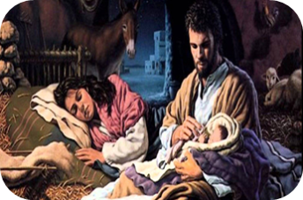
The Holy Family as portrayed in various cultures by different artists
Name:________________
Date:_______
The Holy Family as portrayed in various cultures by different artists
Look at the collage and decide which image of the Holy Family you like best.
Give it a title, share it with your group and say why you chose it.
Reflect on what it says to you about the Holy Family.
Make a summary statement about something you noticed about all the images.
Ask a question about something you are wondering about the Holy Family
Title_______________________
Title______________________
Summary Statement
Title_______________________
Title___________________
Title_____________________
Title______________________
L-2
S-04
Worksheet
Click the up arrow to return to the lesson
Notes:
Slide 4 The Holy Family as portrayed in various cultures by different artists WORKSHEET
This worksheet relates to slide 4

Slide 14
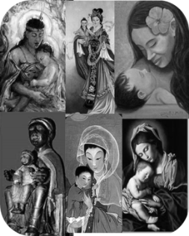
Check up
Name:_________________
Date:_______
1)
Name the 3 events recorded in the Scriptures about the Holy Family.
2)
Choose one event and explain what it says about the life of the Holy Family. Name an equivalent example from life in your family and compare Joseph and Mary’s response to the response your parents would make.
3)
Explain why Mary is called the Mother of God.
4)
Choose one image of Mary and Jesus on the title slide and reflect on how different cultures visualise them and how this helps people to relate to Mary and Jesus.
5)
Which activity do you think helped you to learn best in this lesson?
6)
Questions I would like to ask about the topics in this lesson are …
L-2
S-10
Worksheet
Click the up arrow to return to the lesson
Notes:
Slide 10 Check up WORKSHEET
This worksheet relates to slide 10

Slide 15
Sharing our Learning about CHRISTMAS with family whānau
Write a reflection to share about the Holy Innocents who lost their lives because of fear and rejection of Jesus and the holy innocents in the world today whose lives are ended because of war, selfishness, greed and mean use of power.
Write the text of a play for a younger class to perform based on one of the Scripture stories about the Holy family.
Make a Christmas card that illustrates Christmas as a feast that celebrates the mystery of God becoming human tangata
Write an imaginary excerpt from Mary’s diary during and after one of the events from Scripture about Mary as the Mother of God in the Holy family.
Create a dramatic presentation, as children of the age Jesus was lost for 3 days according to the Scripture story and create a modern version of a similar incident, to illustrate the common responses of human families when their children face separation and possible danger. Take photographs at the presentation and share them with your parents.
Make a power point to teach the children in your school about the feasts of the Christmas season.
Make up your own way of showing and sharing what you have learned and decide with whom you would like to share it.
Name:_________________
Date:_______
L-2
S-12
Worksheet
Click the up arrow to return to the lesson
Notes:
Slide 11 Sharing our Learning about CHRISTMAS with family whānau WORKSHEET
This worksheet relates to slide 11

