Slide 1
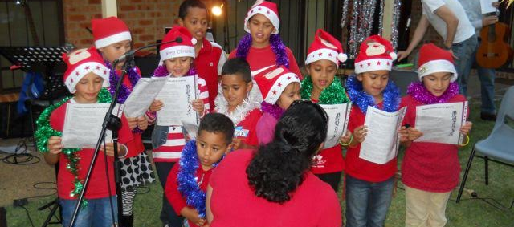
Carol Singing Waiata
L-1
S-01
Notes:
Use this slide as a focussing strategy to introduce the lesson topic. Read the title together and invite children to share something they know about carol singing waiata and how it helps people to prepare for Christmas.

Slide 2
Learning Intentions
The children will:
1)
recognise the relationship between the words of carols and the Christmas story and Christmas traditions.
identify and compare Christmas themes and symbols from the northern and southern hemispheres.
2)
identify various ways that carols help people to celebrate Christ’s coming at Christmas.
3)
L-1
S-02
Click the boxes to reveal text.
Notes:
Read through the Learning Intentions with the class and identify some ideas/questions that might be explored in the lesson.

Slide 3
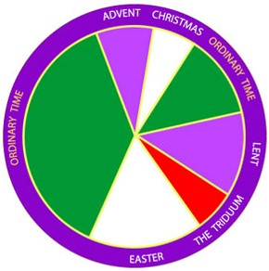
A rapid recap on the liturgical year – what have we learned so far?
The penitential seasons are
The longest time in the Liturgical Year is
The most important day in the Liturgical Year is
The season of Lent begins on
The Liturgical Year retells the stories of the life of
The new Liturgical Year begins with
The Liturgical Year is made up of
Easter and Christmas are seasons of
Each season has special stories that are read from the
Each season is marked with special liturgies and
Advent and Lent
Ordinary Time
Easter Sunday – Jesus’ resurrection
Ash Wednesday
Jesus Christ
the first Sunday of Advent
seasons and feasts
celebration
Bible
symbols
a) Ordinary Time
b) seasons and feasts
c) symbols
d) the first Sunday of Advent
e) Jesus Christ
f) Ash Wednesday
g) Bible
h) Celebration
i) Advent and Lent
j) Easter Sunday – Jesus’ Resurrection
L-1
S-03
Click a word from the list or an empty space to correctly position a word.
Notes:
Use the screen version of the rapid recap and /or the worksheet.
Check children’s knowledge using the floaters.
You could repeat slides 3 & 4 at the end of the Christmas lessons as a post test.
ANSWERS: 1-i, 2-a, 3-j, 4-f, 5-e, 6-d, 7-b, 8-h, 9-g, 10-c

Slide 4
Did you know that…
Can you name each season and it’s liturgical colour?
What are the themes of the stories in the seasons of Christmas and Easter?
What are people expected to do in Lent?
What time of the Liturgical year focuses on the stories in the Scripture about Jesus’ ordinary life?
What is one religious practice used in Advent?
What part of the Bible do we read in Holy Week?
L-1
S-04
Click on arrows to reveal statements
Notes:
Use this slide to get a sense of what children know already about the Liturgical Year.
Read the text on the image carefully and ask children to explain each bullet point.
Children can respond to each arrow statement and say how many out of 6 they knew.

Slide 5
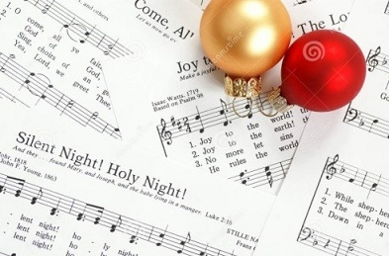
What is special about Christmas carols?
Other carols tell of Christmas traditions from long ago that people used to celebrate Christmas, such as holly and ivy, Christmas lights, Christmas pudding and Santa Claus. Can you name some?
How would you describe what a Christmas carol is?
What makes it different from an ordinary song?
Many carols are based on the stories of Jesus’ birth told by St Luke in his gospel. Some feature different parts of the story – the angels, the shepherds, Mary and Joseph and Jesus.
Carols are a very old Christmas tradition that are used to keep the Christmas stories and traditions alive and this is the reason why they are sung, especially when people gather in their churches and in their homes during the season of Christmas.
Carols are special songs which tell the story of Christmas and celebrate the joy and peace of the traditional Christmas themes in music. The word carol is an old word meaning to sing joyfully.
L-1
S-05
Click the pins on the right to reveal post-it notes.
Notes:
Use each post it note to start children talking in small groups about what they know about Christmas carols.
Explain how they are different from songs? What the word ‘carol’ means?
Name a carol that focusses on angels? What purpose does carol singing serve?
Invite children to share their experiences of carol singing.
How does carol singing make people feel?

Slide 6
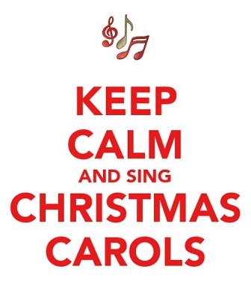
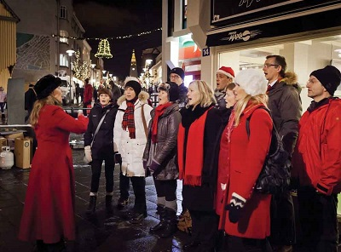
The story behind ‘Silent Night’
Read the story and watch the clip about how the most famous Christmas carol of all came to be written.
Click the video button to play a video.
L-1
S-06
Click the audio button to stop ‘Silent Night’
Click the audio button to play ‘Silent Night’
Notes:
Read the story on the Teacher’s Resource page 20 in Teacher’s Book or on Lesson Home page. Alternatively, you could show the clip
Watch the clip - Story of Silent Night 4.40 minutes
https://www.youtube.com/watch?v=F_N9c9G75lo
Sing using the MP3 ‘Silent Night’

Slide 7
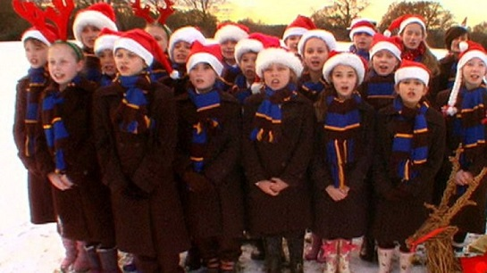
Christmas carols are sung all over the world
Singing carols at Christmas brings back memories and helps people to make peace with each other and with God.
Where do you think these carol singers are from?
What makes you say that?
Name the other countries in this part of the world that will be celebrating Christmas in similar conditions.
Can you name some of the carols they may be singing?
What sort of memories will these children have of their childhood Christmases?
Singing carols at Christmas brings back memories and helps people to make peace with each other and with God.
What sort of memories will these children have of their childhood Christmases?
Can you name some of the carols they may be singing?
Name the other countries in this part of the world that will be celebrating Christmas in similar conditions.
What makes you say that?
Where do you think these carol singers are from?
L-1
S-07
Click cards on right to flip through them (there are 6)
Notes:
Children share their observations of the carol singers in the image.
Read pages on the flip book and answer the questions.

Slide 8
Singing carols at Christmas helps to bring peace even when countries are at war
Watch the clip and see what happened in 1914 when Britain was at war with Germany.
Talk about how this true story could have happened.
What difference do you think singing carols made to the soldiers?
What did the soldiers share and can you imagine how they felt especially as it was Christmas?
Talk about how this clip made you feel.
Click the down-button to move the blind down,
click the up-button (appears at bottom) to move the blind to the top.
L-1
S-08
Notes:
Explain the setting of this clip and what was happening in this true story.
Draw children’s attention to the power of music and singing carols together at Christmas to build friendship even between enemies.
Watch the clip Oh what a lovely war! Christmas Truce 3:39
https://www.youtube.com/watch?v=NOz9SpWc_yE

Slide 9
Families celebrate Christmas all over the world
In which part of the world do you think this family is celebrating Christmas?
Can you justify your answer?
Who is sharing the Christmas dinner?
What do you think the family might do after their Christmas dinner?
How is this family’s celebration similar to and different from yours?
L-1
S-09
Click the down-button to move the blind down.
Notes:
Children look closely at the image and read and respond to each reveal.
Use children’s responses as conversation starters about how families celebrate Christmas.

Slide 10
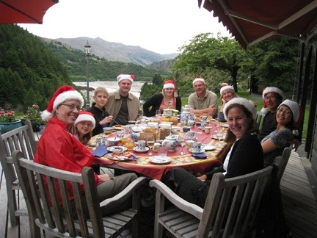
Where is this family whānau celebrating their Christmas together?
X
How is this like your Christmas lunch with your family whānau?
Can you name what makes Christmas celebrations in the southern hemisphere different from the northern hemisphere?
What might this family do after their Christmas lunch?
What Christmas carols might they sing?
Can you name the advantages and disadvantages of celebrating Christmas in the northern hemisphere and the southern hemispheres?
L-1
S-10
Click the ‘i’ button to reveal information
Notes:
Children read each item on the pop up and tell each other stories about their different celebrations of Christmases. Suggest children carry on the conversations about this at home and ask their parents to share their stories of Christmas celebrations in different times, countries and cultures.

Slide 11
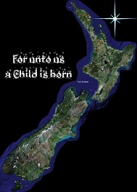
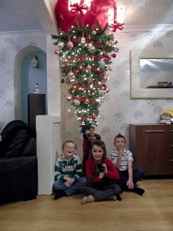
Christmas in Aotearoa New Zealand
In Aotearoa New Zealand people of all cultures and religions celebrate Christmas in ways that suit summer weather which is opposite to what people do who celebrate it in winter.
Do you know anyone who is celebrating Christmas in the northern hemisphere this Christmas?
These children are New Zealanders and now they are living in the northern hemisphere. They are having an upside down Christmas in winter so their dad made them an upside down Christmas tree! Have you heard the Christmas carol about an upside down Christmas?
L-1
S-11A
Click the images to reveal text
Click the audio button to stop ‘Carol our Christmas’
Click the audio button to play ‘Carol our Christmas’
Notes:
Read each reveal and discuss the questions.
Explain why we talk about an ‘upside down Christmas’
Sing using the MP3 ‘Carol our Christmas’ after the image of the children and the tree.

Slide 12
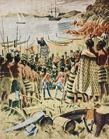
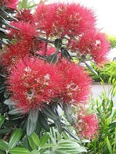
Christmas in Aotearoa New Zealand
In Aotearoa we sing traditional carols about snow and holly. We also sing carols about when the Maori people first heard the Christmas story from the missionaries on the beach a long time ago. The pakeha people who first came to live in Aotearoa shared the story with them. Have you heard the carol ‘Te Harinui’ that tells the story about this?
In Aotearoa we have our own Christmas symbols and traditions. We even have our own Christmas tree that blooms especially for us at Christmas. Do you know its name and where it grows?
L-1
S-11B
Click the images to reveal text
Click the audio button to stop ‘Te Harinui’
Click the audio button to play ‘Te Harinui’
Notes:
Read each reveal and discuss the questions.
Sing using the MP3 ‘Te Harinui’ after the image of the early settlers hearing the story of Christmas for the first time.
Research images of New Zealand Christmas symbols and share them.

Slide 13
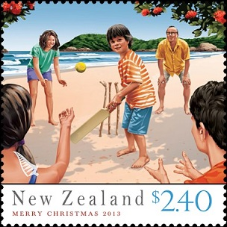
Christmas in Aotearoa New Zealand
Some of the traditional carols such as ‘The Twelve Days of Christmas’ have been adapted so they make sense to New Zealand children. New Zealand children sing ‘A Pukeko in a Ponga Tree’ which is about things New Zealand children are familiar with. Can you sing this song?
A game of cricket is a New Zealand tradition which brings family together for some fun on Christmas Day and through the Christmas season. Some families celebrate Christmas near the beach under the summer sun which reminds them of the warmth and light that Jesus brought to the world. What games does your family whānau like to play at Christmas?
L-1
S-11C
Click the images to reveal text
Click the audio button to stop ‘A Pukeko in a Ponga Tree’
Click the audio button to play ‘A Pukeko in a Ponga Tree’
Notes:
Read each reveal and discuss the questions.
Sing using the MP3 ‘A Pukeko in a Ponga Tree’ after the image of the book cover. Children can use the words on the worksheet to sing the carol.
Access the original ’12 days of Christmas’ carol for them to listen to and explain the 12 days refers to the 12 days of the Christmas season.

Slide 14
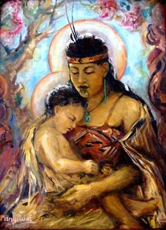
Christmas in Aotearoa New Zealand
We are very lucky to live in Aotearoa and to celebrate Christmas here. We have the traditional images, food, music and ways of doing things as well as our own Aotearoa New Zealand ways which include Maori language and images. The mixture of all of these things helps us to celebrate the birth of Jesus in a very special way.
What things does your family whānau do at Christmas to help everyone join in the good will and celebrations?
Don’t forget to wish everyone ‘Meri Kirihimete’ Merry Christmas”
L-1
S-11D
Click the images to reveal text
Notes:
Explain to children that where ever people celebrate Christmas there are ways to make it special and unique to that place.
Look at the images and share some ways that Christmas in Aotearoa is special
Read the reveals and think about how you can help to make your New Zealand Christmas meaningful and happy for everyone.
Remind people that ‘Jesus is the reason for the season’. Practise saying ‘Meri Kirihimete’.

Slide 15
Find all the Christmas symbols and carols there are in the Word Find
C | G | N | I | R | A | H | S | C | N | C
H | H | S | N | O | W | O | U | U | T | A
R | T | R | E | L | A | C | F | E | S | R
I | C | R | I | C | K | E | T | O | Y | O
S | R | O | N | S | A | U | R | I | L | L
T | H | G | I | N | T | N | E | L | I | S
M | A | V | V | Y | U | C | E | E | M | D
A | Y | L | L | O | H | S | H | A | A | R
S | I | L | E | N | O | U | C | I | F | A
N | E | C | A | E | P | F | P | W | L | C
U | P | S | I | D | E | D | O | W | N | D
Pohutakawa | Christ Child | Peace | Sharing
Cricket | Cards | Silent Night | Fun
Holly | Carols | Upside down | Tree
Ivy | Christmas | Family | Snow
L-1
S-12
Click the words to reveal their position in the word find.
Click the audio button to stop ‘Away in a Manger’
Click the audio button to play ‘Away in a Manger’
Notes:
Find each word on the matrix and highlight it in the list and in the Word Find
Children complete their worksheets and add them to their RE Learning Journals as evidence of their learning.
Sing using the MP3 ‘Away in a Manger’

Slide 16
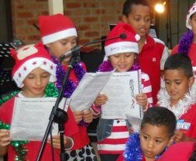
Check Up
1)
Think of an example of words in a carol that are part of the Christmas story and name both.
2)
Draw and write 3 examples of Christmas carols, themes and symbols from the northern and southern hemispheres.
3)
Tell a story about how Christmas carols can change people’s hearts and feelings.
4)
Which activity do you think helped you to learn best in this lesson?
5)
Questions I would like to ask about the topics in this lesson are…
L-1
S-13
Click in each caption space to reveal text
Notes:
This formative assessment strategy will help teachers to identify how well the children have achieved the Learning Intentions of the lesson.
Teachers can choose how they use the slide in their range of assessment options.
A worksheet of this slide is available for children in Years 5-8 to complete.
The last two items are feed forward for the teacher.
Recording the children’s responses to these items is recommended as it will enable teachers to adjust their learning strategies for future lessons and target the areas that need further attention.

Slide 17
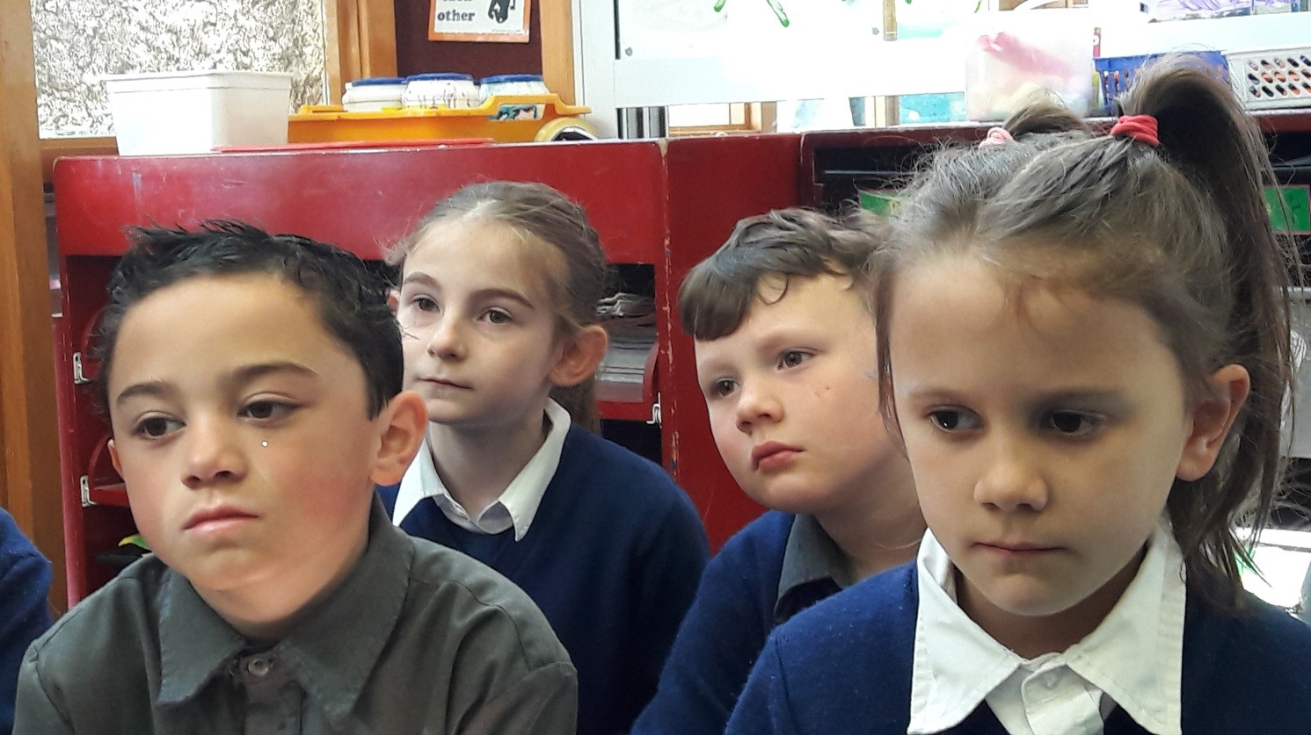
Time for Reflection
L-1
S-14
Click the audio button to stop Reflective Music
Click the audio button to play Reflective Music
Notes:
The MP3 is played to help create a reflective atmosphere and bring the children to stillness and silence as the teacher invites them to reflect on how lucky they are to be celebrating Christmas in a country that is peaceful and has beautiful symbols, music and stories to add to Christmas family celebrations.

Slide 18
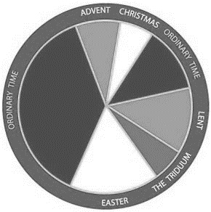
A rapid recap on the liturgical year – what have we learned so far?
Name___________________________ Date_______________
The penitential seasons are ________________
The longest time in the Liturgical Year is _______________
The most important day in the Liturgical Year is _________________________
The season of Lent begins on _________________
The Liturgical Year retells the stories of the life of _________________
The new Liturgical Year begins with _______________________
The Liturgical Year is made up of __________________________
Easter and Christmas are seasons of _______________
Each season has special stories that are read from the _________
Each season is marked with special liturgies and ___________
a) Ordinary Time | b) seasons and feasts | c) symbols | d) the first Sunday of Advent
e) Jesus Christ | f) Ash Wednesday | g) Bible | h) celebration
i) Advent and Lent | j) Easter Sunday – Jesus’ Resurrection
L-1
S-03
Worksheet
Click the up arrow to return to the lesson
Notes:
This worksheet relates to slide 3
ANSWERS: 1-i, 2-a, 3-j, 4-f, 5-e, 6-d, 7-b, 8-h, 9-g, 10-c

Slide 19
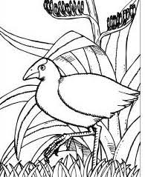
A Pukeko in a Ponga Tree
On the first day of Christmas
My true love gave to me
A pukeko in a ponga tree
On the second day of Christmas
My true love gave to me
Two kumara
And a pukeko in a ponga tree
On the third day of Christmas
My true love gave to me
Three flax kits
Two kumara
And a pukeko in a ponga tree
On the fourth day of Christmas
My true love gave to me
Four huhu grubs
Three flax kits
Two kumara
And a pukeko in a ponga tree
On the fifth day of Christmas
My true love gave to me
Five big fat pigs
Four huhu grubs
Three flax kits
Two kumara
And a pukeko in a ponga tree
On the sixth day of Christmas
My true love gave to me
Six pois a twirling
Five big fat pigs
Four huhu grubs
Three flax kits
Two kumara
And a pukeko in a ponga tree
On the seventh day of Christmas
My true love gave to me
Seven eels a swimming
Six pois a twirling
Five big fat pigs
Four huhu grubs
Three flax kits
Two kumara
And a pukeko in a ponga tree
On the eighth day of Christmas
My true love gave to me
Eight plants of puha
Seven eels a swimming
Six pois a twirling
Five big fat pigs
Four huhu grubs
Three flax kits
Two kumara
And a pukeko in a ponga tree
On the ninth day of Christmas
My true love gave to me
Nine sacks of pipis
Eight plants of puha
Seven eels a swimming
Six pois a twirling
Five big fat pigs
Four huhu grubs
Three flax kits
Two kumara
And a pukeko in a ponga tree
On the tenth day of Christmas
My true love gave to me
Ten juicy fish heads
Nine sacks of pipis
Eight plants of puha
Seven eels a swimming
Six pois a twirling
Five big fat pigs
Four huhu grubs
Three flax kits
Two kumara
And a pukeko in a ponga tree.
On the eleventh day of Christmas
My true love gave to me
Eleven haka lessons
Ten juicy fish heads
Nine sacks of pipis
Eight plants of puha
Seven eels a swimming
Six pois a twirling
Five big fat pigs
Four huhu grubs
Three flax kits
Two kumara
And a pukeko in a ponga tree.
On the twelfth day of Christmas
My true love gave to me
Twelve piupius swinging
Eleven haka lessons
Ten juicy fish heads
Nine sacks of pipis
Eight plants of puha
Seven eels a swimming
Six pois a twirling
Five big fat pigs
Four huhu grubs
Three flax kits
Two kumara
And a pukeko in a ponga tree.
Draw a pukeko in a ponga tree
L-1
S-11
Worksheet
Click the up arrow to return to the lesson
Notes:
This worksheet relates to slide 11

Slide 20
Find all the Christmas symbols and carols there are in the Word Find
Name___________________________ Date_______________
C | G | N | I | R | A | H | S | C | N | C
H | H | S | N | O | W | O | U | U | T | A
R | T | R | E | L | A | C | F | E | S | R
I | C | R | I | C | K | E | T | O | Y | O
S | R | O | N | S | A | U | R | I | L | L
T | H | G | I | N | T | N | E | L | I | S
M | A | V | V | Y | U | C | E | E | M | D
A | Y | L | L | O | H | S | H | A | A | R
S | I | L | E | N | O | U | C | I | F | A
N | E | C | A | E | P | F | P | W | L | C
U | P | S | I | D | E | D | O | W | N | D
Pohutakawa | Christ Child | Peace | Sharing
Cricket | Cards | Silent Night | Fun
Holly | Carols | Upside down | Tree
Ivy | Christmas | Family | Snow
L-1
S-12
Worksheet
Click the up arrow to return to the lesson
Notes:
This worksheet relates to slide 12

