Slide 1
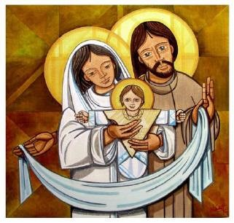
The Christmas Story
L-2
S-02
Notes:
Use this slide as a focussing strategy to introduce the lesson topic. Read the title together and invite children to share something they know about the Christmas story.

Slide 2
Learning Intentions
The children will:
1)
retell the Christmas story.
2)
name the important characters in the Christmas story.
L-2
S-02
Click the boxes to reveal text.
Notes:
Read through the Learning Intentions with the class and identify some ideas/questions that might be explored in the lesson.

Slide 3
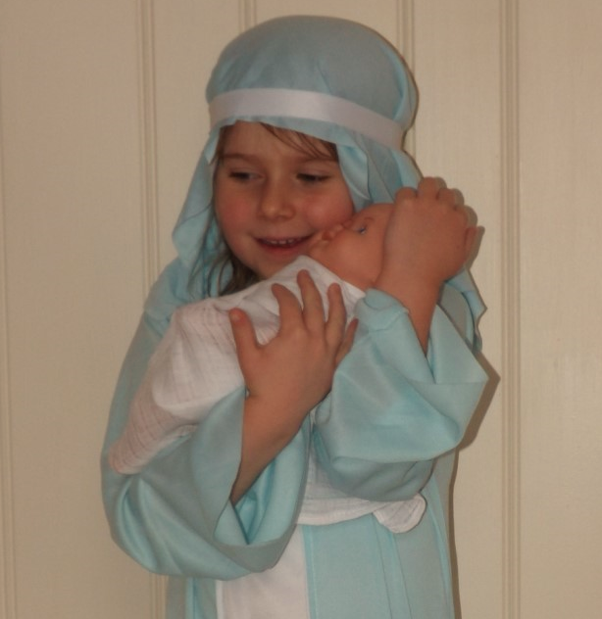
Why was Jesus such a special baby?
Jesus was special because he was God’s son.
Jesus was Mary’s son too.
Joseph was Jesus’ foster father on earth.
They all loved Jesus very much.
L-2
S-03
Click arrows to reveal text
Notes:
Read through the Learning Intentions with the class and identify some ideas/questions that might be explored in the lesson.

Slide 4
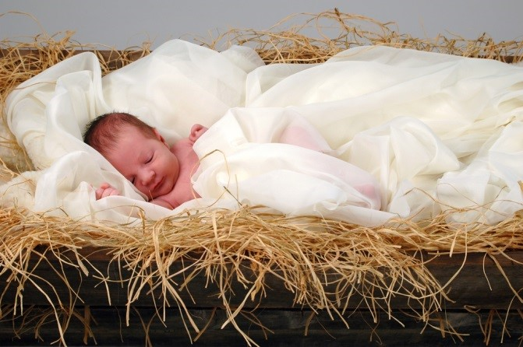
Jesus’ birth was ‘good news’ for everyone on earth
Jesus taught people that God cares for people because they belong to God.
God sent Jesus to live on earth so he could tell everyone about God.
Thank you God for giving us Jesus. He is the best gift ever!
The good news Jesus shared was that God loves all people very much.
L-2
S-04
Click the pins on the right to reveal post-it notes.
Notes:
Find each word in the sentence on the matrix and highlight it in the sentence and in the Word Find.
Children complete the word find on the worksheet and add it to their RE Learning Journal. Check out each word together on the screen word find.

Slide 5
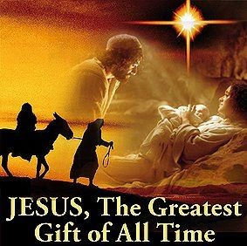
Jesus was God’s gift to everyone on earth
J | S | G | G | A | P | S | H
E | O | R | I | L | E | B | E
S | N | E | F | L | O | E | I
U | T | A | T | T | P | C | S
S | H | T | O | O | L | A | G
X | E | E | F | N | E | U | O
I | L | S | Q | L | S | S | D
S | A | T | U | Y | T | E | S
Jesus is the greatest gift of all to people because he is God’s only son.
L-2
S-05
Click the words to reveal their position in the puzzle.
Notes:
Find each word in the sentence on the matrix and highlight it in the sentence and in the Word Find.
Children complete the word find on the worksheet and add it to their RE Learning Journal. Check out each word together on the screen word find.

Slide 6
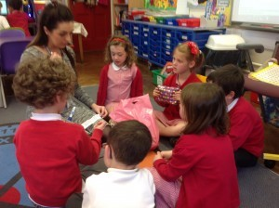
Pass the parcel – Thank you God for giving us Jesus
Can you guess what is in the parcel?
Ask your teacher for a clue
L-2
S-06
Notes:
Adapt Teaching and Learning Experience 4
Guess the answer to the question.
Teachers please play any Christmas CD with Carols during the game.

Slide 7
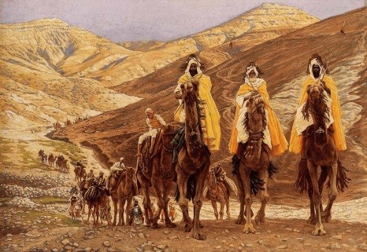
The second part of the Christmas story – More visitors for Mary, Joseph and Jesus
These visitors are called wise men or kings.
They followed a star that led them to the stable where Jesus was born.
They brought birthday presents for Jesus.
What do you think they were?
L-2
S-07
Click the video button to play a video
Notes:
Look closely at the picture and read and talk about each bullet point.
The presents they brought for Jesus were gold, frankincense and myrrh.
From the clips of the story of the arrival of the three kings – chose a suitable version for your class:
https://www.youtube.com/watch?v=LfvRjFs_IKY
The arrival of the wise men – Olivia Hussey, traditional images
https://www.youtube.com/watch?v=7mocxuLzUmU
Heart felt figures – 3 wise men
https://www.youtube.com/watch?v=4qxqCEqf0N0
animated version of the coming of the 3 kings

Slide 8
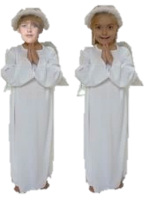
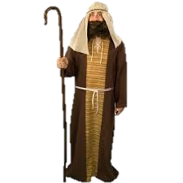
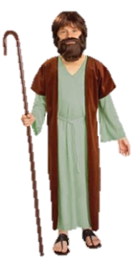
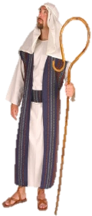
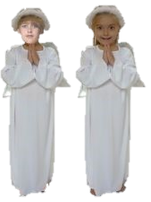
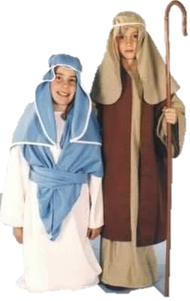
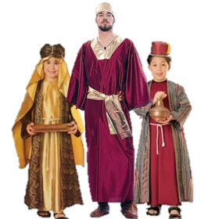
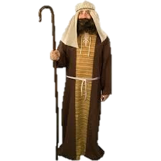
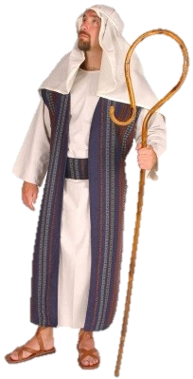
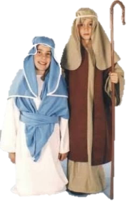
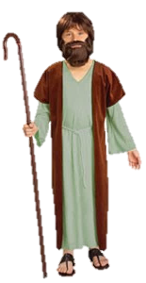
Listening to the Christmas story and thinking about the characters and their part in it
L-2
S-08
Click characters on the right as they appear in the story to bring them into the main box.
Notes:
Adapt Teaching and Learning Experience 3
Read the Scripture story from Matthew2:1-12 and as the characters are mentioned. Click on them to appear in the main screen.
1st Mary and Joseph, 2nd Angels, 3rd Shepherds, 4th Wise men.

Slide 9
Check Up
1)
Who is your favourite character in the Christmas story – can you say why?
2)
Use the pictures on slide 8 and tell the Christmas story to your group.
3)
Why do we believe Jesus is God’s best gift to the world?
4)
Which activity do you think helped you to learn best in this lesson?
5)
Questions I would like to ask about the topics in this lesson are…
L-2
S-09
Click in each caption space to reveal text
Notes:
This formative assessment strategy will help teachers to identify how well the children have achieved the Learning Intentions of the lesson.
Teachers can choose how they use the slide in their range of assessment options.
A worksheet of this slide is available for students in Years 5-8 to complete.
The last two items are feed forward for the teacher.
Recording the children’s responses to these items is recommended as it will enable teachers to adjust their learning strategies for future lessons and target the areas that need further attention.

Slide 10
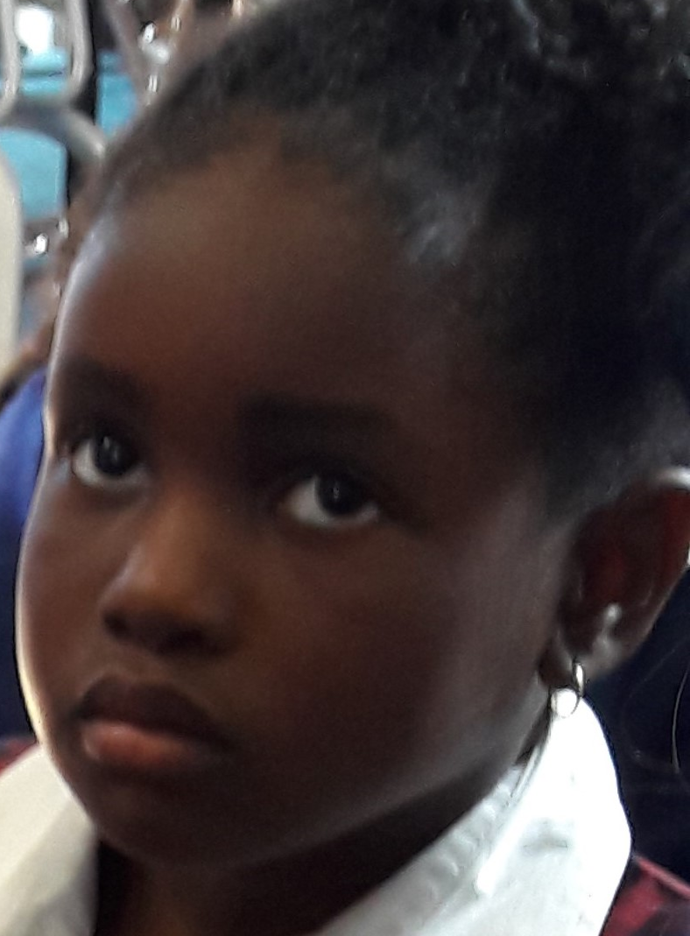
Time for Reflection
L-2
S-10
Click the audio button to stop Reflective Music
Click the audio button to play Reflective Music
Notes:
The MP3 is played to help create a reflective atmosphere and bring the young people to stillness and silence as the teacher invites them to think about the Christmas story and how all the characters in it showed their love for Jesus, God’s son. How do you show your love for Jesus, God’s son?

Slide 11
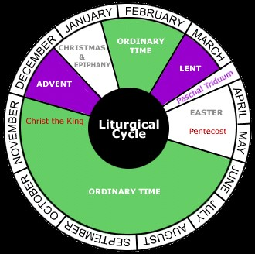
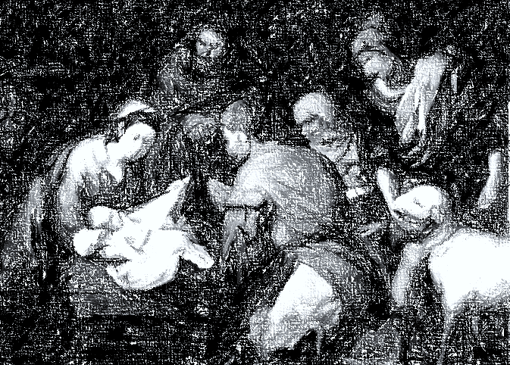
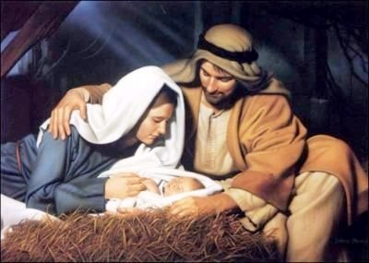
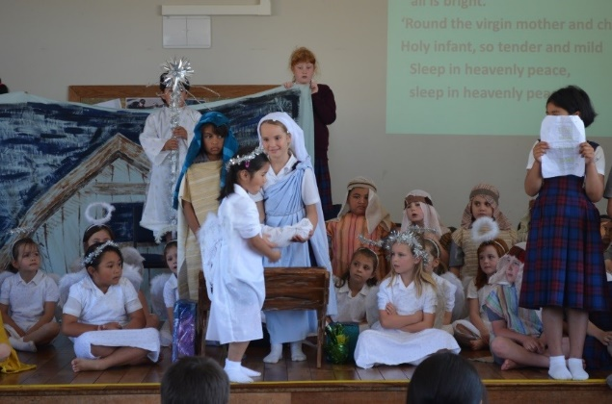
Sharing our Learning about CHRISTMAS with family whānau
Make up your own way of showing and sharing what you have learned and decide with whom you would like to share it.
Ask someone to tell you about how they celebrated the feast of CHRISTMAS when they were a child and you share the way you celebrate it.
Listen to CHRISTMAS carols that are about the CHRISTMAS story that tells about when Jesus was born.
Ask your family to buy a CHRISTMAS crib and set it up in your family space. Sing the CHRISTMAS songs you know and talk about what the angels in the CHRISTMAS story sang about and what happened next.
Watch a you-tube clip about the CHRISTMAS story and explain it to someone at home.
Share you Liturgical Calendar worksheet and read what you have learned about how ADVENT gets us ready for CHRISTMAS
Make a picture to hang at home of the stable with all the characters in the CHRISTMAS story in it. Tell the story to your family.
L-2
S-11
Click the arrow to move through options (7 total)
Notes:
This slide provides some choices for children to show and share what they have learned. Examples could be photographed as evidence of children’s learning.
You may like to put a copy of the Sharing our Learning page in children’s RE Learning Journals. You could talk through the choices using the slide and let children make their choice from their own copy.
Children could work on their choice at school and/or at home and you may like to set a day for sharing. Please let parents and whānau know what you expect them to do with this.
The slide is focussed on the Achievement Objective for Year 1 which is covered in Lessons 1-2
Year 1 AO Children will be able to: recognise that CHRISTMAS celebrates the birth of Jesus.

Slide 12
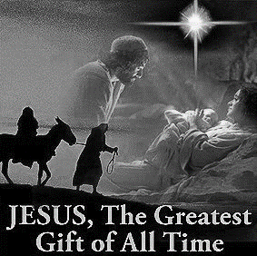
Jesus was God’s gift to everyone on earth
Name___________________________ Date_______________
J | S | G | G | A | P | S | H
E | O | R | I | L | E | B | E
S | N | E | F | L | O | E | I
U | T | A | T | T | P | C | S
S | H | T | O | O | L | A | G
X | E | E | F | N | E | U | O
I | L | S | Q | L | S | S | D
S | A | T | U | Y | T | E | S
Jesus is the greatest gift of all to people because he is God’s only son.
L-2
S-5
Worksheet
Click the up arrow to return to the lesson
Notes:
This worksheet relates to slide 5
Find each word in the sentence on the matrix and highlight it in the sentence and in the Word Find
Children add worksheets to their RE Learning Journals as evidence of their learning.

Slide 13
Sharing our Learning about CHRISTMAS with family whānau
Name___________________________ Date_______________
Make a picture to hang at home of the stable with all the characters in the CHRISTMAS story in it. Tell the story to your family.
Share you Liturgical Calendar worksheet and read what you have learned about how ADVENT gets us ready for CHRISTMAS
Watch a you-tube clip about the CHRISTMAS story and explain it to someone at home.
Ask your family to buy a CHRISTMAS crib and set it up in your family space. Sing the CHRISTMAS songs you know and talk about what the angels in the CHRISTMAS story sang about and what happened next.
Listen to CHRISTMAS carols that are about the CHRISTMAS story that tells about when Jesus was born.
Ask someone to tell you about how they celebrated the feast of CHRISTMAS when they were a child and you share the way you celebrate it.
Make up your own way of showing and sharing what you have learned and decide with whom you would like to share it.
L-2
S-11
Worksheet
Click the up arrow to return to the lesson
Notes:
This worksheet relates to slide 11

