Slide 1
The Message of Advent
L-1
S-01

Slide 2
Learning Outcomes
The Students will:
1)
explain what Christians prepare for during Advent
2)
identify ways Christians could prepare to receive Christ more fully in their lives during Advent.
L-1
S-02
Click the borders to reveal text
Notes:
Slide 2 Learning Outcomes
Read through the Learning Intentions with the class and identify some ideas/questions that might be explored in the lesson.

Slide 3
The place of Advent in the Liturgical Year
Explain where the season of Advent comes in the Liturgical Year Cycle
How would you describe the season of Advent?
Identify 3 symbols on the calendar that relate to Advent.
X
L-1
S-03
Click the I-button to reveal information
Notes:
Slide 3 The place of Advent in the Liturgical Year
Look closely at the Advent Calendar.
Respond to each item on the pop up.
What questions do you have about Advent?
Adapt Teaching and Learning Experiences 2 & 3

Slide 4
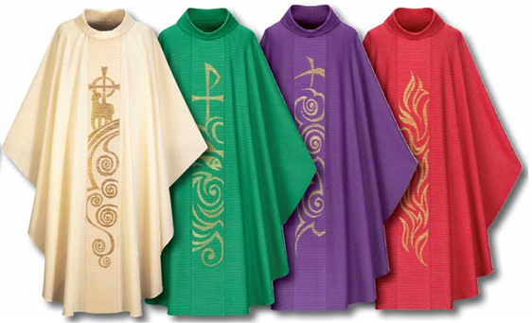
The vestments priests wear at Mass reflect the colour of the feast or Liturgical Season
If the priest is wearing purple vestments it is …
If the priest is wearing green vestments it is …
If the priest is wearing red vestments it is …
If the priest is wearing white vestments it is …
What other church decorations reflect the liturgical season?
L-1
S-04
Click on the worksheet button to go to the worksheet
Notes:
Slide 4 The vestments priests wear at Mass reflect the colour of the feast or Liturgical Season
Adapt Teaching and Learning Experience 1
Students discuss and complete the sentences and answer the question on the Worksheet which needs to be printed in colour.

Slide 5
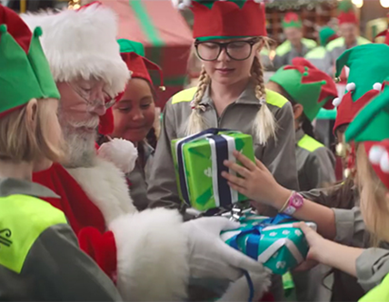
The message of Advent
The message and meaning of Advent is to reflect on our lives and open our hearts so Jesus may become present to us in a more meaningful way.
Advent is a time of prayer karakia and a time to prepare our hearts by reaching out in love to those in need.
This means that as followers of Jesus we will feel his presence in our lives, especially when life is hard.
Advent is a time of new hope tūmanako as we rely on God’s goodness and power to bring peace to a troubled world.
Click on the worksheet button to go to the worksheet
L-1
S-05
Click the pins on the right to reveal post-it notes.
Notes:
Slide 5 The message of Advent
Read each post it note and ask yourself how these ideas about Advent apply to your life.
Complete the worksheets in pairs or groups and share your responses.

Slide 6
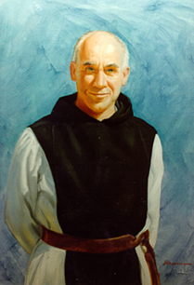
Thomas Merton
Thomas Merton was a Catholic poet, writer, monk, spiritual thinker whose father, Owen was a new Zealander. Thomas had a long journey coming to know Jesus.
You can find out more about him if you are interested. Watch the clip of his most well- known prayer.
His life and his prayer and writings have led many people to come
to know and have faith in Jesus.
What is uncertain is not the coming of Christ,
but our own reception of him,
our own response to him,
our own readiness and capacity
‘To go forth and meet him’.
Reflect on Thomas Merton’s words - Ask yourself
How do I go forth and meet Jesus each day?
Whose face and actions make Jesus present to me?
What is my response when I hear Jesus’ loving words spoken in the voices of others?
How can I use the season of Advent to let Jesus into my life?
L-1
S-06
Click the video button to play a video
Notes:
Slide 6 Thomas Merton
Share the information about Thomas Merton.
Read the quote from Thomas Merton and discuss its meaning.
Use the questions on the left to reflect on your own response and readiness for the coming of Christ.
Watch the clip https://www.youtube.com/watch?v=vqtvB0_MqEM
Pray Thomas Merton’s prayer with Father Horan at class prayer time. (1:26 minutes)
Listen to the words of the prayer and relate them to yourself.

Slide 7
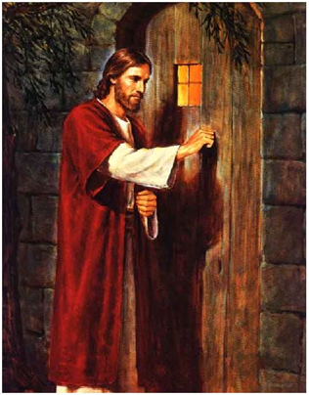
Jesus at the door waiting to be let in
The painting of Jesus at the door is well known.
Look closely at the door – what do you notice?
The door represents the door of the heart.
Jesus will not force his entry – he waits to be welcomed in.
Advent is a time to welcome Jesus into your heart.
L-1
S-07
Click the icons to reveal a text line
Notes:
Slide 7 Jesus at the door waiting to be let in
Adapt Teaching and Learning Experience 5
There is no handle on the outside of the door.
Alternatively refer to Teacher Resource on p13 Teacher’s book or the Lesson home page.

Slide 8
The season of Advent
WAITING as Joseph, Mary, Anna, Joachim, Elizabeth and Zechariah waited for the birth of
EXPECTATION with joy and celebration that Christ has come already into
PREPARATION as we make a space for Jesus to make a home within our
HOPE that God will restore the grace and harmony diminished by sin in the
Jesus
history
world
history
hearts
Jesus
hearts
WHAT ARE YOU WAITING FOR WITH HOPE AND JOYFUL EXPECTATION THIS ADVENT?
world
L-1
S-08
Click a word from the list or an empty space in the sentence to correctly position a word in the sentence.
Notes:
Slide 8 The season of Advent
Read each statement and click on a word to complete the cloze activity.
Share your responses to the question.

Slide 9
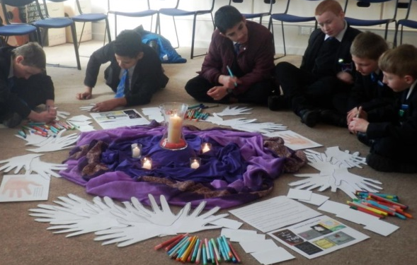
Christians prepare to receive Christ more fully into their lives during Advent...
Write a question
Q: _________________________________________________________
A: Through our class prayer and liturgy.
Q: ________________________________________________________________________________
A: By listening to the Advent readings in Isaiah about how the people waited for hundreds of years for Jesus to come.
Q: ________________________________________________________________________________
A: By consciously noticing people in need and offering to help them.
Q: ________________________________________________________________________________
A: By standing up against unfair treatment and acting with tika.
Q: ________________________________________________________________________________
A: By demonstrating a willing attitude to support and care for others and bring about peace.
L-1
S-09
Click on the worksheet button to go to the worksheet
Notes:
Slide 9 Christians prepare to receive Christ more fully into their lives during Advent…
Read the answer and construct a question to match.
Suggest some other ways Christians of your age can prepare to receive Christ more fully into their lives during Advent.

Slide 10
Check up
1)
Identify the challenges of using the season of Advent to live its message in the midst of preparations for Christmas, finishing the school and working year and making holiday plans. Write 2 tips to help people focus on using Advent for its rightful purpose.
2)
Recall the challenge of Thomas Merton’s words about how we receive and respond to the coming of Jesus and go forth and meet him in our lives. (Slide 6) Write a short response.
3)
Name 3 ways young people of your age can show you are taking Advent seriously by your attitude and actions towards others.
4)
Which activity do you think helped you to learn best in this lesson?
5)
Questions I would like to ask about the topics in this lesson are …
Click in each caption space to reveal text
Click on the worksheet button to go to the worksheet.
L-1
S-10
Notes:
Slide 10 Check Up
This formative assessment strategy will help teachers to identify how well students have achieved the Learning Intentions of the lesson.
Teachers can choose how they use the slide in their range of assessment options.
A worksheet of this slide is available for students in Years 5-8 to complete.
The last two items are feed forward for the teacher.
Recording the students’ responses to these items is recommended as it will enable teachers to adjust their learning strategies for future lessons and target the areas that need further attention.

Slide 11
Time for Reflection
L-1
S-11
Click the audio button to stop reflective music
Click the audio button to play reflective music
Notes:
Slide 11 Time for Reflection
The MP3 is played to help create a reflective atmosphere and bring the young people to stillness and silence as the teacher invites them to reflect on how they could make a greater effort to let Jesus come into their lives more fully during Advent through prayer and kindness.
Original Student’s Activities available on lesson home page

Slide 12
The vestments priests wear at Mass reflect the colour of the feast or Liturgical Season
If the priest is wearing purple vestments it is …
If the priest is wearing green vestments it is …
If the priest is wearing red vestments it is …
If the priest is wearing white vestments it is …
What other church decorations reflect the liturgical season?
Name: _______________
Date: _________
L-1
S-04
Worksheet
Click on the worksheet button to go to the worksheet
Click the up arrow to return to the lesson
Notes:
Slide 4 The vestments priests wear at Mass reflect the colour of the feast or Liturgical Season WORKSHEET
This worksheet relates to slide 4

Slide 13
Where is the message of Advent visible as people prepare for Christmas?
Name: ________________
Fill the shape with all the ways people prepare for Christmas
Date: _________
When completed look at the ideas and mark using 3 different colours
Those that celebrate Christmas before it happens
Those that are about parties, present giving, shopping, decorations
Those that help people prepare to receive Jesus in a more meaningful way into their lives
Make a summary statement about what your findings tell you below.
L-1
S-05A
Worksheet
Click on the worksheet button to go to the worksheet
Click the forward arrow to go to the next worksheet
Notes:
Slide 5A The message of Advent WORKSHEET
This worksheet relates to slide 5

Slide 14
Where is the message of Advent visible as people prepare for Christmas?
Think about the following and make your suggestions
Name: ________________
Date: _________
Do you think that the message of Advent gets lost in the busyness of preparing for Christmas?
My suggestion to improve this is …
Do you get a sense that Christmas has been celebrated before it has come?
My idea to address this is …
What other factors in Aotearoa New Zealand affect how people prepare for Christmas?
Because it is the end of the year, people …
I would like to offer this idea that could help people in Aotearoa New Zealand make the message of Advent more meaningful …
L-1
S-05B
Worksheet
Click the up arrow to return to the lesson
Notes:
Slide 5B The message of Advent WORKSHEET
This worksheet relates to slide 5

Slide 15
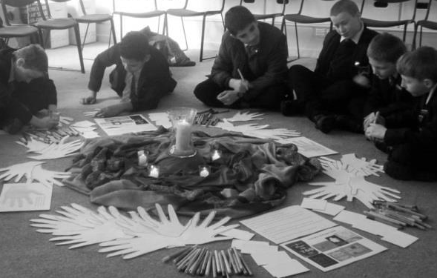
Christians prepare to receive Christ more fully into their lives during Advent...
Name: ________________
Write a question
Date: _________
Q: _________________________________________________________
A: Through our class prayer and liturgy
Q: ________________________________________________________________________________
A: By listening to the Advent readings in Isaiah about how the people waited for hundreds of years for Jesus to come.
Q: ________________________________________________________________________________
A: By consciously noticing people in need and offering to help them.
Q: ________________________________________________________________________________
A: By standing up against unfair treatment and acting with tika.
Q: ________________________________________________________________________________
A: By demonstrating a willing attitude to support and care for others and bring about peace.
L-1
S-09
Worksheet
Click the up arrow to return to the lesson
Notes:
Slide 9 Christians prepare to receive Christ more fully into their lives during Advent… WORKSHEET
This worksheet relates to slide 9

Slide 16
Check up
Name: _______________
Date: _________
1)
Identify the challenges of using the season of Advent to live its message in the midst of preparations for Christmas, finishing the school and working year and making holiday plans. Write 2 tips to help people focus on using Advent for its rightful purpose.
2)
Recall the challenge of Thomas Merton’s words about how we receive and respond to the coming of Jesus and go forth and meet him in our lives. (Slide 6) Write a short response.
3)
Name 3 ways young people of your age can show you are taking Advent seriously by your attitude and actions towards others.
4)
Which activity do you think helped you to learn best in this lesson?
5)
Questions I would like to ask about the topics in this lesson are …
L-1
S-10
Worksheet
Click the up arrow to return to the lesson
Notes:
Slide 10 Check Up WORKSHEET
This worksheet relates to slide 10

