Slide 1
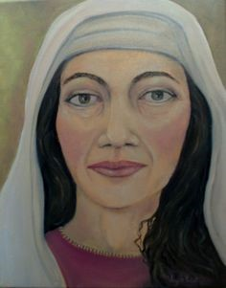
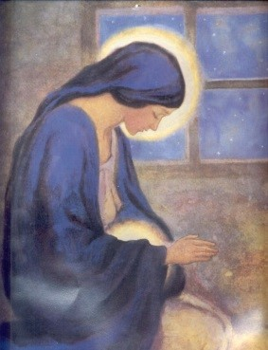
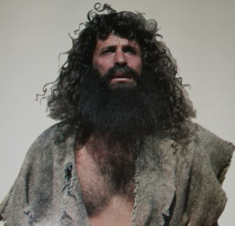
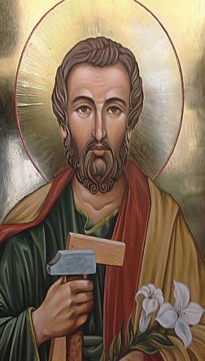
The people who prepared
the way for the Messiah
L-2
S-01

Slide 2
Learning Intentions
The children will:
1)
identify how to follow John the Baptist’s message to prepare the way of the Lord.
recognise that the gospels about St John the Baptist, Elizabeth, Mary and Joseph tell who Jesus is.
2)
L-2
S-02
Click the boxes to reveal the learning intentions

Slide 3
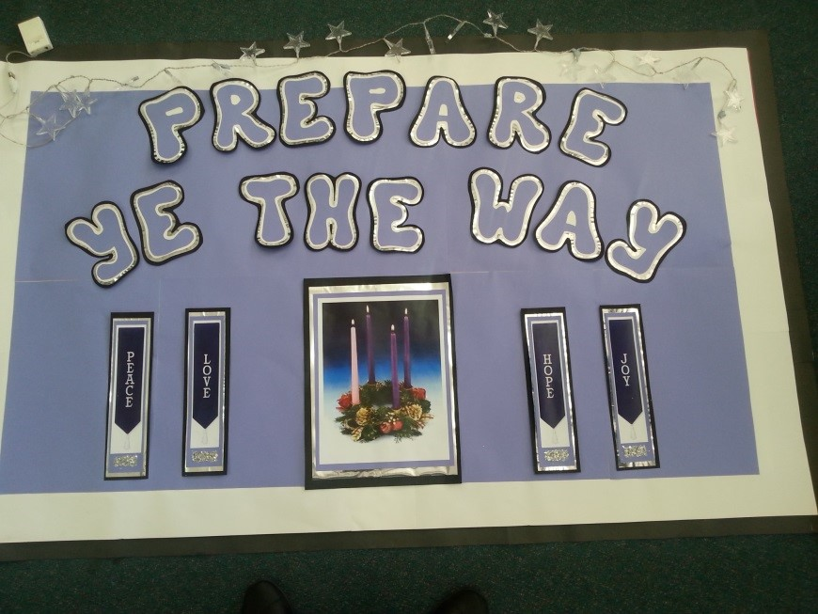
John the Baptist prepared the way for Jesus to come by preaching to the people
The gospels about John the Baptist are read on the 2nd and 3rd Sunday of Advent.
In the 2nd Sunday reading his message is to prepare the way of the Lord and make a straight path for his coming.
This is like saying straighten out your life and live in just and loving ways as God wants you to.
In the 3rd Sunday reading John tells the people to prepare for someone who will come after him, who is so powerful he is not fit to even untie his sandals.
Click the down-button to move the blind down,
click the up-button (appears at bottom) to move the blind to the top.
L-2
S-03

Slide 4
How can we prepare the way of the Lord
in our lives today?
Write a Question or an Answer
1) Q) __________________________________________________________________
A) John the Baptist was an itinerant preacher who challenged people to prepare for the coming of the Messiah by getting their lives in order and in line with God’s laws.
2) Q) __________________________________________________________________
A) He proclaimed a baptism of repentance for the forgiveness of sins to the people who had turned away from God – he was known as John the baptizer.
3) Q)__________________________________________________________________
A) John knew Jesus was the Messiah so his mission was to encourage people to change their lives and to open their hearts and prepare to receive him after thousands of years of waiting.
4) Q) What did John tell the people to do to prepare for the coming of the Messiah?
(Lk 3:10-14)
A) _________________________________________________________________
5) Q) How are you heeding John’s message and preparing the way of the Lord this Advent?
A) _________________________________________________________________
Click the audio button to stop ‘Prepare the Way’
L-2
S-04
Click the audio button to play ‘Prepare the Way’
Click the worksheet button to go to the worksheet
Notes:
Sing using the MP3 ‘Prepare the Way’

Slide 5
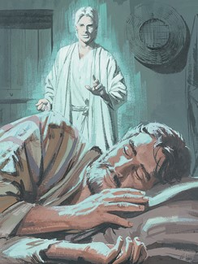
The 4th Sunday gospels tell about who Jesus is from different people’s experience - Joseph
Read Matthew 1:18-24 which tells what was revealed to Joseph about who Jesus is
Share responses to the following:
What did the angel ask Joseph to do about Mary?
What 2 things did the angel reveal to Joseph about Mary’s baby?
What did the angel reveal to Joseph that Jesus would do?
Do you think Joseph would have known about this already? How could he have known it?
What does this incident tell us about Joseph?
L-2
S-05
Press the button to advance through the lines

Slide 6
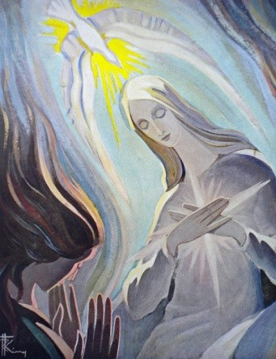
Mary’s experience –
what was revealed to her about Jesus
Read Luke 1:26- 38 which tells what was revealed to Mary about who Jesus is
Use the conversation starters to discuss what
The angel asks Mary to …
Mary is to name her son …
Her child is …
Title the child will be known by …
Mary’s response to this was …
This incident tells us about Mary …
L-2
S-06
Press the button to advance through the lines

Slide 7
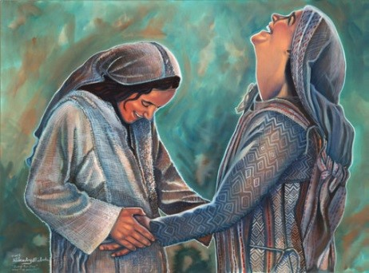
Elizabeth’s experience –
what was revealed to her about Jesus
Read Luke 1:38-45 which tells what was revealed to Elizabeth about who Jesus is
Some questions to ponder:
Who was the first human to recognise that Jesus was the Messiah?
Why do you think God revealed to Elizabeth that Mary’s baby was God’s son, the Messiah?
What was revealed to Elizabeth about Jesus and how do you think she responded to this
revelation from God? – look closely at the image on the slide.
Imagine what Mary and Elizabeth did as they waited for their babies to be born.
Whose prophecy is Mary fulfilling?
L-2
S-07
Press the button to advance through the lines

Slide 8
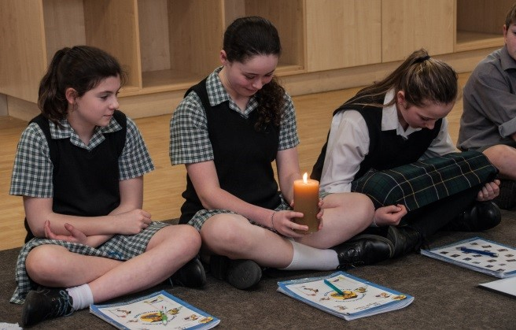
How can we use Advent to open ourselves and
let Jesus become a bigger part of our lives?
Share some ideas to expand these thinking prompts
thinking about our attitudes we can recognise what needs to be changed so …
reflecting on how much Jesus is part of our lives we …
appreciating the season of Advent as a gift to be used to make a straight path so that …
recalling all the people we have learned about who prepared for the coming of Jesus we also …
preparing for Jesus can be responding to invitations to follow him more closely when we ...
L-2
S-08

Slide 9
Check up
1)
Make a poster about John the Baptist – showing who he was, what he did and what his message to the people was and how he prepared them for the coming of the Messiah.
2)
Name the people in the New Testament who prepared for Jesus and what God revealed to them about him.
Give 3 examples of how people can use Advent to let Jesus become a bigger part of their lives so they can follow him more closely.
3)
4)
Which activity do you think helped you to learn best in this lesson?
5)
Questions I would like to ask about the topics in this lesson are …
Click the worksheet button to go to the worksheet
L-2
S-09
Click the boxes to reveal the check up activities

Slide 10
Time for Reflection
L-2
S-10
Click the audio button to stop reflective music
Click the audio button to play reflective music

Slide 11
Sharing our learning about
Advent with family whānau
Prepare an interview with the prophet Isaiah: include questions about his life, the time he was living in, the challenges faced by the prophets and how his messages were received by the people. Question him about what it was like prophesying for 40 years and seeing no results for your work.
Write a dialogue between Jesus and John the Baptist that illustrates what they were doing in their 30th year of their lives. Make clear how each one’s work supported the others.
Identify some similarities and differences in their lives and their deaths.
Present this to your class as an Advent activity.
Create a presentation about Mary and Joseph’s experience of God’s revelation to them about who Jesus was. Explain how Mary and Joseph’s response to God shows their faith and trust in God. Include some key questions for those who listen to your presentation.
Make a collage of the people from the New Testament who prepared for Jesus and include captions of their messages, Scripture quotes that express what they did and ideas about how people today can prepare for the coming of Jesus into their lives. Display this in your school or church foyer.
Create an Advent Liturgy and include the Gospel stories that tell how Mary, Joseph, Elizabeth and John the Baptist prepared for the coming of the Messiah, Jesus. Include music and appropriate colours and symbols. Share this with your school.
Make up your own way of showing and sharing what you have learned and decide who you would like to share it with.
Press the button to reveal the ways to share our learning
Click the worksheet button to go to the worksheet
L-2
S-11

Slide 12
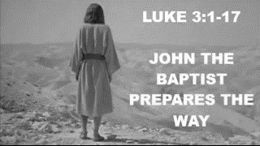
How can we prepare the way of the Lord
in our lives today?
Write a Question or an Answer
1) Q)
______________________________________________________________________________________________________
A) John the Baptist was an itinerant preacher who challenged people to prepare for the coming of the Messiah by getting their lives in order and in line with God’s laws.
2) Q)
______________________________________________________________________________________________________
A) He proclaimed a baptism of repentance for the forgiveness of sins to the people who had turned away from God – he was known as John the baptizer.
3) Q)
______________________________________________________________________________________________________
A) John knew Jesus was the Messiah so his mission was to encourage people to change their lives and to open their hearts and prepare to receive him after thousands of years of waiting.
4) Q) What did John tell the people to do to prepare for the coming of the Messiah? (Lk 3:10-14)
A)
______________________________________________________________________________________________________
5) Q) How are you heeding John’s message and preparing the way of the Lord this Advent?
A)
______________________________________________________________________________________________________
L-7
S-03
L-2
S-04
Worksheet
Click the up arrow to return to the presentation

Slide 13
Check up
Name:____________________________
Date:____________
1) Make a poster about John the Baptist – showing who he was, what he did and what his message to the people was and how he prepared them for the coming of the Messiah.
2) Name the people in the New Testament who prepared for Jesus and what God revealed to them about him.
3) Give 3 examples of how people can use Advent to let Jesus become a bigger part of their lives so they can follow him more closely.
4) Which activity do you think helped you to learn best in this lesson?
5) Questions I would like to ask about the topics in this lesson are …
L-2
S--09
Worksheet
Click the up arrow to return to the presentation

Slide 14
Sharing our learning
Name:____________________________
Date:____________
Create a presentation about Mary and Joseph’s experience of God’s revelation to them about who Jesus was. Explain how Mary and Joseph’s response to God shows their faith and trust in God. Include some key questions for those who listen to your presentation.
Prepare an interview with the prophet Isaiah: include questions about his life, the time he was living in, the challenges faced by the prophets and how his messages were received by the people. Question him about what it was like prophesying for 40 years and seeing no results for your work.
Write a dialogue between Jesus and John the Baptist that illustrates what they were doing in their 30th year of their lives. Make clear how each one’s work supported the others.
Identify some similarities and differences in their lives and their deaths.
Present this to your class as an Advent activity.
Create an Advent Liturgy and include the Gospel stories that tell how Mary, Joseph, Elizabeth and John the Baptist prepared for the coming of the Messiah, Jesus. Include music and appropriate colours and symbols. Share this with your school.
Make a collage of the people from the New Testament who prepared for Jesus and include captions of their messages, Scripture quotes that express what they did and ideas about how people today can prepare for the coming of Jesus into their lives. Display this in your school or church foyer.
Make up your own way of showing and sharing what you have learned and decide who you would like to share it with.
L-2
S-11
Worksheet
Click the up arrow to return to the presentation

