Slide 1
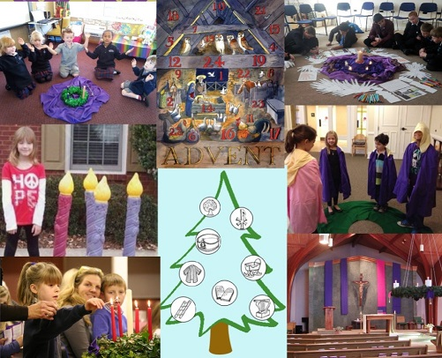
Preparing the way today
L-2
S-01
Notes:
Use this slide as a focussing strategy to introduce the lesson topic. Read the title together and invite children to share something they know about how people today prepare for Jesus to come at Christmas.

Slide 2
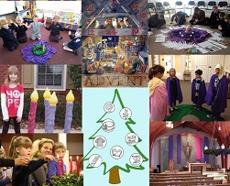
Learning Intentions
The children will:
1)
identify people in the family whānau, school and parish or pastoral area and the ways they prepare the way during Advent for the coming of Jesus.
L-2
S-02
Click the box to reveal text.
Notes:
Read through the Learning Intentions with the class and identify some ideas/questions that might be explored in the lesson.

Slide 3
God’s people prepare to celebrate the coming of Jesus into the world
X
How do you think the people felt who waited their whole lives for the Messiah to come and they died before he came and then their children and their grandchildren lived and died and Jesus had still not come? What might they have thought about this?
Share 3 ways God’s people in your class use the season of Advent to prepare to celebrate the coming of Jesus into the world.
How does it feel to be God’s people who did not have to wait because Jesus Emmanuel – God with us - is already here with us?
L-2
S-03
Click the ‘i’ button to reveal information then click green button to move arrow through the bullet points
Notes:
Use the information on the pop up to get children thinking and talking about those who waited for Jesus in the past and how people today prepare for his coming now.
Use the red arrow as you read each item and encourage comments and questions. Look closely at the images in the collage and name all the ways people prepare to celebrate the birth of Jesus today.

Slide 4
Advent is a time to reflect on God’s people who have waited for centuries for Jesus to come
W | O | H | E | S | E | L | O | H | W
A | L | A | T | N | C | F | O | R | H
S | L | I | W | A | I | T | I | N | G
O | U | S | O | I | P | G | H | R | F
F | F | S | T | T | E | I | A | E | O
D | N | E | P | S | O | S | S | M | R
T | M | M | H | I | P | D | A | O | I
I | T | O | S | R | L | W | A | C | E
M | P | A | I | H | E | T | S | Y | H
E | F | I | L | C | A | N | N | O | T
Christians today cannot imagine how it was for people to spend their whole life time full of hope waiting for the Messiah to come.
L-2
S-04
Click the words to reveal their position in the puzzle.
Notes:
Read the word find sentence and invite children to say how these people would have felt. Find each word in the sentence on the matrix and highlight it in the sentence and in the Word Find. Check children’s worksheets using the screen Word Find. Children add worksheets to their RE Learning Journals as evidence of their learning.

Slide 5
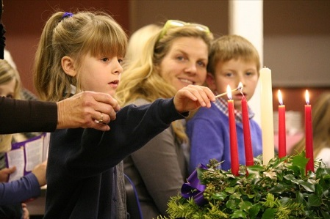
Getting ready for Jesus doing outside things people can see
In our family we prepare for Advent by…
L-2
S-05
Click in the word balloon to type text
Notes:
Adapt Teaching and Learning Experience 3 and invite children to share ways families can get ready for Jesus’s birth. Record some ideas on screen. Children record their own ideas on their worksheets.

Slide 6
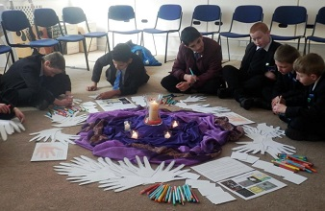
Getting ready doing inside things people cannot see
In Advent we get our hearts, our inside selves, ready
Others may not notice how we are getting our hearts
Each day we can talk to Jesus in a quiet place and
We can choose to take time to grow in friendship with
When our hearts are ready for Jesus we will feel
to make Jesus welcome when he comes.
ready for Jesus by doing kind actions for others.
tell him we are waiting to celebrate his birth.
Jesus and listen to his voice in our hearts.
full of joy when he comes on Christmas day.
a)
b)
c)
d)
e)
tell him we are waiting to celebrate his birth.
Jesus and listen to his voice in our hearts.
full of joy when he comes on Christmas day.
ready for Jesus by doing kind actions for others.
to make Jesus welcome when he comes.
L-2
S-06
Click a line from the list or an empty space to correctly position a line.
Notes:
Children talk about what is meant by our inside selves and how we get them ready. They read each statement and suggest the statement that completes it. Check this with the floaters. Children record their work on their worksheet. ANSWERS 1)E, 2) D, 3) A, 4) B, 5) C

Slide 7
Ideas for families to get ready for Jesus to come
Make an advent wreath to light and pray with after dinner each night.
Make a Jesse Tree and add a new figure and tell their story each day.
Buy or make an Advent Calendar and pray for Jesus to come and be more part of your family.
Reflect on what it would have been like for the people who waited for Jesus for thousands of years.
Fill a box with things for people who will find Christmas hard and give it to Vinnie de P to pass on.
Click the down-button to move the blind down,
click the up-button (appears at bottom) to move the blind to the top.
L-2
S-07
Notes:
Adapt Teaching and Learning Experience 4 Children choose a word on the wordle and use it and ADVENT in a sentence about preparing for Jesus to come. Children read and discuss each reveal and decide what they could encourage their family to do to use Advent as a season to prepare for Jesus’ coming.

Slide 8
God’s people prepare for the coming of Jesus
Reflect on how preparation for an event makes it more meaningful when it happens.
Think of something you can do each day to make Christmas more meaningful this year.
Do something to recognise the millions of people who have prepared for Jesus to come.
Pray in your heart with gratitude that you did not have to wait thousands of years for Jesus to come because he is already with us and he is waiting for us to welcome him into our lives to be friends with him.
Whisper, “Come, Lord Jesus, Come”.
L-2
S-08
Click the stamps to reveal text.
Click the audio button to stop ‘Prepare the Way’
Click the audio button to play ‘Prepare the Way’
Notes:
Children read each reveal and choose one they would like to make a comment on or ask a question about. Read the last item and spend some time in silence reflecting on how they can welcome Jesus into their lives more deeply this Christmas. Sing using the MP3 ‘Prepare the Way’

Slide 9
Check Up
1)
Make a list of:
Two ways you prepare your heart for Jesus to come
Two ways your family uses Advent to prepare for Christmas
Two ways your parish/pastoral area helps God’s people prepare for the coming of Jesus
Two ways you use to count down through Advent until Jesus comes at Christmas.
2)
Write down 5 names you know for Jesus.
3)
Which activity do you think helped you to learn best in this lesson?
4)
Questions I would like to ask about the topics in this lesson are…
L-2
S-09
Click in each caption space to reveal text
Notes:
This formative assessment strategy will help teachers to identify how well the children have achieved the Learning Intentions of the lesson. Teachers can choose how they use the slide in their range of assessment options. A worksheet of this slide is available for children in Years 5-8 to complete. The last two items are feed forward for the teacher. Recording the children’s responses to these items is recommended as it will enable teachers to adjust their learning strategies for future lessons and target the areas that need further attention.

Slide 10
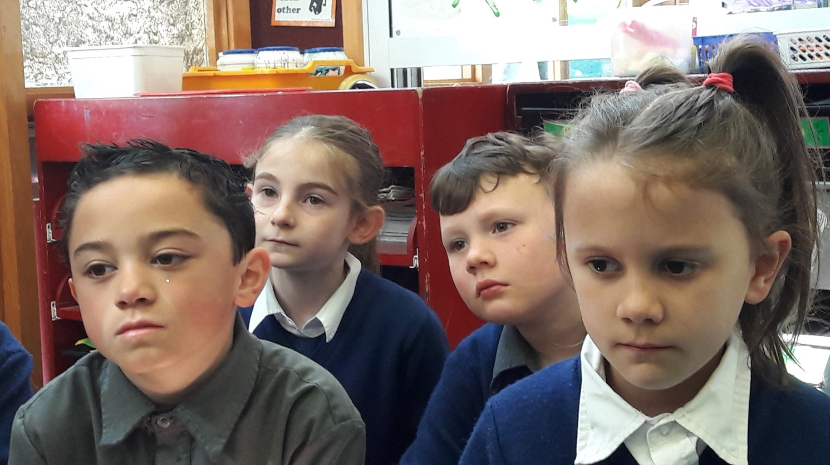
Time for Reflection
L-2
S-10
Click the audio button to stop Reflective Music
Click the audio button to play Reflective Music
Notes:
The MP3 is played to help create a reflective atmosphere and bring the young people to stillness and silence.

Slide 11
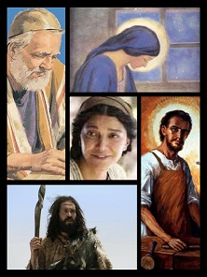
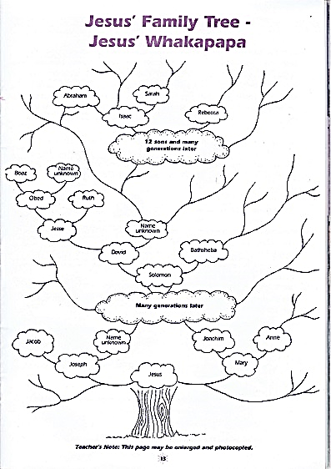
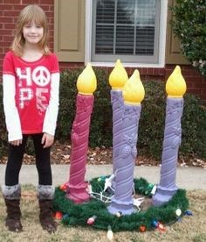
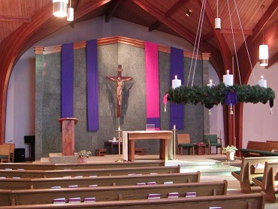
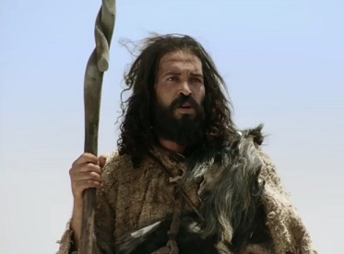
Sharing our Learning about ADVENT with family whānau
Make up your own way of showing and sharing what you have learned and decide with whom you would like to share it.
Share with your parish at Mass all the ways you are using Advent to prepare for the birth of Jesus and sing ‘Prepare the Way”. Show and explain how the Advent Wreath, the Jesse Tree and the Advent Calendar are useful reminders for you to prepare to make more room in your heart for Jesus.
Dress up as John the Baptist and write and share your story with your family and your class.
Work in groups of 6 – assign people to be Isaiah, Joseph, Mary, Elizabeth, John the Baptist and an interviewer. Create 5 questions as a group that will enable the characters to tell who they are, something about their family, their connection with each other and with Jesus and how they are prepared for Jesus to come. Practise responses and present the interviews to different classes.
Make up a rap about Jesus’ whakapapa and share it at assembly.
L-2
S-11
Click the red arrow to move through options (5 total)
Notes:
This slide provides some choices for children to show and share what they have learned. Examples could be photographed as evidence of children’s learning. You may like to put a copy of the Sharing our Learning page in children’s RE Learning Journals. You could talk through the choices using the slide and let children make their choice from their own copy. Children could work on their choice at school and/or at home and you may like to set a day for sharing. Please let parents and whānau know what you expect them to do with this. The slide is focussed on Year 4 Achievement Objective which is covered in Lessons 1-2 Year 4 AO) Children will be able to: recognise how Advent is a time to prepare the way for the coming of Jesus, Son of Mary and Son of God.

Slide 12
Advent is a time to reflect on God’s people who have waited for centuries for Jesus to come
Name___________________________ Date_______________
W | O | H | E | S | E | L | O | H | W
A | L | A | T | N | C | F | O | R | H
S | L | I | W | A | I | T | I | N | G
O | U | S | O | I | P | G | H | R | F
F | F | S | T | T | E | I | A | E | O
D | N | E | P | S | O | S | T | M | R
T | M | M | H | I | P | D | A | O | I
I | T | O | S | R | L | W | A | C | E
M | P | A | I | H | E | T | S | Y | H
E | F | I | L | C | A | N | N | O | T
Christians today cannot imagine how it was for people to spend their whole life time full of hope waiting for the Messiah to come.
L-2
S-4
Worksheet
Click the up arrow to return to the lesson
Notes:
This worksheet relates to slide 4 Find each word in the sentence on the matrix and highlight it in the sentence and in the Word Find.

Slide 13
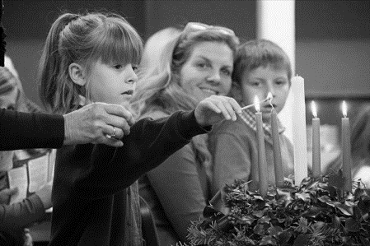
Getting ready for Jesus doing outside things people can see
Name___________________________ Date_______________
In our family we prepare for advent by…
L-2
S-5
Worksheet
Click the up arrow to return to the lesson
Notes:
This worksheet relates to slide 5

Slide 14
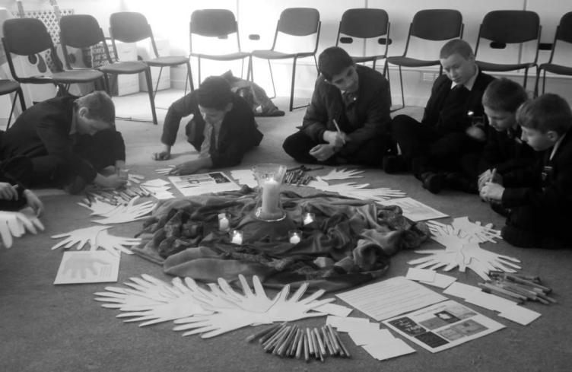
Getting ready doing inside things people can not see
Name___________________________ Date_______________
In Advent we get our hearts, our inside selves, ready
Others may not notice how we are getting our hearts
Each day we can talk to Jesus in a quiet place and
We can choose to take time to grow in friendship with
When our hearts are ready for Jesus we will feel
tell him we are waiting to celebrate his birth.
ready for Jesus by doing kind actions for others.
full of joy when he comes on Christmas day.
Jesus and listen to his voice in our hearts.
to make Jesus welcome when he comes.
L-2
S-6
Worksheet
Click the up arrow to return to the lesson
Notes:
This worksheet relates to slide 6
ANSWERS 1)E, 2) D, 3) A, 4) B, 5) C

Slide 15
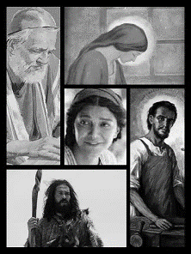
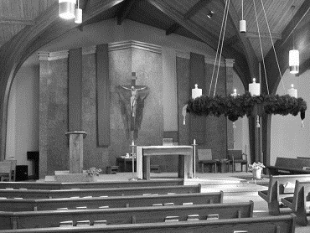
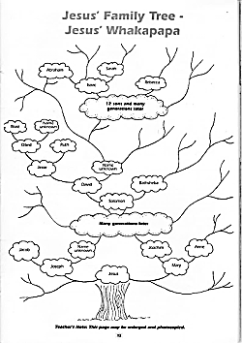
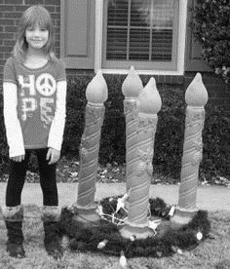
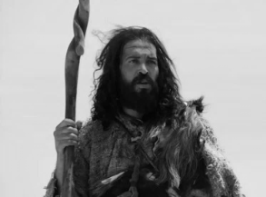
Sharing our Learning about ADVENT with family whānau
Name___________________________ Date_______________
Work in groups of 6 – assign people to be Isaiah, Joseph, Mary, Elizabeth, John the Baptist and an interviewer. Create 5 questions as a group that will enable the characters to tell who they are, something about their family, their connection with each other and with Jesus and how they are prepared for Jesus to come. Practise responses and present the interviews to different classes.
Share with your parish at Mass all the ways you are using Advent to prepare for the birth of Jesus and sing ‘Prepare the Way”. Show and explain how the Advent Wreath, the Jesse Tree and the Advent Calendar are useful reminders for you to prepare to make more room in your heart for Jesus.
Make up a rap about Jesus’ whakapapa and share it at assembly
Make up your own way of showing and sharing what you have learned and decide with whom you would like to share it.
Dress up as John the Baptist and write and share your story with your family and your class.
L-2
S-11
Worksheet
Click the up arrow to return to the lesson
Notes:
This worksheet relates to slide 11

