Slide 1
Advent is a waiting time
L-1
S-01
Notes:
Use this slide as a focussing strategy to introduce the lesson topic. Read the title together and invite children to share something they know about Advent is a time for waiting for Jesus to be born.

Slide 2
Learning Intentions
The children will:
1)
recognise Advent as a time for waiting
2)
identify who people are waiting for in Advent
3)
name some of the thoughts and feelings associated with waiting
L-1
S-02
Click the borders to reveal text
Notes:
Read through the Learning Intentions with the class and identify some ideas/questions that might be explored in the lesson.

Slide 3
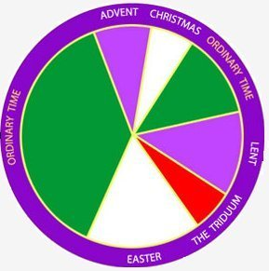
The Church has its own calendar
We call the Church’s calendar the Liturgical Calendar – it shows the seasons and feasts that the Church celebrates.
Purple is for waiting times – Advent and Lent are waiting and getting ready to celebrate times.
Green is for Ordinary time.
The seasons have different colours on the calendar – purple, white or gold, red and green.
White or gold are for celebration times – Easter and Christmas are celebration times.
L-1
S-03
Click the pins on the right to reveal post-it notes.
Notes:
Talk about the special calendar the Church has to help people know when the special times and feasts are that the people celebrate each year.
Read each post it note and talk about what it means.
Point to the season that is just beginning – we call it Advent.

Slide 4
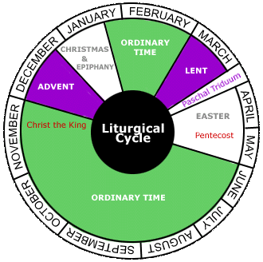
The Season of Advent is a time for waiting and getting ready to celebrate Jesus’ birth
How many weeks is the season of Advent?
What feast do we prepare for in Advent?
What month is Advent in?
What colour is the season of Advent?
Find the season of Advent on the calendar
L-1
S-04
Click top card to discard it
Notes:
Look closely at the calendar and point to the season of Advent.
Read and follow the flip cards.

Slide 5
In Advent we are waiting for Emmanuel to be with us
A special name given to Jesus is …
Emmanuel
Emmanuel means …
God is with us
We call Jesus this name in Advent to remind us of his …
coming
God wants to be with his …
people
That is why he sent Jesus, his …
son
God is with us
Emmanuel
coming
son
people
Click a word from the list or an empty space in the sentence to correctly position a word in the sentence.
Click on worksheet button to go to worksheet.
L-1
S-05
Click the audio button to stop ‘O Emmanuel’
Click the audio button to play ‘O Emmanuel’
Notes:
Read the title and talk about what Emmanuel means.
Children share ideas about how they see God with us – in creation, in the love and kindness of their family and friends, in people who are like Jesus, because Jesus is God’s son.
Do the cloze activity with the children and use the floaters to check.
Children complete their own worksheet and add it to their RE Learning Journal.
Sing using the MP3 ‘O Emmanuel’

Slide 6
Children have waiting times too
Waiting for your birthday
How does that feel?
Waiting your turn for something
How does that feel?
Waiting for your food
How would that feel?
Waiting for Christmas
How does that feel?
L-1
S-06
Click an images to reveal a text line
Notes:
Adapt Teaching and Learning Experience 3
Children share experiences about waiting times they have experienced.
Use the images and text as a focus for discussion.

Slide 7
Waiting words and waiting feelings – do you know some?
Share your suggestions about …
Good things to do while you are waiting
Not good things to do while you are waiting
L-1
S-07
Click in word balloon to type
Notes:
Children’s responses can be recorded in the word balloons.
Use suggestions on screen if needed.

Slide 8
Things that can help us to be good
‘waiters’ in Advent
We can open the doors of an Advent calendar to help us through the season of Advent as we prepare for the coming
of Emmanuel.
We take time to think about Mary and Joseph and how they prepared for Jesus.
When we record the progress on our journey
to Christmas it helps us to be patient and use the days of Advent well to get our hearts ready to welcome Jesus.
We can make an Advent wreath and light a new candle each week to show where we are up to during the 4 weeks of Advent.
By doing this we make a space to get ready for Jesus in our busy lives.
L-1
S-08
Click on images to reveal text.
Click the audio button to stop ‘Mo te Awenti’
Click the audio button to play ‘Mo te Awenti’
Notes:
Adapt Teaching and Learning Experience 6
Read each reveal and talk about how it could help you to be a good ‘waiter’ in Advent.
Children share their own ideas that could help them to be patient waiters.
Adapt Teaching and Learning Experience 5
Sing using the MP3 ‘Mo te Aweneti”

Slide 9
Advent – A happy waiting time for Jesus Emmanuel
Looks like
Sounds like
L-1
S-09
Click the worksheet button to go to the worksheet
Notes:
Adapt Teaching and Learning Experience 4
Share ideas that describe what waiting for Jesus in Advent looks and sounds like. Include Advent language, rituals and stories eg Emmanuel, Advent wreath, Advent calendar, lighting candles, opening calendar doors, thinking about Jesus and talking to him, welcoming Jesus, being patient, helping at home. Children complete their own T chart in their worksheet.

Slide 10
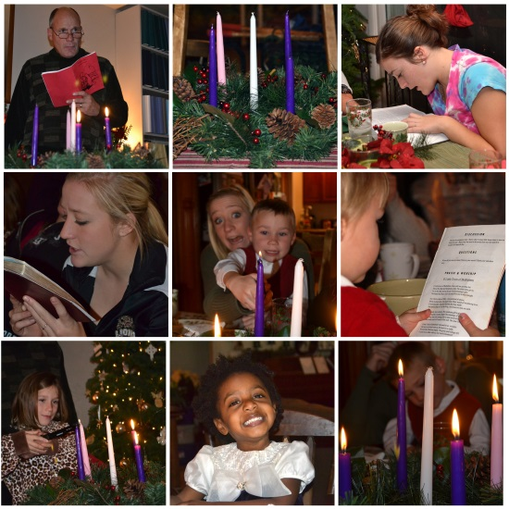
Advent is a busy time for families
During Advent our families are …
I can help to make Advent go smoothly by …
We can remind each other it is Advent by …
L-1
S-10
Click in a white box to type.
Click the audio button to stop ‘O Emmanuel’
Click the audio button to play ‘O Emmanuel’
Notes:
Adapt Teaching and Learning Experiences 7 & 8
Share ideas that describe what waiting for Jesus in Advent looks and sounds like. Include Advent language, rituals and stories eg Emmanuel, Advent wreath, Advent calendar, lighting candles, opening calendar doors, thinking about Jesus and talking to him, welcoming Jesus, being patient, helping at home. Children complete their
Look at the images and talk about what people are doing.
Share ideas about all the other things families are doing in Advent that make I s very busy time.
Children suggest ways they can help Advent go smoothly and how they can help others remember it is Advent. All these ideas can be recorded on screen.
Sing using the MP3 ‘O Emmanuel’

Slide 11
Check Up
1)
Advent is a time of …
2)
Things that help us to remember what Advent means are …
3)
Who are people waiting for in Advent?
4)
Name 3 things you know about waiting and share one experience you have of waiting.
5)
Which activity do you think helped you to learn best in this lesson?
6)
Questions I would like to ask about the topics in this lesson are …
L-1
S-11
Click the borders to reveal text
Notes:
This formative assessment strategy will help teachers to identify how well students have achieved the Learning Intentions of the lesson.
Teachers can choose how they use the slide to assess each item.
A worksheet of this slide is available as an option for students to complete.
The last two items are feed forward for the teacher.
Recording the students’ responses to these items is recommended as it will enable teachers to adjust their learning strategies for future lessons and target the areas that need further attention.

Slide 12
Time for Reflection
L-1
S-12
Click the audio button to stop reflective music
Click the audio button to play reflective music
Notes:
The MP3 is played to help create a reflective atmosphere and bring the children to stillness and silence as the teacher invites them to remember the good waiting ideas and ways they can help at home. Whisper to Jesus in your heart about how you are preparing to welcome him into your heart at Christmas.
Original Children’s Activities available on lesson home page

Slide 13
In Advent we are waiting for Emmanuel to be with us – WORKSHEET
Name_______________ Date__________
A special name given to Jesus is …
Emmanuel means …
We call Jesus this name in Advent to remind of his …
God wants to be with his …
That is why he sent Jesus his …
God is with us
Emmanuel
coming
son
people
Emmanuel means God with us
L-1
S-05
Worksheet
Click the up arrow to return to the presentation
Notes:
This worksheet relates to slide 5

Slide 14
Advent – A happy waiting time for Jesus Emmanuel
Name_______________ Date__________
Looks like
Sounds like
L-1
S-09
Worksheet
Click the up arrow to return to the presentation
Notes:
This worksheet relates to slide 9

