Slide 1
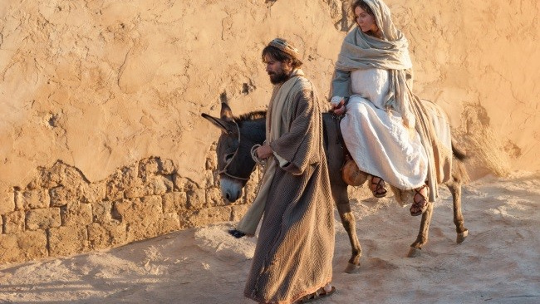
Mary and Joseph get ready for the birth of Jesus
L-1
S-01
Notes:
Use this slide as a focussing strategy to introduce the lesson topic. Read the title together and invite children to share something they know about what Joseph and Mary did to get ready for their new baby.

Slide 2
Learning Intentions
The children will:
1)
describe how Mary and Joseph prepared for the birth of Jesus.
L-1
S-02
Click the box to display text
Notes:
Read through the Learning Intentions with the class and identify some ideas/questions that might be explored in the lesson.

Slide 3
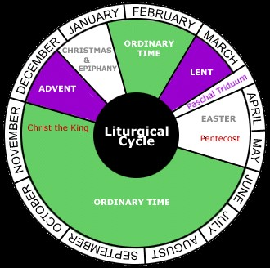
The Liturgical Calendar
Here is the Calendar that tells us the time for the seasons and feasts we celebrate in our church.
We call this calendar the Liturgical Calendar.
Point to each season on the calendar and say its name and its colour.
The season we are just finishing is Ordinary Time.
L-1
S-03
Click the arrows to reveal text, click button to move arrow around calendar.
Notes:
Adapt Teaching and Learning Experience 1
Read the items revealed by the black arrows and use the button to move the arrow to indicate the season and name its colour.

Slide 4
What do we do in Ordinary Time?
We do ordinary things like
The colour for ordinary time on the calendar is
There are two ordinary times in the
One ordinary time is short and one is very
The season we are just starting is
going to school
green
year
long
Advent
a) green
c) year
e) long
b) going to school
d) Advent
L-1
S-04
Click a word from the list or an empty space to correctly position a word.
Notes:
Read the title question and each of the statements – suggest the correct words to fill the gaps then click on the floaters to check them.
Answers: 1-b, 2-a, 3-c, 4-e, 5-d

Slide 5
Advent means coming
What do you know about Advent?
Who do you think is coming? Look at the wordle and get a clue!
Advent is the special season for us to…
X
L-1
S-05
Click the I-button to reveal information
Notes:
Adapt Teaching and Learning Experiences 2&3
Read the words you know in the wordle and say why it would be in an Advent wordle.
Press I button and read and answer each question.
Share ideas to complete the last sentence.

Slide 6
Mary and Joseph get ready for Jesus to come into the world
?
SEE – What do you see?
THINK – What do you think?
WONDER – What are you wondering about?
L-1
S-06
Click the audio button to stop ‘Mary Said “Yes!”
Click the audio button to play ‘Mary Said “Yes!’
Notes:
Children look at the image and share what they see, think and wonder about.
Sing using the MP3 ‘Mary said Yes’
Show children the Bible and explain that the story about Mary and Joseph getting ready for Jesus to come into the world is written in the Bible. This story happened a very long time ago and we remember it every Christmas.
Select from the clips below:
https://www.youtube.com/watch?v=O9VyT9sY_Dc
Birth of Jesus Ignatius press 4:06 minutes
https://www.youtube.com/watch?v=cs3D3cAVr08
The Nativity 5:21 minutes. Simple narration and text on screen – clips from movie
https://www.youtube.com/watch?v=K7FUUxF4u7E
The Beginners Bible includes the Annunciation and the Nativity 2:17 minutes

Slide 7
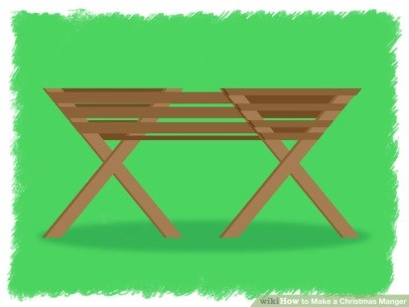
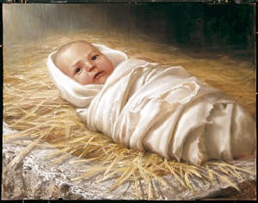
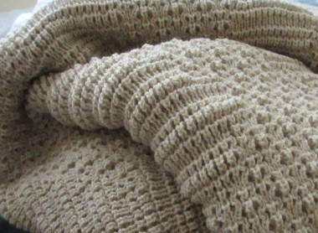
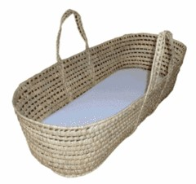
Here is what Mary and Joseph got ready for Jesus
A bed for him to sleep in.
A hat to keep his head warm.
Swaddling Clothes to keep him warm.
A basket to carry him on long journeys.
A warm blanket to wrap him in.
L-1
S-07
Click an image to reveal text. Click worksheet button for worksheet.
Click the audio button to play ‘An Angel Came From Heaven’
Click the audio button to stop ‘An Angel Came From Heaven’
Notes:
Click in each image and read the caption and talk about each item.
Children say where the items came from.
Sing using the MP3 ‘An angel came from heaven’
Share poem ‘Waiting’

Slide 8
Mothers and fathers get ready for new babies
Can you name things parents prepare when they are waiting for their new baby to come?
L-1
S-08
Click in the box and write your text
Notes:
Adapt Teaching and Learning Experience 4
Discuss what parents like theirs do to prepare for a new baby and record ideas in the white box.

Slide 9
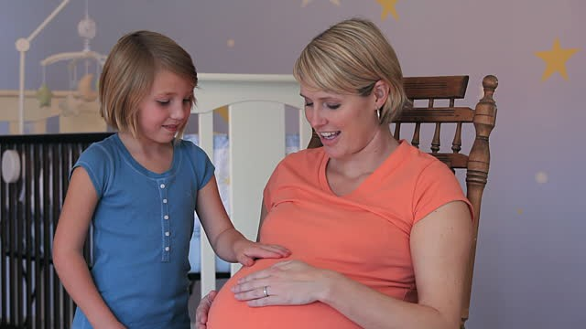
What can you share about getting ready for a baby in your family whānau?
L-1
S-09
Click in the box and write your text
Notes:
Children share their experiences of preparing for a new baby in their family
whānau. Ideas are recorded.

Slide 10
Check up
1)
What did Mary do to get ready for Jesus to be born?
2)
What did Joseph do to get ready for Jesus to be born?
3)
What did someone you know do to get ready for their baby to be born?
4)
Which activity do you think helped you to learn best in this lesson?
5)
Questions I would like to ask about the topics in this lesson are…
L-1
S-10
Click in each caption space to reveal text
Notes:
This formative assessment strategy will help teachers to identify how well the children have achieved the Learning Intentions of the lesson.
Teachers can choose how they use the slide in their range of assessment options.
A worksheet of this slide is available as an option for children in Year 1-6 to complete
The last two items are feed forward for the teacher.

Slide 11
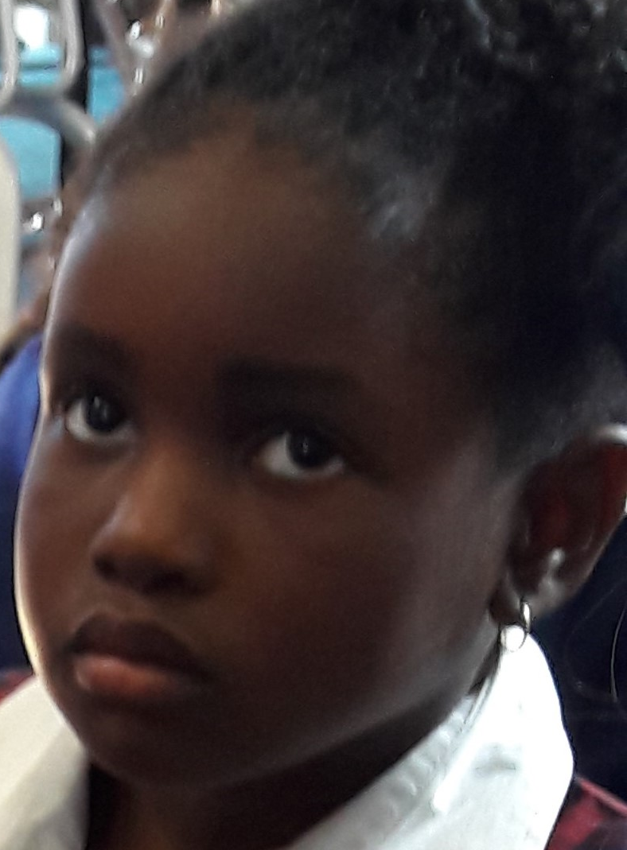
Time for Reflection
L-1
S-11
Click the audio button to stop Reflective Music
Click the audio button to play Reflective Music
Notes:
The MP3 is played to help create a reflective atmosphere and bring the children to stillness and silence as the teacher invites them to think about all the ways Mary and Joseph prepared for Jesus’ birth by getting the things he needed ready and waiting patiently for him to come into their family.

Slide 12
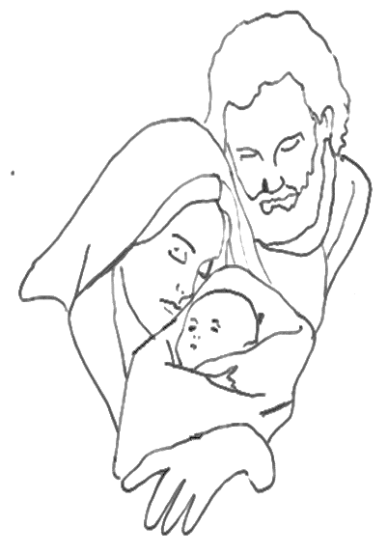
Here is what Mary and Joseph got ready for Jesus
Name___________________________ Date_______________
Mary and Joseph talked and prayed about their new baby.
They loved him already as they waited for his birth.
Swaddling clothes for Jesus | A bed for Jesus | A warm blanket for Jesus | A hat for Jesus | A basket to carry Jesus in
L-1
S-7
Worksheet
Click the up arrow to return to the lesson
Notes:
This worksheet relates to slide 7

