Slide 1
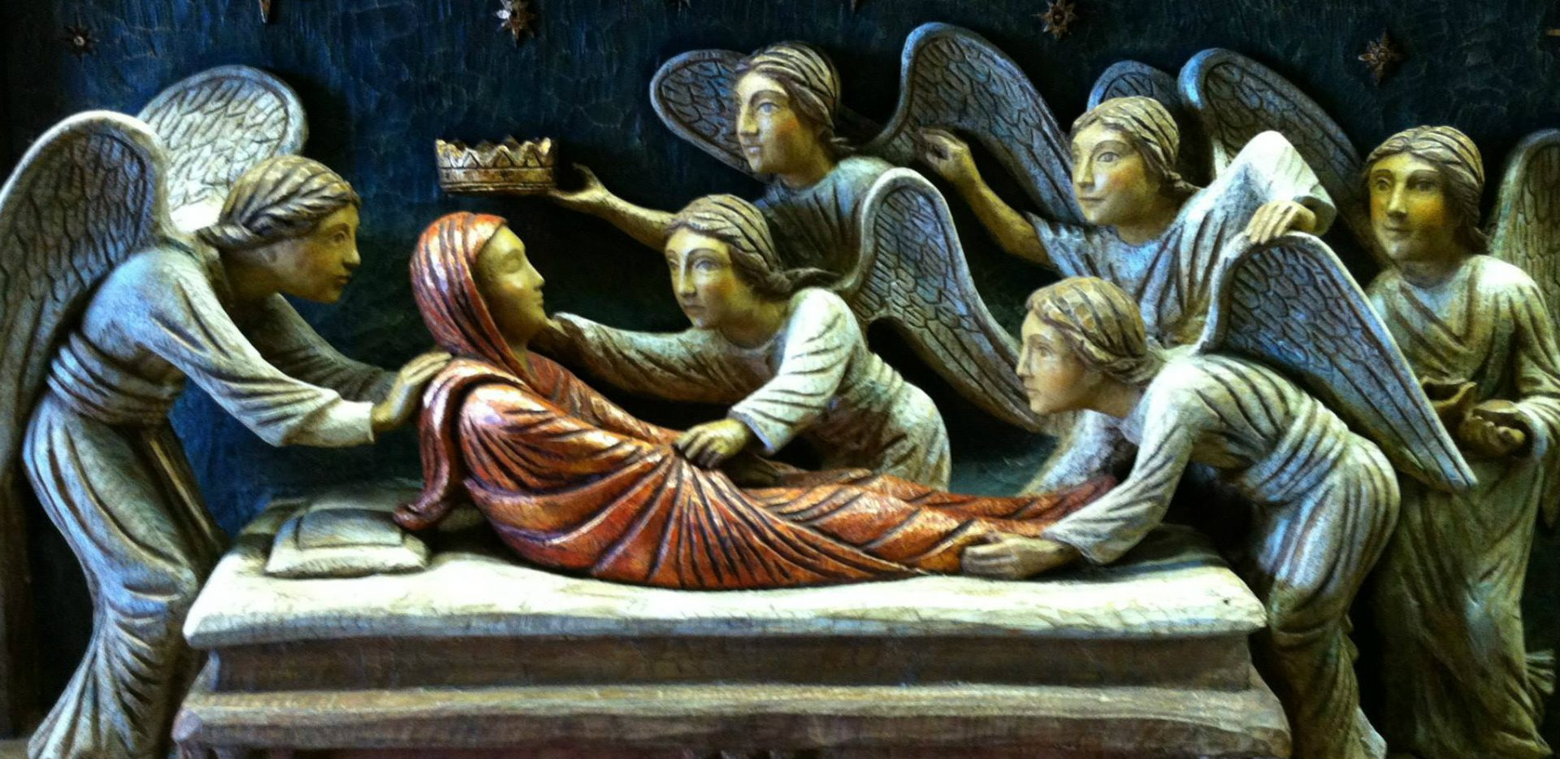
The Feast of the Assumption
R-1
S-01
Notes:
Slide 1 The Feast of the Assumption
Use this slide as a focussing strategy to introduce the resource topic. Read the title together and invite students to share something they know about Mary’s Assumption to heaven and how through this she shares in the resurrection of her son Jesus.
Note well: Read background notes for teachers and children on Slides 3A & 3B before starting to use the resource.

Slide 2
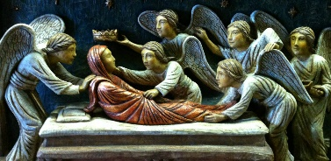
Learning Intentions
The students will:
1)
recognise that the feast of the Assumption is a Holy Day of Obligation
2)
recognise that in her Assumption to Heaven Mary shares in the resurrection of her son.
R-1
S-02
Click the borders to reveal text
Notes:
Slide 2 Learning Intentions
Read through the Learning Intentions with the class and identify some ideas/questions that might be explored in the resource.
Create a Mary class prayer focus and read the gospel of Luke 1:39-56 and songs on Slides 6B, 8, and the you tube on Slide 10 for class prayer this week.

Slide 3
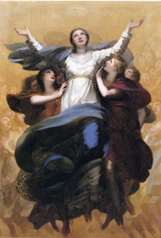
What does the Assumption of Mary mean?
The Assumption of Mary means that Mary was taken to heaven, body and soul, by God. How this happened is a mystery of faith but has been believed by Christians from the earliest days of the Church. In 1950 Mary’s Assumption was declared a dogma of the Church by the Pope.. Can you name any other mysteries of the Catholic faith?
A dogma is a truth that has been revealed by God which Catholics have long accepted and believed in by faith and grace. At the Council of Ephesus in 431, the first dogma that was declared about Mary was that she is Mary, the Mother of God.. Why are dogmas important in the Catholic Church?
Originally the belief in the Assumption was celebrated on August 15 and was called the Dormition or Memorial of Mary. Many people had been petitioning Pope Pius XII to have the belief declared a dogma. The Vatican II documents refer to Mary’s Assumption as “a sign of certain hope and comfort to the pilgrim People of God”. Why does Mary’s Assumption give people hope and comfort?
R-1
S-03A
Click on the icons to reveal text and the image on the right
Notes:
Slide 3A What does the Assumption of Mary mean?
Invite the students to share what the word ‘Assumption’ means.
Read background notes for teachers and children on Slides 3A & 3B before starting to use the resource. Share the information below with the class as you work through the text reveals and questions.
Background information for teachers to share - The Assumption of Mary means that Mary was taken to heaven, body and soul, by God. How this happened is a mystery of faith but has been believed by Christians from the earliest days of the Church. In 1950 Mary’s Assumption was declared a dogma of the Church by the Pope.
A dogma is a faith belief revealed by God that is set down by the Magisterium of the Church for Catholics to believe. A dogma is defined formally when there is a controversy that needs to be clarified or when the Church thinks that the faithful can be helped by a particular emphasis being drawn to an already existing belief. This was the case in defining the dogma of the Assumption of Mary in an Apostolic Constitution declared by Pope Pius XII on Nov 1st. 1950. The title of the dogma was ‘Munificentissimus Deus’ which is Latin for the ‘most bountiful God’.
Dogmas of Mary always clarify, highlight and safeguard the integrity and qualities of Jesus. Jesus, who is the Son of God, had been carried within Mary’s body, therefore her ‘sacred body’ could not be left in a tomb to be ‘reduced to dust and ashes’. (M D no. 14)
We bring to mind the Assumption of Our Lady when we pray the 4th decade of the Glorious Mysteries of Mary’s prayer, the Rosary, which has been prayed by Catholics for many centuries. Prayer to Mary unites us more closely to her son, Jesus.

Slide 4
What does the Assumption of Mary mean?
When a dogma is declared by the Pope it has come from an accepted faith belief of the faithful people, and will be celebrated and expressed by them in their faith community prayer and liturgical celebrations. How is the Assumption of Mary celebrated in your faith community now?
During Bishop Pompallier’s first Mass at Totara Point on 13th January 1838, he placed the whole country under the patronage of Our Lady of the Assumption making this feast our national feast day and a Holy Day of Obligation in Aotearoa New Zealand. Watch the clip of the celebrations in Rome when the Pope declared Mary’s Assumption a dogma.
Click on the icons to reveal text and the image on the right
Click the video icon to play ‘The Assumption Declaration’
R-1
S-03B
Notes:
Slide 3B What does the Assumption of Mary mean?
Watch the clip
The Assumption Declaration 1:41 Minutes
https://www.youtube.com/watch?v=PJcSyaRU0kc
Invite students to make some observations of the 1950 clip. Remind them it is taken in the same St Peter’s Square in Rome where Pope Francis is often seen
Background information for teachers to share - The Assumption of Mary means that Mary was taken to heaven, body and soul, by God. How this happened is a mystery of faith but has been believed by Christians from the earliest days of the Church. In 1950 Mary’s Assumption was declared a dogma of the Church by the Pope.
A dogma is a faith belief revealed by God that is set down by the Magisterium of the Church for Catholics to believe. A dogma is defined formally when there is a controversy that needs to be clarified or when the Church thinks that the faithful can be helped by a particular emphasis being drawn to an already existing belief. This was the case in defining the dogma of the Assumption of Mary in an Apostolic Constitution declared by Pope Pius XII on Nov 1st. 1950. The title of the dogma was ‘Munificentissimus Deus’ which is Latin for the ‘most bountiful God’.
Dogmas of Mary always clarify, highlight and safeguard the integrity and qualities of Jesus. Jesus, who is the Son of God, had been carried within Mary’s body, therefore her ‘sacred body’ could not be left in a tomb to be ‘reduced to dust and ashes’. (M D no. 14)
We bring to mind the Assumption of Our Lady when we pray the 4th decade of the Glorious Mysteries of Mary’s prayer, the Rosary, which has been prayed by Catholics for many centuries. Prayer to Mary unites us more closely to her son, Jesus.

Slide 5
Some background information to increase our understanding of the importance of Mary’s Assumption as a feast
We expect Mary died before she was assumed by the power of God into heaven. Death is the natural process that ends all human life. Death was not part of God’s plan but it came into the world because people turned away from God.
God has promised to raise
all people on the last day
to be happy in
heaven forever.
By his death and resurrection Jesus restored God’s original plan for our resurrection. Mary was the first person to show us what God
has planned for us
after we die.
This is why Mary’s Assumption is a feast of great importance
for all people.
Mary’s body and soul were never separated because God brought them to heaven together.
Mary did not have to wait for Jesus
to come again.
God wanted Mary to enjoy her final resurrection from the moment of her death and Assumption.
On the last day of the world Jesus will come again.
The dead will be raised up and their bodies and souls will be reunited.
This is when God will establish the Kingdom of justice, peace and mercy for those who have been faithful to God.
Jesus began his Kingdom while he was on earth and we as his followers have helped to carry it on.
When people’s lives come to an end their bodies die and decay but their souls are immortal – they never die. God’s plan is that the souls of all people will come to heaven to be with God to share eternal happiness.
By sacrificing his life Jesus restored God’s plan and God’s relationship
with people. By Jesus’ life and death all people were saved and became God’s favoured people again. This is why we call Jesus our Saviour.
God loved all of creation very much and did not want to be separated from any part of it especially the people. God sent his son Jesus into the world to restore the relationship they had broken.
Jesus gave his life as a sacrifice to save people from the consequences of their actions that had brought pain, sin and death into the world.
God’s plan was that people and all creation would live in perfect harmony with God and there would be no pain, no sin and no death. But people used their free will to turn away from God and the plan was damaged. The story in the bible of Adam and Eve is a way of explaining how this might have happened.
R-1
S-04
Click on the top right card to flip the page.
Notes:
Slide 4 Some background information to increase our understanding of the importance of Mary’s Assumption as a feast
Let students take turns at reading through the flip book pages and after each page invite them to make a comment or raise a question. Keep note of these and respond to them after the next slide.

Slide 6
Mary’s Assumption is such an important feast because …
Mary’s body and soul were taken to heaven at her Assumption, Mary already shares in the fullness of the new life promised to people through the resurrection of her son, Jesus
Mary shares in Jesus’ resurrection through her Assumption and this makes it possible for us to share in it also. What happened to Jesus through his resurrection has also happened to Mary
the Church understands Mary’s Assumption as a feast that gives people great hope because it means that all people will share in the resurrection of their bodies and their souls
the feast of the Assumption also celebrates the dignity of the body and soul of each person as gifts given by God to be respected not only during life but also after death
Mary’s Assumption gives people hope and faith to believe that heaven is their final goal where they will share in the fullness of God’s tapu forever.
Click the down-button to move the blind down.
Click the Worksheet button to go to the worksheet.
R-1
S-05
Notes:
Slide 5 Mary’s Assumption is such an important feast because …
Print a copy of the worksheet for each student.
Students read each reveal statement in pairs and share what it means in their own words to clarify their thinking.
Invite students to respond to one of the statements that helps them to understand why Mary’s Assumption is an important feast in the Liturgical Year. Students could research and brainstorm words related to the topic to include in the Acrostic poem.
Students complete the Acrostic poem on the worksheet as part of a CELEBRATING MARY’S ASSUMPTION display to share around the school and church in celebration of Mary’s Assumption Day.
REMINDER - An acrostic is a type of poetry where the first letters of words are written vertically down the left side of a page. Students use each letter as the beginnings of an idea related to the theme of the poem. Worksheet could be left until the end of session to complete.

Slide 7
What happened when Mary’s life on earth came to an end
It is not known for certain the place and time of Mary’s death. When Jesus was on the cross he placed Mary in the care of John, his dearest apostle, so there is some belief that she died in Ephesus near where John lived. A house in Ephesus known as Mary’s house remains there today. Mary’s death was first called her ‘dormition’ which means her ‘falling asleep’.
We could expect that as a member of the first Christian community, and the first disciple of her son Jesus, Mary’s death would have caused much sadness among the disciples and they would have anointed her body for burial as was their custom. Accounts of the ‘Passage of Mary’ – the Assumption – were widespread in 5 ancient languages as early as the 4th century and must have originated centuries earlier.
R-1
S-06A
Click the handle to move the blind down.
Notes:
Slide 6A What happened when Mary’s life on earth came to an end
Use each section of the text to initiate questions, comments or topics to research eg the place of relics related to saints and holy people in the life of the Church.
Remind students that what is known about Mary’s life comes from the Scripture. Other possible events that may have taken place can be accepted as legend or cultural practices of her time and place.
Draw to the students’ attention to the traditional styles of many art works associated with special events in Mary’s life. Notice the style of the images on the slides, think about what is happening, who is present and what your reaction to the image is. Discuss the style you prefer and give reasons for your choice.
Students could research the use of the colours blue and red in art works that include Mary and Jesus and what they symbolise.

Slide 8
What happened when Mary’s life on earth came to an end
In keeping with Catholic belief a person’s soul leaves their body when they die and goes to be with God. Their body is buried before it begins to decompose which is the natural process of all living things. This did not happen to Mary’s body because her body had carried Jesus, who was God. God brought her body and her soul to heaven to be honoured with God and Jesus.
The Assumption of Mary was a privilege granted not only to her body and to her soul but to the whole person, Mary. The belief in the Assumption of Mary is not found in the Bible, it was derived from what the Church calls Sacred Tradition. This is the oral (spoken not written) tradition handed down from the apostles that is equal in authority to the Bible.
The early Christians prized greatly the relics of the first martyrs. Martyrs’ bones were ‘like jewels, more precious that gold’. There were never any references in early Church writings to Mary’s relics, that would have been the most highly prized. This is because it was believed that the remains of her earthly body were taken up, assumed, by God to heaven.
Click the handle to move the blind down.
R-1
S-06B
Click the audio button to play ‘Te Waiata a Maria’
Click the audio button to stop ‘Te Waiata a Maria’
Notes:
Slide 6B What happened when Mary’s life on earth came to an end
Use each section of the text to initiate questions, comments or topics to research eg the place of relics related to saints and holy people in the life of the Church.
Remind students that what is known about Mary’s life comes from the Scripture. Other possible events that may have taken place can be accepted as legend or cultural practices of her time and place.
Draw to the students’ attention to the traditional styles of many art works associated with special events in Mary’s life. Notice the style of the images on the slides, think about what is happening, who is present and what your reaction to the image is. Discuss the style you prefer and give reasons for your choice.
Students could research the use of the colours blue and red in art works that include Mary and Jesus and what they symbolise.

Slide 9
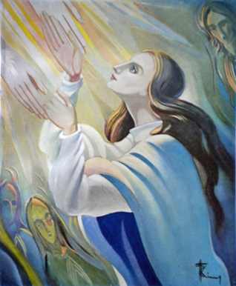
How do we benefit from Mary’s Assumption?
God rewarded Mary for living her life free of sin and
Mary’s life was bound closely to Jesus as his human mother
In God’s plan Mary was the living example of
Jesus ascended to God by his own power as God’s son
Mary’s Assumption shows us that now she is in heaven
Mary’s Assumption affirms the fulfilment of our human
The feast of the Assumption teaches us to have
with a spirit of faithfulness and cooperation with God.
and God used Mary as an example that God never forgets his promises to people.
the promise God made of eternal life for all human beings.
and Mary’s Assumption was by the power of God.
she can intercede and speak to God for us when we pray.
destiny and the dignity and respect due to our human bodies.
hope that God will do for us what he did for Mary.
and Mary’s Assumption was by the power of God.
destiny and the dignity and respect due to our human bodies.
and God used Mary as an example that God never forgets his promises to people.
with a spirit of faithfulness and cooperation with God.
hope that God will do for us what he did for Mary.
she can intercede and speak to God for us when we pray.
the promise God made of eternal life for all human beings.
R-1
S-07
Click sentence part from the list to complete the sentences above.
Notes:
Slide 7 How do we benefit from Mary’s Assumption?
ANSWERS
1) D, 2) C, 3) G, 4) A, 5) F, 6) B, 7) E
Students read and discuss the correct statement that will complete each sentence.
Check suggestions by using the floater tool. Use sentences to uncover students’ questions and comments.

Slide 10
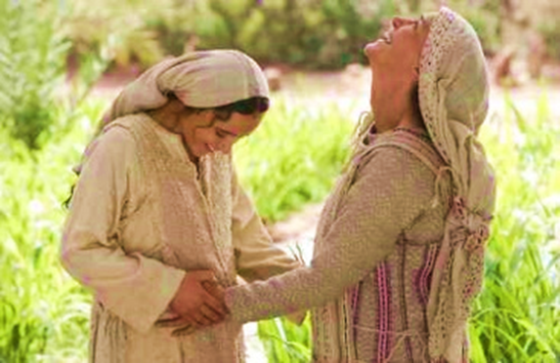
Mary was recognised as a woman blessed by God
Mary was chosen to be the mother of Jesus, the Saviour of the world. She was the most blessed of all women and this was recognised by her cousin Elizabeth in her greeting “Blessed are you among women and blessed is the fruit of your womb”. Who is Elizabeth referring to?
Mary is now praising God in heaven as she did while she was on earth (Luke 1: 46-55). Mary did not have to wait for the end of time as other humans do for their body to be reunited with their souls in heaven because her body was with her soul as she was assumed into heaven. Mary never forgets all of humanity and takes their prayers to God and speaks to God on their behalf. What can Mary do for us now?
Mary’s response to Elizabeth’s recognition of her special role in the life of God’s son Jesus was to attribute it all to God’s faithfulness and goodness, that she could live her life doing exactly what God asked her to do through the grace of the Holy Spirit. She took no credit for herself. What prayer uses these words that honour Mary?
Click the pins on the right to reveal post-it notes.
R-1
S-08
Click the audio button to stop ‘My Spirit Sings’
Click the audio button to play ‘My Spirit Sings’
Notes:
Slide 8 Mary was recognised as a woman blessed by God
Sing using the MP3 ‘My Spirit Sings’
Adapt Teaching and Learning Experience 3
The story of Mary’s Visitation to Elizabeth (Luke 1:39-56) is the gospel read at Eucharist on Assumption Day, August 15. Read this gospel in class prayer this week, pray the prayers mentioned below and sing the Mary songs in this resource.
Question responses:
Who is Elizabeth referring to? Jesus
What prayers use these words that honour Mary? The Magnificat , The Hail Mary, The Angelus
What does Mary show us that we too will share in at the end of our lives? We will share in the resurrection of her son and he will take us to heaven to live with him forever.
What can Mary do for us now? Although Mary is now our Mother in heaven and she knows what it is like to be human and will speak to God for us. We only need to ask for her help and she will bring our needs to God and this unites us more closely to God.

Slide 11
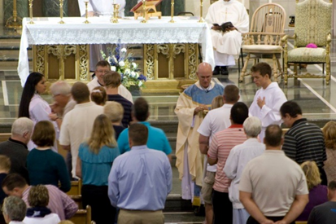
We honour Mary’ Assumption day as a Holy Day of Obligation
What does a Holy Day of Obligation mean?
What day every week is a Holy Day of Obligation and why?
What are the two feast days that are Holy Days of Obligation in Aotearoa New Zealand?
What does the Church celebrate on Mary’s Assumption day?
How does the Church celebrate Holy Days of Obligation?
Why is participating in the Eucharist a good way to celebrate Holy Days of Obligation?
X
R-1
S-09
Click the I-button to reveal information
Notes:
Slide 9 We honour Mary’ Assumption day as a Holy Day of Obligation
Discuss how some of the ideas from this resource could be used in the parish celebration of the Eucharist to celebrate this Holy Day of Obligation.
Adapt Teaching and Learning Experience 2
What does a Holy Day of Obligation mean? These are special feast days in the Liturgical Year on which Catholics are expected to gather and celebrate Eucharist.
What day every week is a Holy Day of Obligation and why? Every Sunday.
What are the two feast days that are Holy Days of Obligation in Aotearoa New Zealand? Christmas Day, December 25, and the feast of the Assumption on August 15
What does the Church celebrate on Mary’s Assumption day? The Church celebrates that God took Mary to heaven body and soul and God has promised that the same will be done for faithful people like Mary and this is what Christians hope for.
How does the Church celebrate Holy Days of Obligation? By community celebrations of the Eucharist.
Why is participating in the Eucharist a good way to celebrate Holy Days of Obligation? It reminds the community:
of Mary’s faithfulness to God and encourages everyone to be like Mary,
that Mary is proof that God keeps his promises to bring people to heaven.
to give honour to Mary as our heavenly Mother and model of faith.
that Assumption day is the national feast day for Aotearoa New Zealand and Mary is our protector and guide.

Slide 12
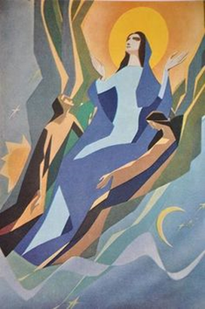
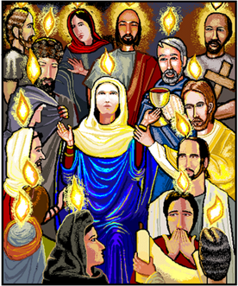
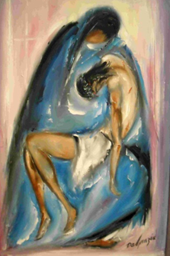
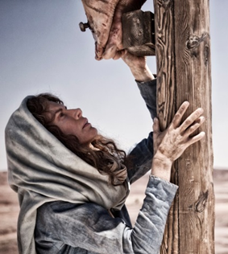
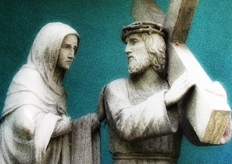
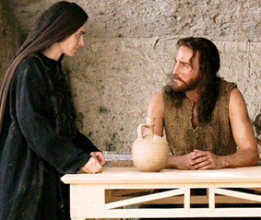
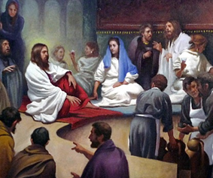
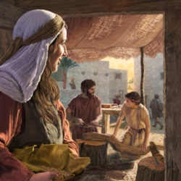
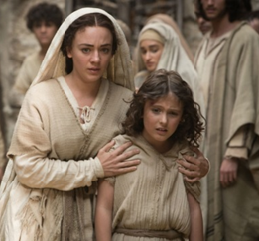
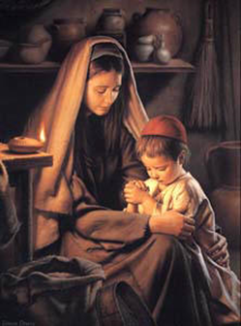
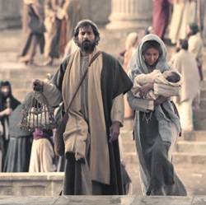
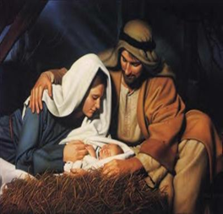
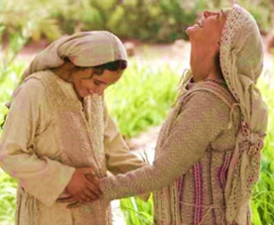
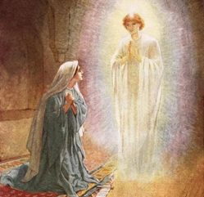
Recalling Mary’s Life
Find your own images of some of the important events in Mary’s life.
Create a power point presentation with text to share with younger classes to teach them about Mary and her life.
The last slide could be about Mary’s Assumption.
You could include the words of a hymn to honour Mary on her special feast.
Joseph taught Jesus to work with wood
The Annunciation
The Visitation
The Presentation
Mary gives birth to Jesus
Mary and Joseph find Jesus in the temple
Jesus carries his cross to Calvary
At Cana Jesus performed his first miracle
Mary supported Jesus
Mary stands at the foot of the cross
Mary taught Jesus to pray
Mary is present when the Holy Spirit comes at Pentecost
Mary is assumed into heaven body and soul
Jesus is taken down from the cross
Click any Image for more information, click again to return. Click the worksheet button to go to the worksheet and the Video button to play ‘Hail Mary Gentle Woman’
R-1
S-10
Notes:
Slide 10 Recalling Mary’s Life
Students recall and share what they know about Mary’s life and make a list of key events. Decide which events they would like to include in a power point to share with younger classes or with their family members. The power point could be used as part of a Liturgy to celebrate Mary’s Assumption.
Adapt Teaching and Learning Experience 4
Students complete their worksheet and add to their RE Learning Journal.
Pierre could you make a slide where the worksheet images appear and each title (in bold) appears on the worksheet image when they are clicked on so students could check their completed worksheet. Please leave a space for students to write the bolded title of the image.
Image titles for teachers’ reference
The Annunciation – Mary agrees to be the mother of God’s Son, Jesus.
The Visitation – Mary visits her cousin Elizabeth while pregnant with Jesus.
Mary gives birth to Jesus in Bethlehem.
The Presentation - Mary and Joseph present Jesus at the Temple.
Mary, Joseph and Jesus live in Nazareth and Mary teaches Jesus to pray.
Mary and Joseph find Jesus in the temple after he was lost for 3 days in Jerusalem.
Joseph taught Jesus to work with wood in his carpenter’s shop.
As he grew to be an adult Mary supported Jesus as he gathered his group of apostles.
At the marriage feast at Cana Jesus performed his first miracle at Mary’s request.
Jesus carries his cross to Calvary – he meets Mary on the way.
Mary stands at the foot of the cross and watches as her much loved son dies.
Jesus is taken down for the cross and Mary holds his dead body in her arms.
Mary is present when the Holy Spirit comes at Pentecost.
Mary is assumed into heaven body and soul giving people hope that they will do the same.
Watch the clip ‘Hail Mary Gentle Woman’
4:30 minutes https://www.youtube.com/watch?v=RERoQ1biLdE&list=RD3zIIWVioh-Q&index=20
Please note there is no Scriptural account of Jesus appearing to his mother after the resurrection but there is little doubt he did but it was not recorded. Mary is mentioned in the Pentecost story in Acts 1:14.

Slide 13
Check up
1)
Write 5 things you learned about what a dogma is and when and how Mary’s Assumption became an official teaching dogma of the Church. (Slides 3A and 3B. YouTube and Teacher Notes)
2)
Make a 2 minute speech explaining how Mary shares in Jesus’ resurrection through her Assumption and how this makes it possible for us to share in it also. (Slide 5)
3)
Make a flowchart to show what happened when Mary’s life on earth came to an end. (Slide 6A and 6B)
4)
List of 3 ways we benefit from Mary’s Assumption. (Slide 7)
5)
How do Catholics honour Mary on her Assumption day and name what this day is called? (Slide 9)
Click in each caption space to reveal text
Click on the worksheet button to go to the worksheet.
R-1
S-11A
Notes:
Slide 11A Check Up
This formative assessment strategy will help teachers to identify how well students have achieved the Learning Intentions of the resource.
Teachers can choose how they use the slide in their range of assessment options.
A worksheet of this slide is available for students in Years 5-8 to complete.
The last two items are feed forward for the teacher.
Recording the children’s responses to these items is recommended as it will enable teachers to adjust their learning strategies for future resources and target the areas that need further attention.

Slide 14
Check up
6)
Make a timeline of human statues or a power point presentation of Mary’s life to share with your class, family and parish. (Slide 10)
7)
Prepare a liturgy to celebrate Mary’s life and her Assumption and use the Mary songs in the resource. (Slide 6B MP3, Slide 8 MP3, Slide 10 Youtube clip 10)
8)
Which activity do you think helped you to learn best in this resource?
9)
Questions I would like to ask about the topics in this resource are …
Click in each caption space to reveal text
Click on the worksheet button to go to the worksheet.
R-1
S-11B
Notes:
Slide 11B Check Up
This formative assessment strategy will help teachers to identify how well students have achieved the Learning Intentions of the resource.
Teachers can choose how they use the slide in their range of assessment options.
A worksheet of this slide is available for students in Years 5-8 to complete.
The last two items are feed forward for the teacher.
Recording the children’s responses to these items is recommended as it will enable teachers to adjust their learning strategies for future resources and target the areas that need further attention.

Slide 15
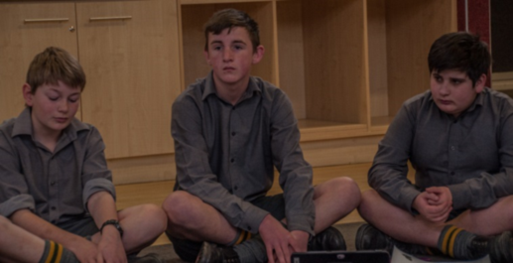
Time for Reflection
R-1
S-12
Click the audio button to play reflective music
Click the audio button to stop reflective music
Notes:
Slide 12 Time for Reflection
The MP3 is played to help create a reflective atmosphere and bring the young people to stillness and silence as the teacher invites them to reflect on what happened to Mary when her earthly life ended and what God did to reward her for the goodness, kindness and faithfulness of her life. Listen to the ideas the Spirit is bringing into their minds and hearts about ways they can live a life of goodness, kindness and faithfulness with Mary as their model.

Slide 16
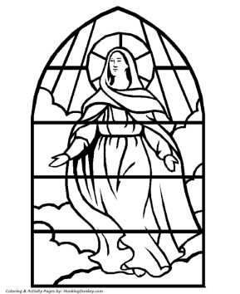
CELEBRATING MARY’S ASSUMPTION INTO HEAVEN
M A R Y S A S S U M P T I O
N
Name: _______________
Date: _________
R-1
S-05
Worksheet
Click on the worksheet button to go to the worksheet
Click the up arrow to return to the lesson

Slide 17
Recalling Mary’s Life
Name: _______________
Date: _________
R-1
S-10
Worksheet
Click any Image for more information, click again to return. Click the worksheet button to go to the worksheet and the Video button to play ‘Lady in Blue’
Click the up arrow to return to the lesson

Slide 18
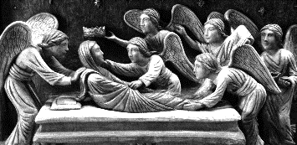
Check up
Name:____________________________
Date:____________
Write 5 things you learned about what a dogma is and when and how Mary’s Assumption became an official teaching dogma of the Church. (Slide 3. YouTube and Teacher Notes)
Make a 2 minute speech explaining how Mary shares in Jesus’ resurrection through her Assumption and how this makes it possible for us to share in it also. (Slide 5)
Make a flowchart to show what happened when Mary’s life on earth came to an end. (Slide 6)
List of 3 ways we benefit from Mary’s Assumption. (Slide 7)
How do Catholics honour Mary on her Assumption day and name what this day is called? (Slides 8, 9)
R-1
S-11A
Worksheet
Click the forward arrow to go to the next worksheet or up arrow to return to the lesson

Slide 19
Check up
Name:____________________________
Date:____________
Make a timeline of human statues or a power point presentation of Mary’s life to share with your class, family and parish. (Slides 9, 10)
Prepare a liturgy to celebrate Mary’s life and her Assumption and use the Mary songs in the resource. (Slides 6B MP3, Slide 8 MP3,Slide 10 YouTube)
Which activity do you think helped you to learn best in this resource?
Questions I would like to ask about the topics in this resource are …
R-1
S-11B
Worksheet
Click the up arrow to return to the lesson

