Slide 1
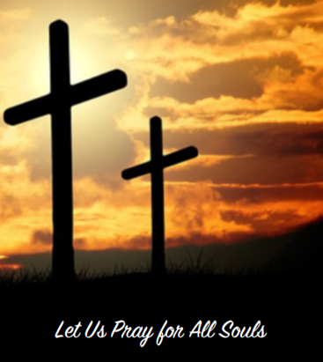
All Souls Day
R-1
S-01
Notes:
Slide 1 All Souls Day
Use this slide as a focussing strategy to introduce the resource topic. Read the title together and invite students to share something they know about what happens to people when they die and the celebration of the Feast of All Souls.
Please note that some of the material in this resource relates to the focus of the material in Year 8 Communion of Saints Strand.

Slide 2
Learning Intentions
The students will:
1)
explain the purpose of All Souls Day
2)
identify one Catholic practice on All Souls Day and explain the belief behind this practice
R-1
S-02
Click the borders to reveal text
Notes:
Slide 2 Learning Intentions
Adapt Teaching and Learning Experience 3.
Create a focus for All Souls Day that can be used all through the month of November for the Holy Souls. You could include photographs, memorial cards and funeral handouts and explain why people use these to help them remember the Holy Souls especially the ones they have known. Remember to use class prayer time every day to pray for the Holy Souls.

Slide 3
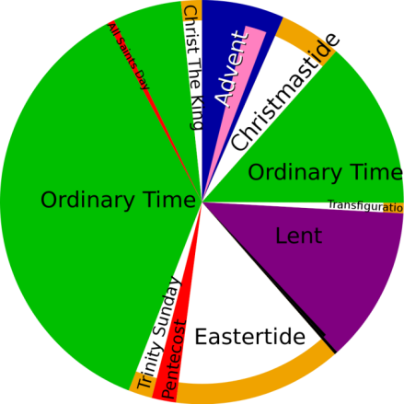
The Feast of All Souls in the Liturgical Calendar
Complete the sentences
The Feast of All Souls is …
the day after the feast of _________________________________ The date is ______________
on the Liturgical Calendar in ____________________________
the day when the community____________________________________________
a day of hope, ______________________________________________________
celebrated in the Catholic community with ______________________________________________________ .
X
R-1
S-03
Click the I-button to reveal information
Notes:
Slide 3 The Feast of All Souls in the Liturgical Calendar
Adapt Teaching and Learning Experience 1.
Work through the items on the pop up and note the
Suggested responses
1) All Saints. The date is November 2
2) Ordinary Time
3) remembers and prays for those who have died.
4) prayer and remembrance especially for people in our family whanau and our friends.
5) a Eucharist to remember the Holy Souls who are waiting in Purgatory to go to heaven.

Slide 4
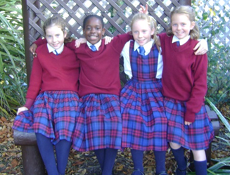
The Human Person – body and soul
The human person’s body shares in God’s dignity and Mana and is made in God’s image through the love and cooperation of parents. The body is brought to life by God when God breathes a soul into it. The body and soul then become one whole person and God has a plan for their life.
When a person’s life comes to an end their body dies and decays and they are buried in the earth. Their soul does not die but it continues to live on – it is immortal. How each person has lived their life determines what happens to their soul after death.
The soul is the most inner part of a person and is the part through which people can come to an awareness of God. The soul is created by God and lives within the person.
God gives each person gifts they can use in their life for their own happiness and to share with others and for the benefit of the earth and all creation.
R-1
S-04
Click the pins on the right to reveal post-it notes.
Notes:
Slide 4 The Human Person – body and soul
Explain that this slide has some important ideas for people of their age to understand as young people in a Catholic school.
After reading each post it, take time to discuss the meaning of the text. Encourage students to ask questions about the ideas in their own words and reflect on how they are aware of their own soul.

Slide 5
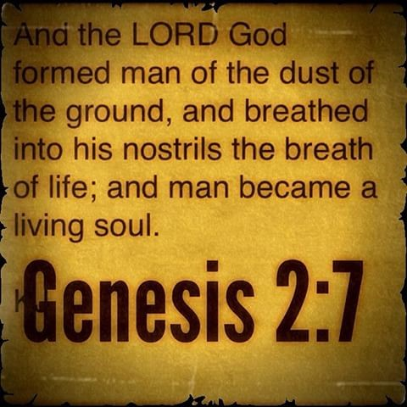
God breathed the breath of life into the first human
God leaned over and ’breathed’ God’s own ‘breath of life’ into the man’s nostrils; God is the Source of life, and God directly placed life within the man and he became a living soul.
The breath of God is the life and power Mana of God, given to all humans to animate them and bring them alive.
The word soul in Hebrew means “an animated, breathing, conscious, and living being.” The man did not become a living soul until God breathed life into him.
R-1
S-05A
Click on the icons to reveal text and the image on the right
Notes:
Slide 5A God breathed the breath of life into the first human
Read each text box and let it generate students’ thinking and questioning.
Read the Genesis quote and reflect on what it means.

Slide 6
God breathed the breath of life into the first human
As physical, animate, rational, and spiritual beings, men and women are unique among all living things upon the earth.
You are one of these unique beings who became alive when God breathed life into you. Imagine the moment God breathed into your little nostrils and you became a unique living human being.
Click on the icons to reveal text and the image on the right.
Click the worksheet button to go to the worksheet.
R-1
S-05B
Notes:
Slide 5B God breathed the breath of life into the first human
Copy a worksheet for each student to complete and add to their RE Learning Journal. Talk through ideas related to each section and create a reflective atmosphere while students complete their work. The ideas are personal so students may prefer not to share them.

Slide 7
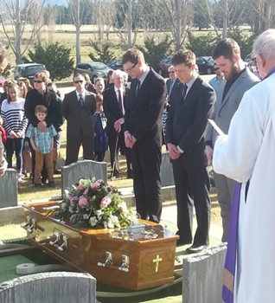
What Catholics believe about what happens after death
Purgatory is a temporary phase which can be hastened through the prayer of people on earth. Remembering and praying for the ‘Holy Souls’ has been a long tradition for Catholics. That is why there is a special feast dedicated to it.
Hell is the enormous pain of separation from God and deep longing to be with God.
Heaven is the perfect life after death in the presence of God, Jesus and the Spirit, Mary, all the Saints and angels and all the blessed. Heaven is the ultimate end and fulfilment of our deepest human longings, the state of supreme and complete happiness forever.
The souls in purgatory are in the final phase of their detachment from sin and its effects. They are full of expectant joy and longing to be with God in heaven. Because God is completely holy those who are with God need to be filled with holiness also.
We are not certain what purgatory is, but we do know that its purpose is to ‘purify’ people so they may be completely holy before they enter heaven. Purgatory is understood to be a ‘state’ not a place or time.
At the moment of death our soul does not die but is separated from our body. We are judged in relation to how we have lived our lives in relationship with God and God’s ways. Then our souls are received into heaven immediately, or through preparation in purgatory, or are separated from God forever.
Death is the end of the journey of life for each human person. Our body dies as our life breath stops. Catholics believe even when our body no longer has life it must be treated with dignity and respect because it has been the temple of the Holy Spirit.
R-1
S-06
Click the top card to discard it.
Notes:
Slide 6 What Catholics believe about what happens after death
Remind students that this topic is important for them to understand as it is about what the Church teaches about what happens when people die. Encourage them to talk to someone older about this.
Read through the flip cards and use them to generate discussion about what happens at the time of the death of a family whānau member or friend and the special feelings of sadness and loss people experience. It is important to acknowledge these and support each other at this sad time.
Explain that the Catholic belief that the soul does not die but will live forever with God gives us hope that we will meet our loved ones again in heaven and this consoles those who are left behind.
Remind the class that the soul and the body are not separate parts of a person and both exist together and make a whole human person. Encourage them to keep in mind what they are learning about that makes them human.

Slide 8
Practices associated with All Souls Day
Praying for the souls of those who have died is a way of carrying on the loving relationships people had with them while they lived on earth. At every Mass there are prayers for those who have died.
The parish community gathers to celebrate Eucharist on All Souls Day to remember those who have died. In some parishes their names are placed in a special box which is kept near the altar and prayed for throughout the month of November.
The Funeral Mass that is held when a person dies celebrates their life and prays for them that their soul is at peace with God.
During this time of mourning the family whānau share their sadness at the loss of the person from their lives. They pray for them, tell stories about them, sing songs and listen to music they liked to remember them.
This is also a time of hope tūmanako because they know their loved one will be enjoying their eternal happiness with God in heaven. They also remember other family whānau members who have died and imagine them all being together in God’s presence.
Click the down-button to move the blind down.
R-1
S-07
Click the audio button to stop ‘Jesus come to Us’
Click the audio button to play ‘Jesus come to Us’
Notes:
Slide 7 Practices associated with All Souls Day
Adapt Teaching and Learning Experiences 1, 2 & 3.
Use the revealed text to generate questions and share experiences about what Catholic people do when a person dies.
Explain to the students that there are traditional rituals, prayers and hymns that are part of how the Catholic Church honours and respects people who have died. Some of these are used at the Funeral Mass for everyone who had died on All Souls Day. They are also remembered and prayed for on the anniversary of their death and during every Mass. Listen for the special prayer for the dead at the next Mass you attend.

Slide 9
Creating rituals of remembrance when people die and on All Souls Day
Families make memory baskets to remind them of their loved ones who have died. These become part of family rituals and prayer on anniversaries which help to keep loving memories alive in a prayerful way.
On Anzac Day children bring flowers for the graves of soldiers to honour them during their community prayer.
In some places All Souls Day is celebrated in a local cemetery to pray for the souls whose bodies lie nearby.
At the end of a Funeral Mass a haka can be performed to pay respect to the person who has died as their coffin leaves the church.
Some schools lead a Liturgy of Remembrance and Thanksgiving at the cemetery during November for the souls of those who have died in their community during the year.
Some family members decorate the coffin of their loved one with art and flowers from
their gardens to remember and celebrate the life
of the person who has died.
Some families gather at their family grave on anniversaries to
remember, pray and give thanks for the lives of their parents and loved ones. Sometimes they bring bunches of rosemary to place on the grave as it is a tradition that rosemary is for remembrance.
R-1
S-08A
Click the images to reveal text, click the text to replace the images.
Notes:
Slide 8A Creating rituals of remembrance when people die and on All Souls Day
Read and comment on the revealed text and invite students to share their experiences and feelings when they have been part of a ritual of remembrance.
Sing ‘Jesus come to me’.

Slide 10
Creating rituals of remembrance when people die and on All Souls Day
R-1
S-08B
Notes:
Slide 8B Creating rituals of remembrance when people die and on All Souls Day
Read and respond to the questions and plan some time for prayer for the Holy Souls on their special feast day.
Adapt Teaching and Learning Experience 5&6.

Slide 11
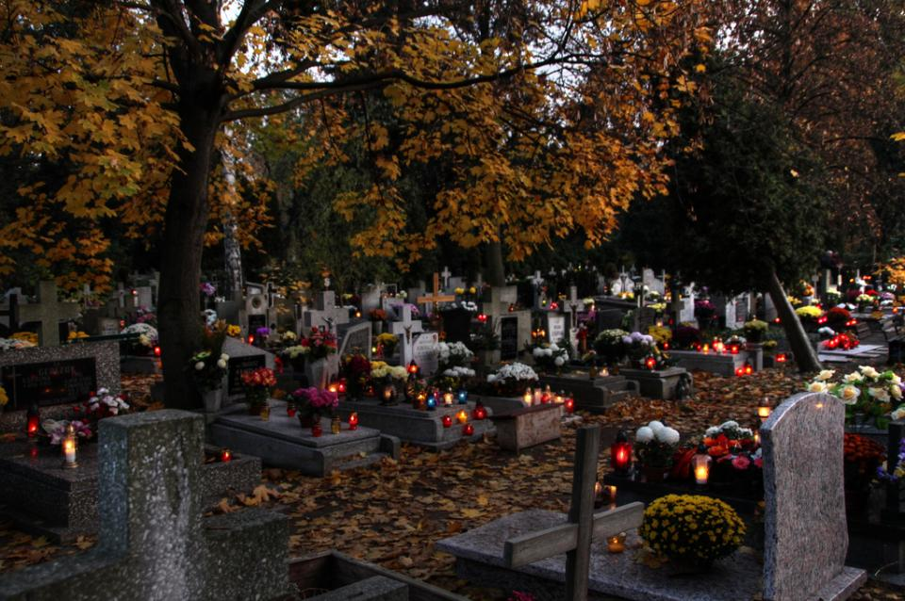
What do you know about All Souls Day practices in other parts of the world?
People bring grave lights and food to the cemetery when they come to pray for the spirits of the dead in
All Souls Day is called the Day of the Dead. It is a national holiday when people bring small altars to the cemetery to pray for the dead in
Entire families spend the night at the graveyard, singing and praying for the souls of their family members in
All Souls Day is a day to reconnect children with their ancestors by showing them photographs and telling stories about them in
On All Souls Day a traditional soup called ‘Soul Food’ and a special cookie called ‘Bones of the Dead’ are made in
People make decorated ‘Sugar Skulls’ for children and ‘Bread for the Dead’ that is eaten at family picnics at cemeteries in
Families sit with the body of the person who has died in their gathering place and talk and sing to them, share memories and honour them in
some European countries.
Mexico and Latin America.
The Philippines.
Poland.
Mexico and Latin America
Italy.
Mexico
Italy
Aotearoa
Mexico.
Poland
The Philippines
some European countries
Aotearoa.
R-1
S-09
Choose words from the list on the right to complete the sentences.
Notes:
Slide 9 What do you know about All Souls Day practices in other parts of the world?
Students share what they know and check them with the floaters.
Answers
1) Some European countries, 2) Mexico and Latin America, 3) The Philippines, 4) Poland, 5) Italy, 6) Mexico, 7) Aotearoa

Slide 12
Check up
1)
Write a paragraph about what makes a human person and how each dimension helps people to be a whole person so they can be who God created them to be. (Slides 4 & 5)
2)
Make a brochure or a power point for younger children that explains why we have All Souls Day and include 2 key Catholic beliefs and practices used to celebrate it. (Slide 6)
3)
Make a list of five things that could be part of a Prayerful Remembrance Ritual you could prepare and use with your family whānau or describe an experience of one you have experienced in your school, parish or marae. (Slide 8)
4)
What is the most useful thing we can do to help the Holy Souls and give a reason for this. (Slide 6 & 7)
5)
Which activity do you think helped you to learn best in this resource?
6)
Questions I would like to ask about the topics in this resource are …
Click in each caption space to reveal text
Click on the worksheet button to go to the worksheet.
R-1
S-10
Notes:
Slide 10 Check Up
This formative assessment strategy will help teachers to identify how well students have achieved the Learning Intentions of the resource.
Teachers can choose how they use the slide in their range of assessment options.
A worksheet of this slide is available for students in Years 5-8 to complete.
The last two items are feed forward for the teacher.
Recording the students’ responses to these items is recommended as it will enable teachers to adjust their learning strategies for future resources and target the areas that need further attention.

Slide 13
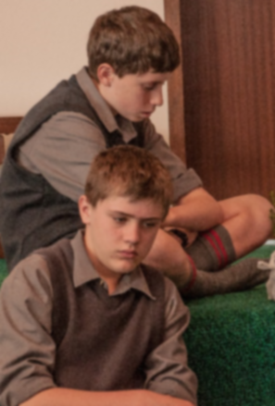
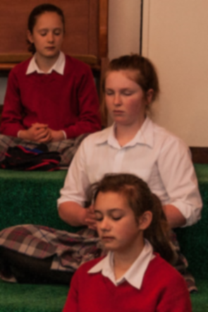
Time for Reflection
R-1
S-11
Click the audio button to play reflective music
Click the audio button to stop reflective music
Notes:
Slide 11 Time for Reflection
The MP3 is played to help create a reflective atmosphere and bring the young people to stillness and silence as the teacher invites them to reflect on how God gave them life, and how they live it in respect of God’s plan will decide what happens to them when their life is ended.

Slide 14
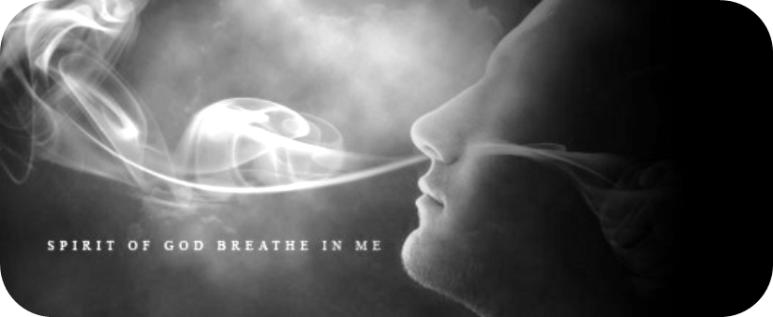
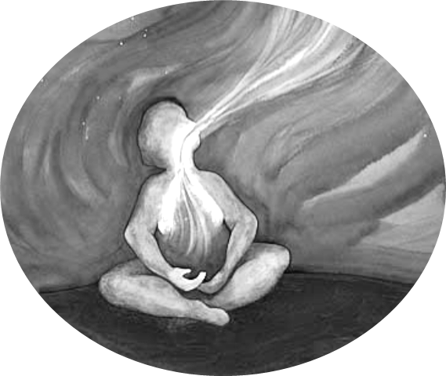
Reflect on the Gift of Life God has Breathed into You
How are you aware of God’s breath of life in you?
What gifts did God give you to make your life full and happy?
What challenges do you have in your life and how do you involve God in dealing with them?
What are you most grateful to God for?
What plan do you think God has for your life and how is it taking shape?
Name: _______________
Date: _________
R-1
S-05
Worksheet
Click the up arrow to return to the lesson
Notes:
Slides 5A&B God breathed the breath of life into the first human WORKSHEET
This worksheet relates to slides 5A&B

Slide 15
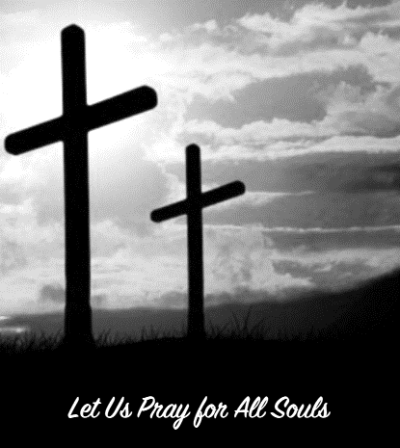
Check up
Name:____________________________
Date:____________
Write a paragraph about what makes a human person and how each dimension helps people to be a whole person so they can be who God created them to be. (Slides 4 & 5)
2. Make a brochure or a power point for younger children that explains why we have All Souls Day and include 2 key Catholic beliefs and practices used to celebrate it. (Slide 6) Check it out it on your class and then share it with younger children.
3. Make a list of five things that could be part of a Prayerful Remembrance Ritual you could prepare and use with your family whānau or describe an experience of one you have experienced in your school, parish or marae. (Slide 8)
What is the most useful thing we can do to help the Holy Souls and give a reason for this. (Slide 6 & 7)
5. Which activity do you think helped you to learn best in this resource?
6. Questions I would like to ask about the topics in this resource are …
R-1
S-10
Worksheet
Click the up arrow to return to the lesson
Notes:
Slide 10 Check Up WORKSHEET
This worksheet relates to slide 10

