Slide 1
All Souls Day
R-1
S-01
Notes:
Use this slide as a focussing strategy to introduce the resource topic.
Read the title together and invite children to share something they know about All Souls Day and how Catholics celebrate it.
Create a class prayer focus to bring this feast into children’s minds: read Luke 23:39-43 in class prayer this week, encourage children to focus their prayer on the holy souls, sing ‘Jesus remember me’, ask children to make a list at home of family whānau who have died and each day read out some names from it to bring to God during prayer.

Slide 2
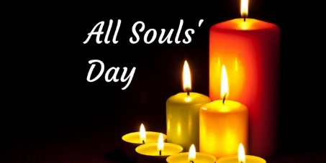
Learning Intentions
The children will:
1)
explain the purpose of All Souls Day
2)
identify how the Church on earth can help the Holy Souls in purgatory.
R-1
S-02
Click in each caption space to reveal text.
Notes:
Read through the Learning Intentions with the class and identify some ideas/questions that might be explored in the resource.

Slide 3
What is the purpose of All Souls day?
Catholics have always had the tradition of praying for people who have died as a way of continuing their relationship with them and helping them on their way to heaven.
Catholics believe that the prayer and good deeds of the living help those in purgatory to achieve the holiness they need to enter into the glory of God in heaven.
Catholics believe that some people who die in the peace of Christ go to heaven immediately after death while others may need to spend time preparing to go to heaven before they can enjoy the fullness of God’s presence. We call this preparation purgatory.
All Souls Day is the day in the Liturgical Year which the Church sets aside for the community to remember and pray for all those who have died especially members of their own family and whānau.
R-1
S-03
Click the pins on the right to reveal post-it notes.
Notes:
Note – All Souls day used to be called Holy Souls day.
Read each post it and use the information as conversation starters about All Souls day, what it is and why we have it, and who the Holy Soul are.
Ask children if they know someone who might be a Holy Soul.

Slide 4
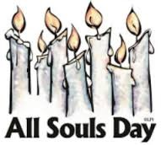
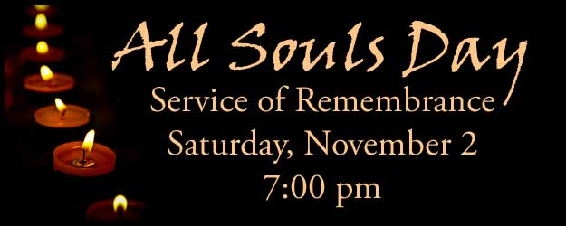
When is All Souls Day celebrated?
The annual celebration of All Souls Day is held on 2 November - if it falls on Sunday it is moved to Monday, November 3. It is one of the feasts that occurs in Ordinary Time. Ask someone in your family whānau to tell you about how they celebrated All Souls Day when they were your age.
All Souls Day is one of the three feast days of All-Hallow-Tide (an old word meaning time) which includes Halloween (31 October) and All Saints Day (1 November). Which feast is your favourite day in All-Hallow-Tide? Why?
Catholic custom is to pray for the living and those who have died every day but especially on November 2nd as it is the day when the prayer of the Church focusses on helping the souls of the people who are waiting to enter heaven. This All Souls Day think of a person you have known and loved that you could pray for - share their name and who they were with a partner.
R-1
S-04A
Click an image on the left to reveal text.
Notes:
Adapt Teaching and Learning Experience 2.
Read and respond to each revealed text block.

Slide 5
When is All Souls Day celebrated?
All Souls Day is at the start of November and this whole month is dedicated to prayer for the souls who are getting ready to be with God. During this time the prayer of the people who loved them while they were on earth is helping them to enter heaven to be with God. Think about how you can use all the days of November to help people to enter into God’s presence.
All Souls Day is a good day to learn something about what happens after death from what Jesus said to the good thief when they were hanging on the cross. Read the story in Luke 23:39-43 and talk about what the good thief was asking for and why.
Make a fridge magnet to remind your family to pray for the souls of your family whānau members and friends who have died.
R-1
S-04B
Click an image on the left to reveal text.
Click the audio button to stop ‘Jesus remember me’
Click the audio button to play ‘Jesus remember me’
Notes:
In pairs share 5 things you know about All Souls Day.
Sing using the MP3 ‘Jesus Remember Me’.
Make a fridge magnet to remind your family to pray this month for the souls of your family whānau and friends who have died.

Slide 6
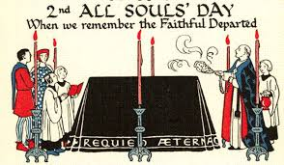
What can people do to celebrate All Souls Day?
The best way to celebrate All Souls and pray
for them is to participate in a special Mass for them.
You can visit the church and ask God to
bring the souls in purgatory to be with God in heaven.
Your family can make a list of people they can pray for
and tell stories about them and tell God all the ways they loved you.
bring the souls in purgatory to be with God in heaven.
and tell stories about them and tell God all the ways they loved you.
for them is to participate in a special Mass for them.
R-1
S-05A
Click on a sentence from the list at the bottom or click an empty text box to complete the sentences.
Notes:
Adapt Teaching and Learning Experience 3
Read each sentence and select the correct statement to complete it. Check it with the floater.

Slide 7
What can people do to celebrate All Souls Day?
Families can visit the graves of their relations and friends
and ask God to hear them when they say “I think I am ready for heaven”.
Make a list of the names of people in your family whānau and put them
in the All Souls box to be remembered at Mass all through November.
Remember to focus your class prayer on All Souls
in November as this is the special time the Church prays for them.
and ask God to hear them when they say “I think I am ready for heaven”.
in November as this is the special time the Church prays for them.
in the All Souls box to be remembered at Mass all through November.
R-1
S-05B
Click on a sentence from the list at the bottom or click an empty text box to complete the sentences.
Notes:
Read each sentence and select the correct statement to complete it. Check it with the floater.

Slide 8
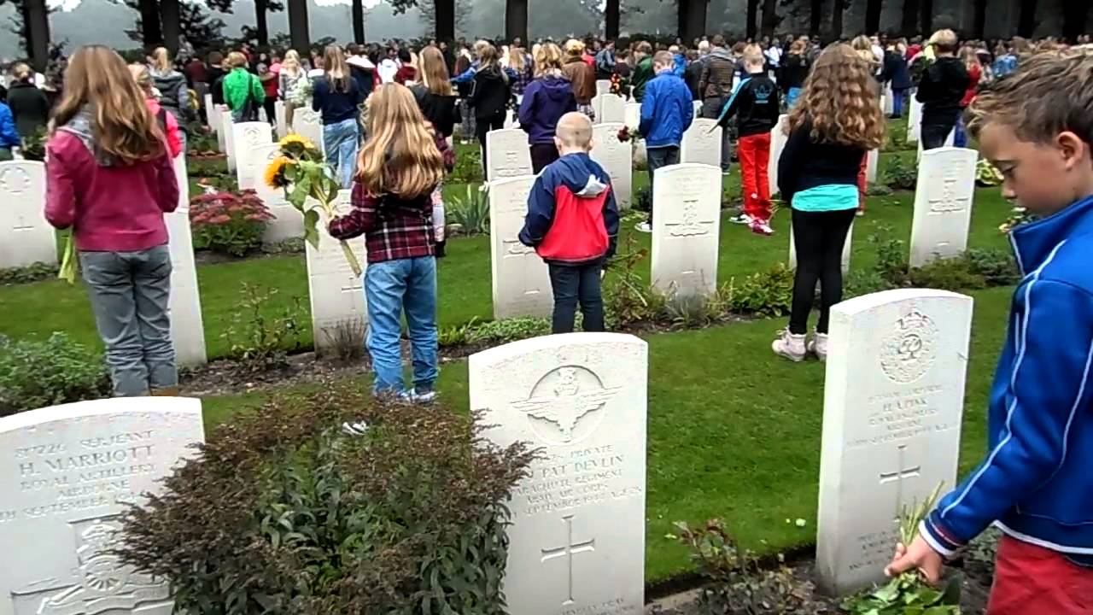
The Souls in Purgatory – who are they and why are they there?
We believe that all the Saints in heaven, all the souls in purgatory waiting to go to heaven and all the people on earth are part of God’s family that we call the Communion of Saints and God’s dream is that one day we will all be together with God in heaven forever.
All Souls Day helps us to be hopeful that one day we will be with God in heaven with all the saints and angels and people we have known and loved on earth. Catholics believe this will happen. We believe death is not the end but the beginning of our new life with God.
All Souls day is a good day to think about these things and how we are living our lives. Jesus showed us how to be kind, loving people who stand up for those in need and serve the people we live with. By doing this now we are preparing ourselves to enter heaven when we die.
We cannot help ourselves and we have to rely on the prayers of our loved ones on earth to help us to become more perfect and when that happens we can say “I am ready to go to God”. We don’t know where, when or how this happens because it is a mystery - but we do know it does happen.
People who die in God’s grace and friendship but are not perfect, need to undergo a purification or preparation before they enter the presence of God in heaven. This is what the Church calls purgatory. We don’t know how this happens but we do know that during it we have a very great longing to be with God.
When most of us die we are not perfect saints or terrible sinners. We believe in God but in our lives there have been times when we have failed to live as God wants us to in the loving ways that Jesus showed us.
To get to heaven we need to live our lives as Jesus showed us - that is with goodness and kindness towards all people. To be with God we must be full of God’s love and grace with no trace of sin or meanness.
R-1
S-06
Click top card to discard it.
Notes:
Look at the image and comment on what is happening.
Read through the flip cards and think about what the text is about. Invite children someone to say what it is saying and encourage questions.
Give children time to wonder about what it would be like for someone to say to God after they die “I am ready to come to you in heaven now”.
What might God say in reply?

Slide 9
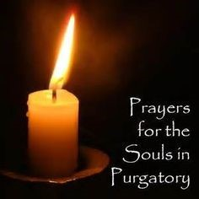
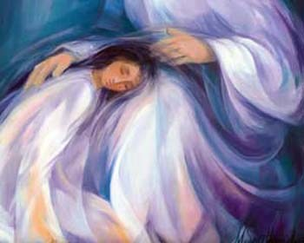
Purgatory - FAQ Frequently Asked Questions
What is Purgatory like?
We don’t really know what purgatory is like except that we really want to be with God and waiting for this to happen is very hard. Purgatory is not like heaven because God is in heaven and God is love so everyone in heaven is completely full of love.
Is purgatory like hell?
No, purgatory is not like hell. People in purgatory will be with God – they just need time to get ready to get there. They long to be with God very much and that is why they depend on people on earth to help them through prayer and good deeds. People in hell have separated themselves from God.
Where is purgatory?
Purgatory is not a place it is more a way of being. In purgatory we become aware that we are not ready to meet God because in our lives on earth we have had times of being selfish and unloving. This is why we must be separated from God until we have made up for this.
R-1
S-07A
Click an image on the left to reveal text.
Notes:
Read the FAQs and talk about their answers. Children add any further questions of their own.
Encourage children to accept that there are mysteries in our faith (and purgatory is one of them) that are beyond our understanding at present but will become clear after our lives have ended.

Slide 10
Purgatory - FAQ Frequently Asked Questions
How long does purgatory last?
After we die time is not like we know it on earth. Because we don’t really know what purgatory is like we don’t know how long it lasts. It may only be for a short time. How long we are in purgatory depends on how we have lived our lives on earth.
Is purgatory a good thing?
Purgatory is a good thing because it gives people time to prepare to meet God face to face. It is like here on earth people do not like going somewhere special without being ready for it. It is God’s way of giving us another chance to get ready to go into the presence of God. Just as we are longing to be with God, God is longing for us to come to heaven.
R-1
S-07B
Click an image on the left to reveal text.
Notes:
Encourage children to accept that there are mysteries in our faith (and purgatory is one of them) that are beyond our understanding at present but will become clear after our lives have ended.

Slide 11
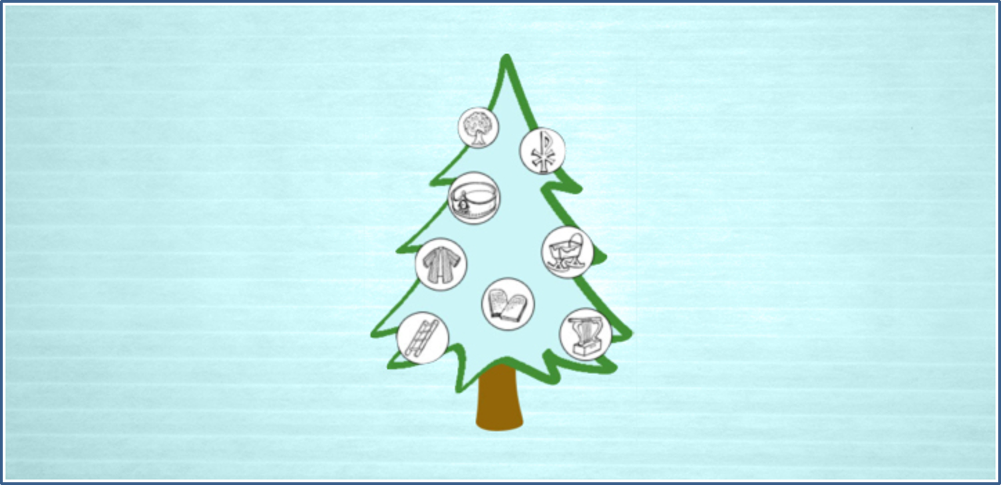
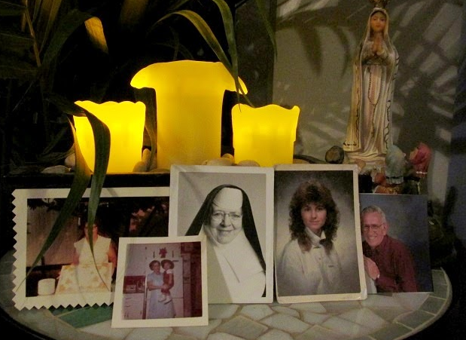
How do people on earth connect with the Souls in Purgatory
All Souls Day is the feast day the Church on earth remembers people in the Church who are in purgatory and who need prayer to help them get to heaven.
The bonds of friendship and love that are created through baptism are not broken when people die and this is why people on earth continue to pray for those who have died.
When we prepare for the Sacrament of Penance we learn that when we do something wrong we must say sorry, ask for forgiveness and do something to make up for it. When people die there will be things that they have not made up for or put right and this will happen while they are in purgatory.
R-1
S-08A
Click the down-button to move the blind down, click the up-button (appears at bottom) to move the blind to the top.
Notes:
Encourage children to talk about people in their family whānau and friends who have died and share stories about them and how they lived their lives. Pray for them that they are in heaven with God and all the saints.

Slide 12
How do people on earth connect with the Souls in Purgatory
When people die those who have loved them on earth, their family whānau, their friends and people in their parish pray that they will rest in peace. They pray especially for them at their funeral and they make a little prayer space at home to remind them to pray for them - see the example in the picture.
It is through the prayer of those who pray for the dead that the sin or hurt they have caused is made up for and this brings them closer to entering heaven to be with God.
R-1
S-08B
Click the down-button to move the blind down, click the up-button (appears at bottom) to move the blind to the top.
Notes:
Suggest children make their own prayer focus at home with photographs and things that help them remember people they have known and loved.

Slide 13
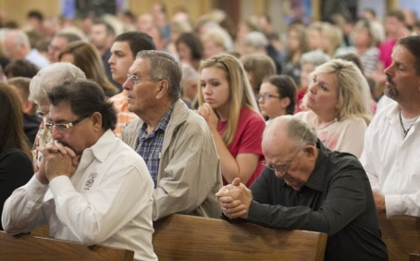
Praying for the Souls in Purgatory
During November, the month of the Holy Souls, people visit the graves of those who have died and pray for them. Sometimes they take flowers to place on the graves as a sign of remembrance and love.
Family members often visit a loved one’s grave on the anniversary of their death to pray for their soul to rest in peace. People often pray at a cemetery for a special person and also for the souls of all the people who are buried in the cemetery and that helps everyone to draw closer to God in heaven.
Many people go to mass on All Souls day as they believe that this could be the day God brings people in their family and parish to be with God in heaven. They pray a special prayer asking God to give them eternal rest.
R-1
S-09A
Click an image to reveal text.
Notes:
Read each text reveal and after each one invite children to share something that children of their age could do to encourage their family whānau to remember and pray for people who are part of it who have died.

Slide 14
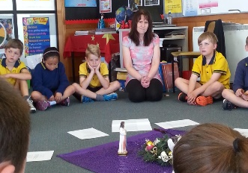
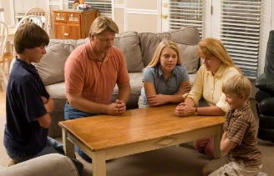
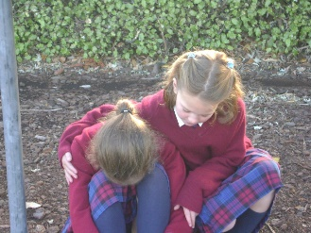
Praying for the Souls in Purgatory
Children use their class prayer time during November to pray for the souls of people in their family whānau and their parish community. God hears their prayers and welcomes more people into their eternal home with God.
In November family whānau pray at home for their parents and grandparents, aunts and uncles who have died. Children of your age could create a prayer space with photographs of family members that your family could gather around to pray in the hope that through their prayer those they have loved will be with God.
Families make visits to the church to light a candle and pray for the souls of people they have loved on earth.
Doing good works and showing kindness is a prayer in action which is a special way to remember and pray for the Holy Souls.
R-1
S-09B
Click an image to reveal text.
Notes:
Read each text reveal and after each one invite children to share something children of their age could do to encourage their family whānau to remember and pray for people who are part of it who have died.

Slide 15
Catholic Prayer for those who have died
Pray the prayer each day with your family and your class and memorise it
Make a Wall of Prayerful Remembrance for the Souls of those we have known and loved.
Make a list of family names to add to the Wall of Prayerful Remembrance and add it to the wall.
R-1
S-10
Notes:
Pray the Prayer for those who have died.
Pray the prayer each day with your family and your class and memorise it
Make a Wall of Prayerful Remembrance for the Souls of those we have known and loved.
Make a list of family names to add to the Wall of Prayerful Remembrance and add it to the wall.

Slide 16
Check Up
1)
What is the purpose of All Souls Day? (Slide 5A and Slide 5B)
2)
Name 3 things you have learned about purgatory. (Slides 6, 7A and 7B)
3)
How does the Church on earth help the souls in purgatory?(Slides 8A, 8B, 9A and 9B)
R-1
S-11A
Notes:
This formative assessment strategy will help teachers to identify how well children have achieved the Learning Intentions of the resource.
Teachers can choose how they use the slide in their range of assessment options.
A worksheet of this slide is available for children in Years 5-8 to complete.
The last two items are feed forward for the teacher.
Recording the children’s responses to these items is recommended as it will enable teachers to adjust their learning strategies for future resources and target the areas that need further attention.

Slide 17
Check Up
4)
What has this resource taught you about the importance of living with kindness, saying sorry, asking forgiveness and making up for hurt you have caused? (Slide 6)
5)
Which activity do you think helped you to learn best in this resource?
6)
Questions I would like to ask about the topics in this resource are …
R-1
S-11B
Click the worksheet button to go to the worksheet

Slide 18
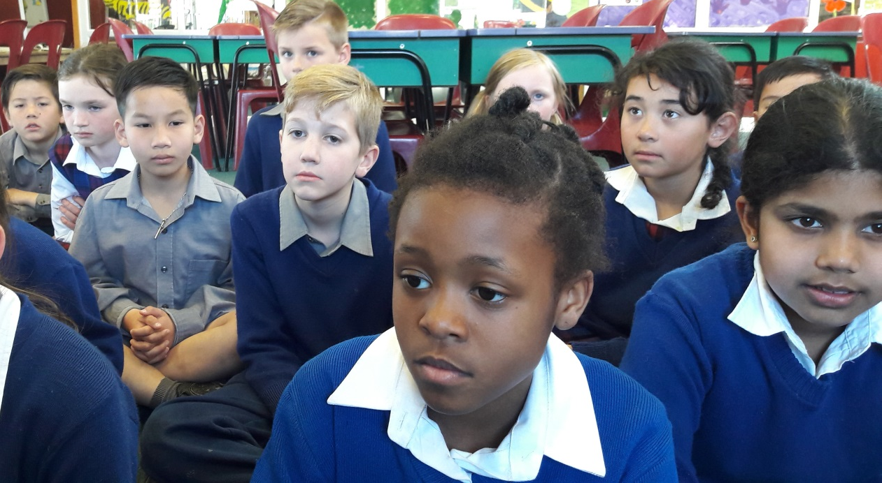
Time for Reflection
R-1
S-12
Click the audio button to stop reflective music
Click the audio button to play reflective music
Notes:
The MP3 is played to help create a reflective atmosphere and bring the children to stillness and silence as the teacher invites them to reflect on their life and how well they say sorry and make up for the hurt they have caused. Think about people they have known and loved who have died and what they can do in November to help them come into the glorious presence of God in heaven for ever.

Slide 19
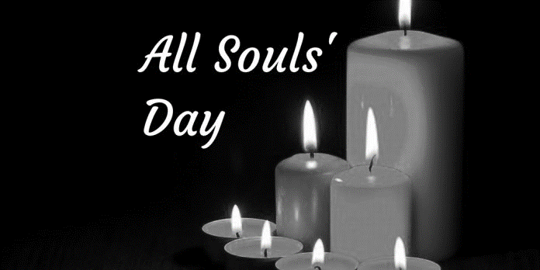
Check Up
Name:____________________________
Date:____________
1) What is the purpose of All Souls Day? (Slide 5A and Slide 5B)
2) Name 3 things you have learned about purgatory. (Slides 6, 7A and 7B)
3) How does the Church on earth help the souls in purgatory?(Slides 8A, 8B, 9A and 9B)
4) What has this resource taught you about the importance of living with kindness, saying sorry, asking forgiveness and making up for hurt you have caused? (Slide 6)
5) Which activity do you think helped you to learn best in this resource?
6) Questions I would like to ask about the topics in this resource are …
R-1
S-11
Worksheet
Click the up arrow to return to the presentation
Notes:
This worksheet relates to slide 11.

